Slide 1
Family-Centered and Child-Centered Care Age 3-9
Kris English, PhD Professor Emeritus, Audiology, The University of Akron

Slide 2
Homework
Compare mum’s report to core principles of family-centered care
Information sharing
Respect for diversity and cultural beliefs
Partnership and collaboration
Negotiation
Care in context of family and community
Your take-aways?
Notes:
https://idainstitute.com/tools/university_course/videos_and_handouts/module_4/unit_3/
Sample discussion points:
Information sharing
Informed by letter regarding CMV diagnosis
Information usually very helpful but processes could be better (see 14:47)
Respect for diversity and cultural beliefs
Pressure not to sign even though it felt right for family (see 15:00)
Partnership and collaboration
Could “7-8 appointments in one week” have been managed more efficiently?
“Sometimes it doesn’t feel like the child is yours, someone telling you what to do all the time”
“Don’t make parents feel guilty when they are managing so many things”
Negotiation
“We need to get referred for an implant… Just tell them, ’sort it out’ and they won’t do it. If I didn’t fight for him, there’d be no way he’d get implanted”
“It shouldn’t be that hard, it’s not fair”
Care in context of family and community
“Trying to find the time when you’ve got two kids”
“Offer for a counseling appointment would have made a world of difference”
“Just enjoy your child”

Slide 3
Learning objectives
At the end of this unit, learners will be able to:
1
Name two child-based rights as recognized by United Nations
2
Define and give an example of Theory of Mind, narrative play, and self-determination
3
Demonstrate the use of the My World tool

Slide 4
Today’s topics
Part 1:
Child Rights per United Nations
Child Development
Theory of Mind
Narrative Play
Self-Determination
Part 2:
Tools Supporting FCC+CCC

Slide 5
01.
Child Rights per United Nations and
Child Development

Slide 6
Part 1a: Child rights
Emerging literature on child-centered care identifies its starting point: United Nations Convention on the Rights of the Child (1989)
Notes:
The emerging literature on child-centered care identifies its starting point with the 1989 United Nations Convention on the Rights of the Child, which describes 4 core principles:
non-discrimination
the best interests of the child (social protections, health care, education)
the right to life, survival, and development
respect for and consideration of the views of children

Slide 7
Child-friendly version
Available at www.unicef.org/media/56661/file
Notes:
Go to: www.unicef.org/media/56661/file. The document recognizes children’s right to freely express their views in all matters affecting them and insists that these views be given due weight in accordance with the age and maturity of the children voicing them (Article 12).
It further proclaims children’s right to freedom of all forms of expression (Article 13).
Articles 12 and 13 are specifically cited by proponents of “child-centeredness in health care,” which requires entities to ‘assure to the child who is capable of forming his or her own views the right to express those views freely in all matters affecting the child, the views of the child being given due weight in accordance with the age and maturity of the child’.
Note, this model does not suggest giving children free reign to be tyrants or monsters! Rather, it’s an effort to support children’s development in healthy, productive ways.
More about Articles 12 and 13 = next slide

Slide 8
Child-friendly version
Specifically cited by proponents of child-centeredness in health care
Requires entities to ‘assure to the child who is capable of forming his or her own views the right to express those views freely in all matters affecting the child, the views of the child being given due weight in accordance with the age and maturity of the child’
Notes:
Recall from Unit 1: underlying this set of rights, as applied to healthcare, are these principles (James et al., 1998):
The child is seen as an active agent and a reliable reporter of his/her life
The child is to be an active participant in the healthcare partnership
Care will consider the whole child, as well as entire family
Care includes a smooth transition into adult services

Slide 9
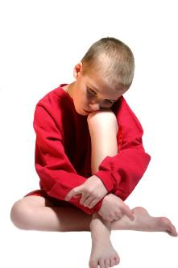
Opportunities to increase competence
By school age, children have emerging capacity for logical thought, understanding others’ perspectives (Theory of Mind)
Children want to develop competence and participate in decision-making (Theory of Self-Determination)
When children’s preferences for inclusion are not met or impeded, they feel powerless and depersonalized (Coyne et al., 2018)

Slide 10
Part 1b: Child development
Theory of Mind
Narrative play
Self-determination
Notes:
In this next section, we will look at 3 aspects of child development that serve as the theoretical foundation of the Ida Tools:
Theory of Mind
Narrative play
Self-determination

Slide 11
What is Theory of Mind (ToM)?
Defined: Ability to attribute mental states to other people and to thereby interpret, explain, and predict their behavior
Dimensions:
Cognitive: thinking about thoughts, knowledge, beliefs, intentions
Affective: thinking about, experiencing emotions
Interpersonal: thinking about other peoples’ thoughts, emotions
Intrapersonal: thinking about one’s own thoughts, emotions

Slide 12
A developmental process: example
(Smith & Wolfe, 2019)
Show child band-aid box, ask ”What do you think is inside?
Likely response: “band-aids”
Open box and show child: actually, a piece of candy! Close box, bring out a little doll
“This little doll has never seen inside this band-aid box. What do you think the doll thinks is in the box?”
Notes:
Show the child a band-aid box and ask what he or she thinks is inside the box. He or she will likely respond “band-aids.”
Open the box and show the child that there is actually a piece of candy and say, “Let's see… it's really candy inside,” then close the box.
Now, you bring out a little doll, which has been hidden up until that point, and say, “This little doll has never seen inside this band-aid box. What do you think the doll thinks is in the box? Band-aids or candy?”

Slide 13
Answer: Depends on age (4-5 years old)
Not yet developed Theory of Mind:
Response: the doll thinks there is candy in box
Mistakenly assumes doll holds same belief/knowledge that he or she does
Has developed Theory of Mind:
Response: the doll thinks band-aids are in box
Understands doll will believe “the obvious” because it did not see/does not know what’s really in the box
Notes:
A child who has not yet developed ToM will likely respond that the doll thinks there is candy in the box, mistakenly assuming that it knows what the child knows.
A child who has developed ToM will reply that the doll will think band-aids are in the box. The child knows that the doll does not know about the candy.

Slide 14
How to promote ToM:
Use ”tuning in” language (aka joint attention)
Talk about what child is doing, looking at, interested in, experiencing
Highlight visual and auditory perception of emotions: Examples?
Support ToM vocabulary
Mental states: I wonder, remember, forgot, wish, want, need, can imagine…
Emotional states: I feel frustrated, delighted, relaxed, overwhelmed, disappointed, excited…
Notes:
Practicing ToM
Instructor note: Ask students to imagine they are 6 years old and ask them “What is this little boy feeling and/or thinking right now? How do we know? What are the clues?”
Stepping out of role: in addition to “6-year-old words,” what additional descriptors could we add to expand ToM vocabulary?

Slide 15
What is narrative?
Children’s experiences are organized in narrative form in their memory
A necessary step towards formal thinking (concepts), comprehending life
A psychological tool formalizing, unifying human thought, knowledge into themes
Children’s first narratives: routines carried out together with caregivers
Small children are interested in human interaction and activity, temporal sequences, unexpected turns of events (surprises)
Adults co-construct early narratives with children
Routine events familiarize children with basic structures of events: beginning, middle, end
It’s time for a bath, then teeth-brushing, pajamas, into bed, story time, then lights out
(Hakkarainen et al., 2013)

Slide 16
What is narrative play?
Collaborative “talk about playing”
Using toys to represent activity, ideas, characters
Child takes lead; adult maintains joint attention, uses observational language to elicit child’s thoughts and feelings
Notes:
Instructor note: ask students “If you were this child, what narrative would you be sharing with the parent?” Ask one student to get started, then after a couple statements stop him/her and ask another student to advance the story further for a couple sentences, etc.

Slide 17
Role of professionals:
Adopt
Adopt a ‘not knowing’ but curious stance
Make
Make no presumptions of how conversation is going to evolve
Remain
Remain open about where the child takes the conversation
Strive
Strive to understand difficulties from the child’s perspective
Notes:
Instructor note: question for students - any experiences as a ”listener” to a child’s narrative?
Also: what challenges might a professional contend with while “only listening”?
(Might feel compelled to “teach” along the way or ask questions that pull the child out of their storytelling mindset, etc.?)

Slide 18
Narrative play and supporting change
Child can try out familiar/unfamiliar worlds in a safe environment
Knowing that he or she is only pretending
Consequences of the real world do not apply
Allows child to externalize a problem, consider alternative options, endings, and solutions, without risk
In this space the child can create stories that are radically new or different
Child can practice new coping strategies, etc.

Slide 19
Narrative play: Another developmental process
(Stadler & Ward, 2005)
Labeling
Listing
Connecting
Sequencing
Narrating: Includes all components as well as developed plots with evidence of planning to reach goals. Listener can predict end from the beginning of story
Personal experiences of child narratives?
Notes:
LABELING: Storytelling at this stage is characterized by lots of labeling, with repetitive syntax and a mixture of unrelated and assorted thoughts: “That’s a dog. That’s not my dog, that’s my dog. That’s mummy, and that’s daddy.”
LISTING: Labels plus verbs and conjunctions to connect items. However, events and actions are presented like a list, with no evidence of temporal or cause and effect relationships: ”And here’s the park. And the boy’s playing football. And there’s a dog. And that one, he’s doing that, he’s falling over. And there’s a car.”
CONNECTING: Narratives include a central topic, where actions are linked to characters and events. Pronouns are used, for instance the boy and girl become “they” in the next sentence. Temporal sequences are still missing, so events could be listed in any order without changing the meaning: “I have my own bedroom in my house. And I don’t have a TV in my room, but I would like one. And my friends came to play. We played in the garden.”
SEQUENCING: Child will use correct temporal sequences, cause and effect. Stories will talk about the “when” and “why” of the plot, so will tend to contain more advanced language: “When I was little, I ran away from my dad. And he shouted “ stop”, but I couldn’t hear him because I didn’t have magic ears then. So I fell over and knocked my tooth out and now I want a new tooth.”
NARRATING: Includes all the components above as well as developed plots with evidence of planning to reach goals. The listener can now predict the end from the beginning of the story.

Slide 20
Active listening during narrative play
Active listening means…?
Notes:
Prompts:
Build trust in the child before introducing tool
Listen carefully
Verify what the child expressed
Use open-ended questions*
Avoid leading questions
Summarize what you heard
Be aware of possible anxiety
Be sincerely curious
Ask "what would you do if...?“
Roleplay solutions and strategies that are discussed with the child
Ensure that the child has heard your message, question correctly and understands what to do
Convey that there are no right or wrong answers
Give child sufficient time to respond

Slide 21
Mind the question gap! Difference in outcomes?
Where do you sit in the classroom?
Where are the windows? And the teacher’s computer screen and whiteboard?
Where does the teacher usually sit or stand?
Can you hear and understand what your teacher is saying?
What do you do if you cannot hear the teacher?
Tell me more about your day
How do you talk to your friends?
Your classroom looks busy, tell me about how you can hear your teacher
Tell me about play time
Notes:
What’s the difference between close and open questions? What happens to the conversation when closed questions are asked? Is it hard to use open-ended questions?

Slide 22
What is self-determination?
Ability for individuals to live their lives as they choose, consistent with their own values, preferences, and abilities
Attitudes and abilities that lead people to set goals for themselves, and to take the initiative to reach these goals
Making one’s own choices, learning to effectively solve problems, and taking control and responsibility for one's life
Accepting the consequences of making choices
Examples?
Notes:
See: http://www.pacer.org/transition/learning-center/independent-community-living/self-determination.asp
Prompts:
Understanding one’s values, preferences, and abilities; be able to name and describe them, for example:
“I would rather join a soccer team than learn gymnastics because…”
Career choices: “I saw a scientist on TV, she studies how porpoises migrate, she basically lives on a boat. I could see myself doing that kind of work.”
Ethical choices: “Kids at school brag about shoplifting…“
Personal choices: Amplification: yes or no? Pros and cons? Consequence either way?
Attitudes and abilities, for example:
Self-awareness, willingness to try something new, learn from missteps, accepting personal responsibility
Note: Self-determination will be further discussed in upcoming units

Slide 23
Components of self-determination
Self-awareness / self-knowledge
Choice / decision-making
Problem-solving
Self-regulation / self-management
Self-advocacy
Notes:
Ask students:
Any concerns about children with hearing loss developing these skills?
Familiar with concept of “learned helplessness”?

Slide 24
Impact of self-determination
Research indicates that it is possible to teach SD skills (Luckner & Sebald, 2013)
SD correlates with higher academic performance
Positive transition outcomes, incl. higher levels of employment and independence
Increased community participation
Success in postsecondary education
Increased quality of life

Slide 25
Self-determination and children with disabilities
Disabilities tend to limit the degree to which children become more self-determined
Goal: support students’ growth in self-determination
Hearing impaired children may demonstrate a learned helplessness - give up without trying:
Due to previous failure
Used to adults providing help
No opportunities to make choices and decisions for themselves
Promote active involvement in:
Problem solving, decision making
Self-advocacy, self-awareness
Student directed (active) learning
Notes:
More on this topic in upcoming units.

Slide 26
02.
Tools Supporting FCC and CCC

Slide 27
Part 2: Tools supporting ToM, self-determination, and narrative play
Patient Who is it for? | 0-3 years | 3-6 years | 6-9 years | 9-12 years | 12-18 years | 18+ years
Professionals (in clinic) | My Hearing Explained for Children | My World My Hearing Explained for Children | My World My Hearing Explained For Children | Living Well for Tweens My Hearing Explained for Children | Living Well for Teens My Hearing Explained for Children | My Hearing Explained
Child / Young Person (self-administered) |  | Growing up with Hearing Loss age 3-6 | Growing up with Hearing Loss age 6-9 | Growing up with Hearing Loss age 9-12 Ida Telecare for Teens and Tweens | Growing up with Hearing Loss 12-18 Ida Telecare for Teens and Tweens | Transitions Management age 18+ Ida Telecare for Teens and Tweens
Parents (self-administered) | Growing up with Hearing Loss age 0-3 | My Turn to Talk for Parents Growing up with Hearing Loss age 3-6 | My Turn to Talk for Parents Growing up with Hearing Loss age 6-9 | My Turn to Talk for Parents Growing up with Hearing Loss age 9-12 | My Turn to Talk for Parents Growing up with Hearing Loss age 12-18+
Notes:
Recall this table. Today we will focus on My World.

Slide 28
Today: My World (ages 4-9)
What’s in the box?
A board game structure
3 different environments
People playing pieces
Everyday object playing pieces
Notes:
My World was developed to help clinicians understand the child’s perspective of their hearing loss. My World gives children with hearing loss a voice, and the opportunity to become an active partner in their hearing care, alongside the professionals that support them.
At first glance, the tool has the look of a board game. It consists of three different environments: a classroom, a home, and an outdoor area. The child uses the cardboard figures and everyday objects in the various environments to explore and describe the successes and challenges they face in everyday life.
Possible benefits: Hear the voice of the child as they openly express their thoughts and feelings
Gain a shared understanding, using genuine curiosity about the child’s:
Use of technology in a range of environments
Communication strategies, skills, and needs
Listening skills and challenges
Problem solving solutions
In the spirit of supporting the development of “child as person,” narratives do not have to be related to hearing, but rather whatever the child wants to talk about.

Slide 29
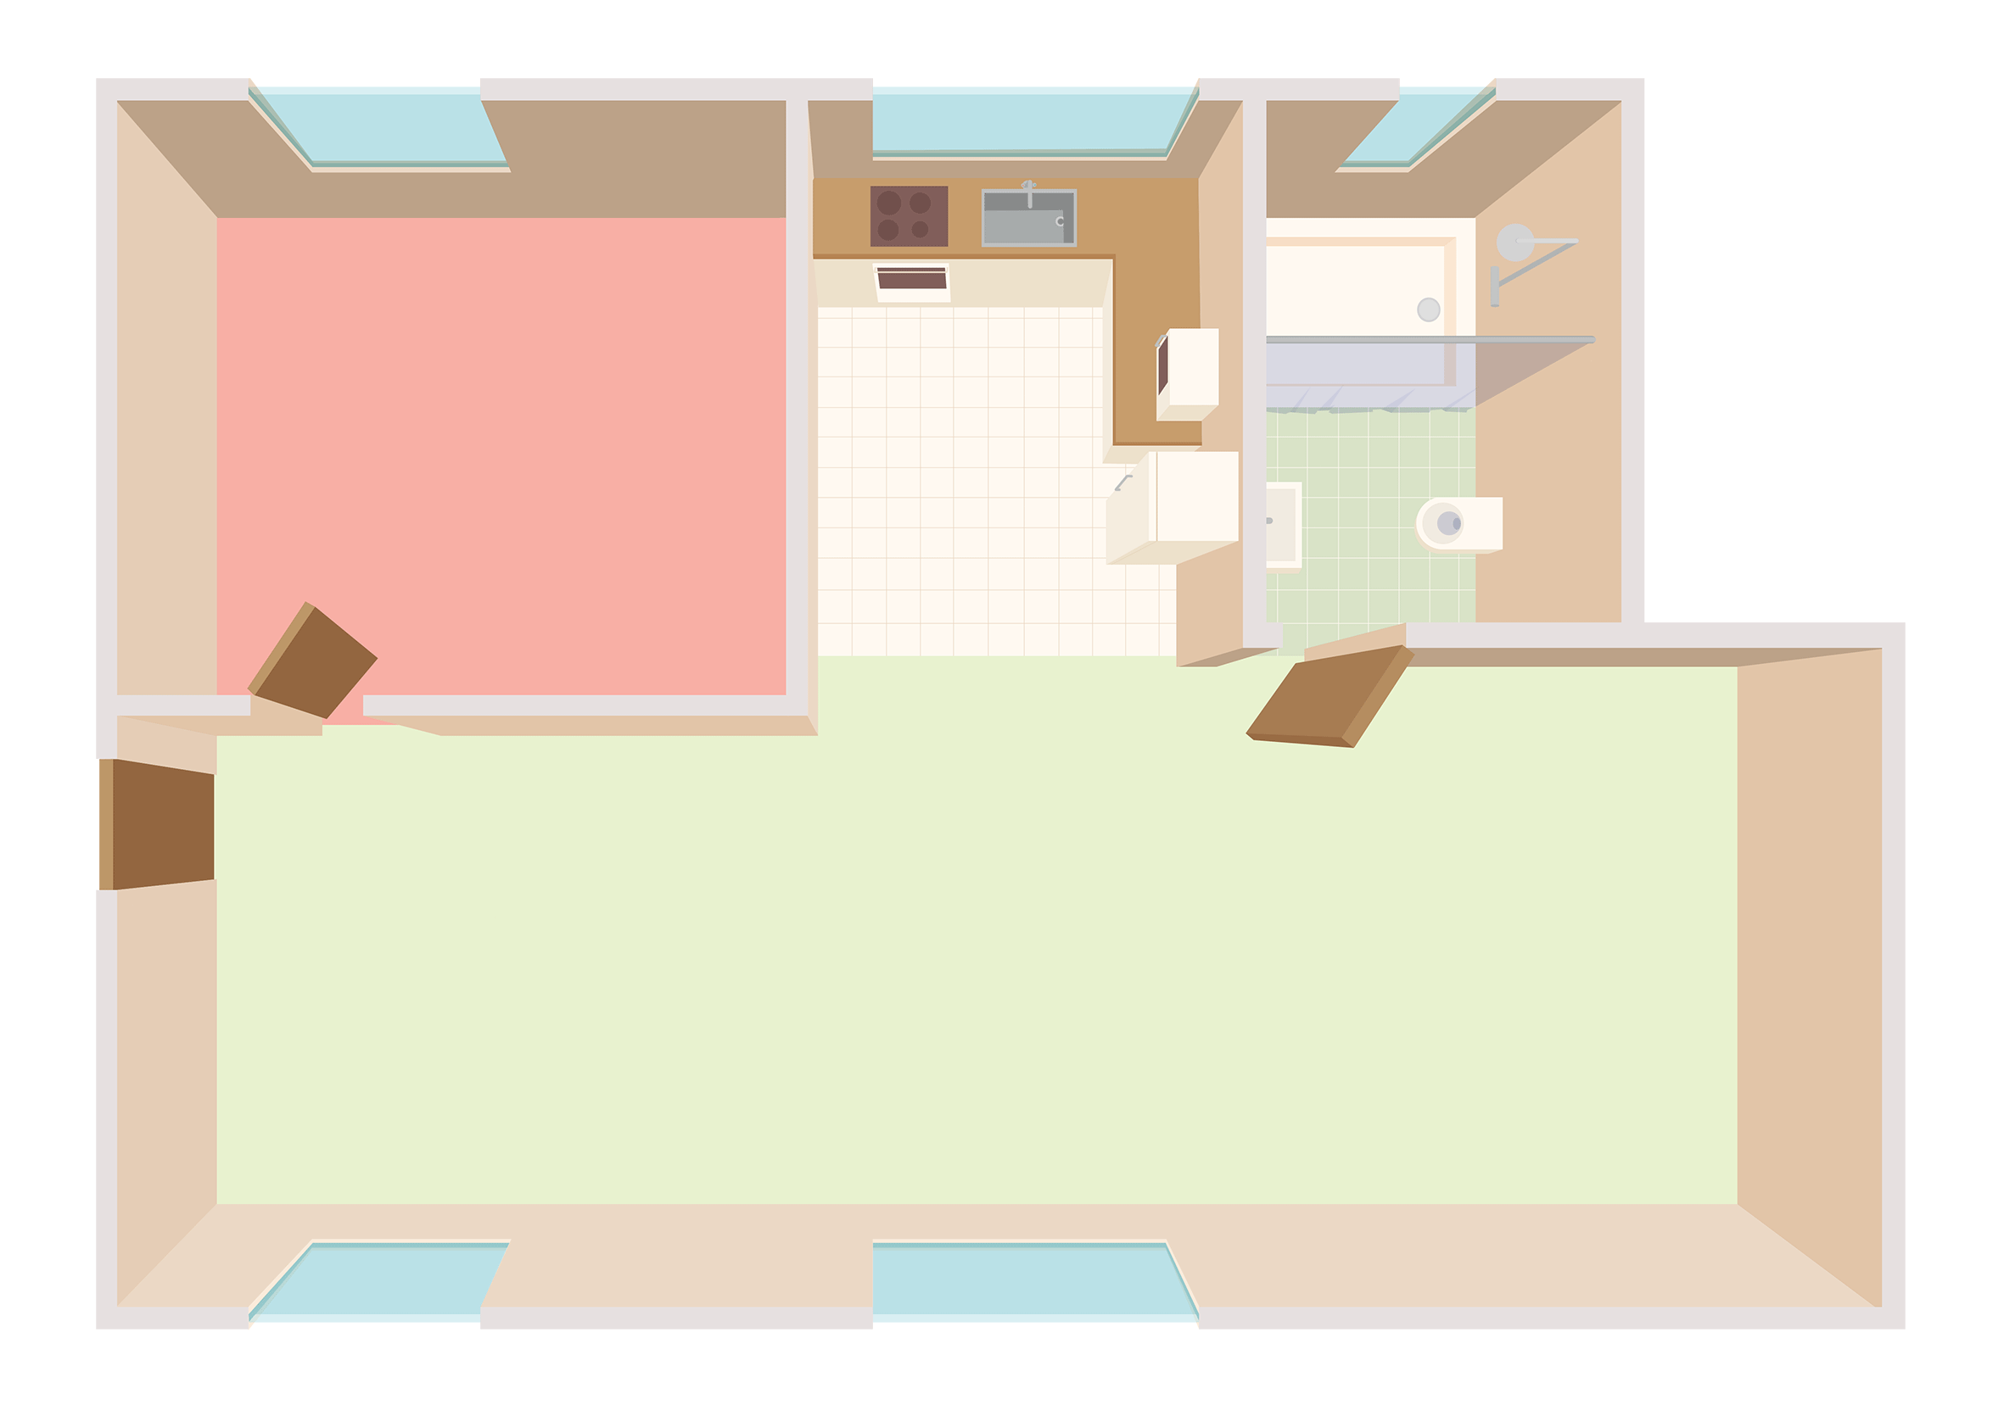
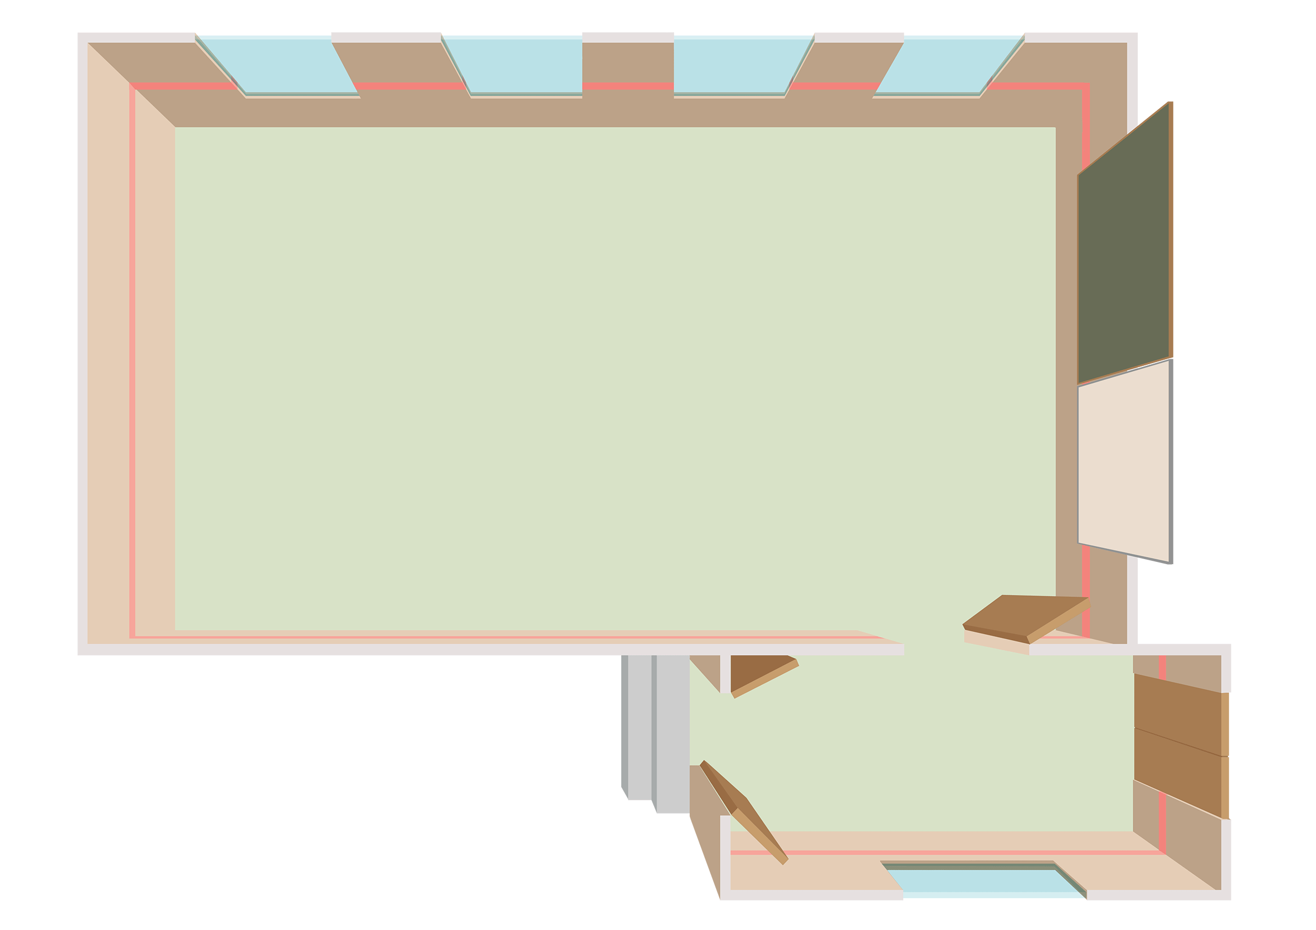
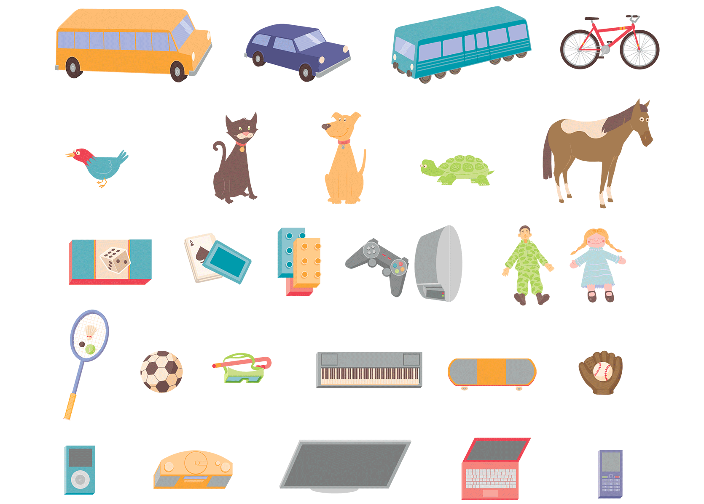
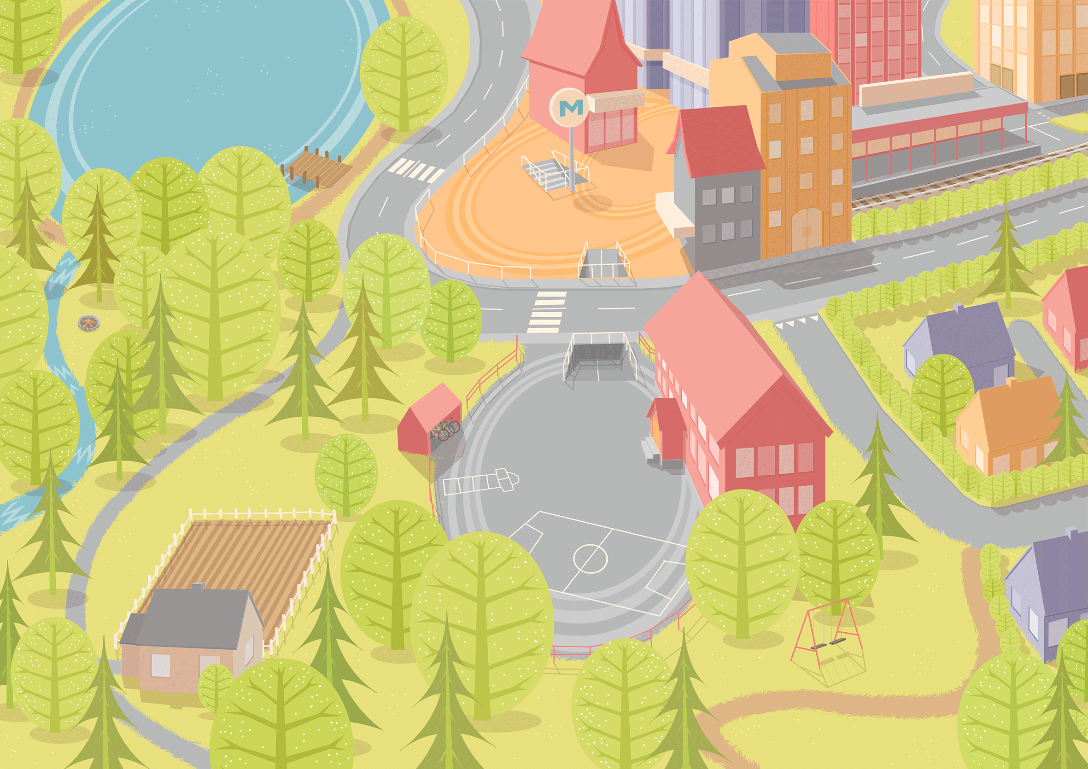
Select an environment with the child and ask them to make it their own by using characters, furniture, etc.
Notes:
As you open the box you will find 3 boards, printed on both sides representing the child’s:
Indoor classroom environment
Indoor home environment
Outdoor environment with urban scene containing a playground, school building, road networks, as well as a rural scene
You will also find cardboard cut-outs of:
Children and adults, young and old of different cultures and races
Everyday objects to populate the boards and facilitate discussions
Hearing technologies
Faces/emojis to portray different emotional states
Important: Although My World at first glance might look like a board game, it is not. It does not have any set rules, prescriptive steps to follow, or winners or losers.

Slide 30
With child, identify primary communication partners in environment
Ask child to describe challenging or successful communication situations
Notes:
Lots of different characters, old and young, different races and cultures
Getting started: Choosing the environment and being curious
With child, choose an environment and then identify primary communication partners.
The professional then asks the child to “make it their own” by selecting items that are meaningful to them in that environment. This is a child-led activity so be aware of the questions you ask and how you phrase them to allow the child’s ideas to flow. This should not simply be a question and answer session. Be conscious that the child may think that you have a set agenda and that there is a right and wrong answer. Make sure you acknowledge and respond positively to all responses as they set the scene.
(For examples, watch videos in the “Tool in Action” section on the My World page: idainstitute.com/toolbox/my_world/the_tool_in_action).
Some practical tips for getting started on this phase:
Once you have chosen the environment, put the other scenes to one side
Be selective about the characters and objects you are using, balancing keeping the ideas flowing, whilst reducing unnecessary distractions
Be aware how you handle the cut-out objects. Holding them all to one side in your hand may promote a feeling of you being in control of the whole activity and in turn the conversation

Slide 31
To use My World, children must…
Have language skills
Be comfortable and confident with the partner
Be able to understand abstract picture materials
Be comfortable with the situation
Notes:
A child needs some language - not necessarily age appropriate - but some language

Slide 32
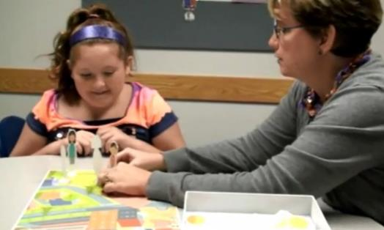
Activity #2: Ashlynn and Eileen
Look for:
opportunities to engage child
support ToM development
narrative play skills
self-determination skills
Notes:
Go to: https://idainstitute.com/tools/university_course/videos_and_handouts/module_4/unit_3/ and watch Ashlynn and Eileen video (5:40 min). Take notes for subsequent discussion.

Slide 33
Report
Examples
opportunities to engage child
support ToM development
narrative play skills
self-determination skills
Notes:
Possible observations:
Opportunities to engage child
Invitation to decide on avatars and environment (trampoline)
Support ToM development
Does Sophia ever have something important to tell you?
What if sister Kayla was sad, what would help her?
Narrative play skills
First plan (knock kids over) not OK, another choice: move away
Self-determination skills
Encouraging choice options, alternatives

Slide 34
Activity #3: My World in small groups: "Kathleen and Two Friends”
Form groups of 4
Assign roles: Kathleen (age 8), 2 friends, hearing care professional
Roleplay a session with My World
Explore one of Kathleen’s communication challenges (in the interest of time, focused topic rather than open-ended)
Audiologist: use open-ended questions, encourage group conversation, refrain from giving advice
10 minutes: Time’s up! What insights did small group format provide?
Notes:
Instructor note: This roleplay should take about 6-7 minutes, to give learners enough time to collect data for the follow-up questions, what insights did narrative play in small groups provide? Each group will need one environment, and a few figures and accessories.
Small groups allow for (sample responses):
Working as a team to problem solve
Hearing about thoughts, opinions and strategies that you would not necessarily have thought of yourself
Empathizing with others’ view and experiences
Being able to practice for situations that will occur in the real world
Being able to think about situations that are not in your direct world

Slide 35
My World: An evidence-based practice
(Allen et al., 2017)
Shown to:
Engage children easily
Help professionals ‘hear the child’s voice’ and understand individual issues, needs
Encourage the child to take the lead and develop self-determination
Facilitate discussion about abstract or “tricky” issues, other views, feelings and experiences
Support children in learning new skills in a safe environment
Compare to 5-level model of CCC
Irrespective of age, child is listened to
Child is supported in expressing his/her views
Child’s views are taken into account
Child is involved in decision-making process
Child can share power and responsibility in decision-making
(Söderbäch et al., 2011)
Notes:
How do the Allen et al. (2017) data relate to this 5-level model?

Slide 36
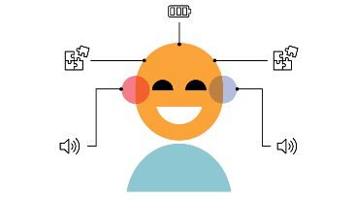
Next time: 3 other tools (aged 6-12)
My world
My Hearing Explained for Children

Slide 37
Homework
Read Smith & Wolfe (2019), “Supporting Theory of Mind Development”
https://journals.lww.com/thehearingjournal/Fulltext/2019/05000/Supporting_Theory_of_Mind_Development.4.aspx
Be prepared to describe concerns regarding ToM development among children with hearing loss and author recommendations

Slide 38
References
Allen, S. et al. (2017). An evaluation of professional’s use of the Ida Institute My World tool. The Ear Foundation.
Hakkarainen, P., et al. (2013). Adult play guidance and children's play development in a narrative play-world, European Early Childhood Education Research Journal, 21:2, 213-225.
James, A., Jenks, C., & Prout, A. (1998). Theorizing childhood. Cambridge: Polity Press.
Luckner & Sebald (2013). Promoting self-determination of students who are deaf or hard of hearing. American Annals of the Deaf, 158(3), 377–386.
Söderback, M., et al. (2011). The importance of including both a child perspective and the child’s perspective within health care settings to provide truly child-centred care. Journal of Child Health Care, 15(2), 99–106.
Smith & Wolfe, J. (2019). Supporting Theory of Mind development. https://journals.lww.com/thehearingjournal/Fulltext/2019/05000/Supporting_Theory_of_Mind_Development.4.aspx
Stadler, M., & Ward, G. (2005). Supporting the narrative development of young children. Early Childhood Education Journal, 33, 73-80. DOI: 10.1007/s10643-005-0024-4
United Nations/UNICEF. (1978). Convention on the Rights of the Child. Accessed 15 May, 2020: https://www.unicef.org/sowc2012/pdfs/SOWC-2012-The-Convention-on-the-Rights-of-the-Child.pdf

