Slide 1
Extending Person-Centered Care to Families and Children
Kris English, PhD
Professor Emeritus, Audiology, The University of Akron

Slide 2
Learning objectives
Define the concept of person-centered care (PCC) and list its core principles
Define the concept of family-centered care (FCC) and list its core principles
Describe the principles of child-centered care (CCC)
Describe how CCC complements or extends traditional FCC
Give an example of an FCC experience in pediatric hearing clinics, then expand the example to represent CCC
Notes:
Increasingly, different models of “centeredness” are being used to describe the focus of healthcare (Coyne et al., 2018). In this unit, we will consider the history, principles, and concerns of person-centered, family-centered, and child-centered care.
We will then consider answers to this overarching question, “What does it mean to be person-centered in pediatrics, and what is the role of the hearing care professional?”

Slide 3
Our big questions
What does it mean to be
person-centered in pediatrics?
and
What is the role of the
hearing care professional (HCP)?

Slide 4
01.
Models of care

Slide 5
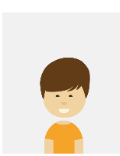
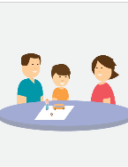
Part 1: Models of care
Person-centered
Patient-centered
Family-centered
Child-centered

Slide 6
Person-centered care (PCC) defined
There are many definitions of person-centered healthcare, which include many of the same core principles.
The Person-Centered Hearing Network defines person-centered care as follows:
Person-centered care (PCC) ensures that people are equal and active partners in the management of their hearing difficulties. Designed around the individual, PCC focuses on and is respectful of people’s needs and preferences, involves family and other communication partners, and includes shared decision-making and goal-setting.
Notes:
There are many definitions of person-centered healthcare, which include many of the same core principles. Person-centered care respects the client’s preferences and values, involves family and friends, reinforces shared decision-making and goal setting, and prioritizes the free-flow of information.
The Person-Centered Hearing Network (https://idainstitute.com/ida_community/our_partners/person_centered_hearing_network/) defines person-centered care as follows:
Person-centered care (PCC) ensures that people are equal and active partners in the management of their hearing difficulties. Designed around the individual, PCC focuses on and is respectful of people’s needs and preferences, involves family and other communication partners, and includes shared decision-making and goal-setting.

Slide 7
Person-centered care (PCC) defined
Holistic approach to delivering care
Is respectful and individualized
Allows for negotiation of care
Offers choice
Based on therapeutic relationship with healthcare provider
Persons are empowered to be involved in health decisions (Morgan & Yoder, 2012)
A “near synonym” with patient-centered care (Entwistle & Watts, 2013)
Notes:
Morgan and Yoder (2012) offer this definition for person-centered care: “A holistic approach to delivering care that is respectful and individualized, allowing negotiation of care, and offering choice through a therapeutic relationship where persons are empowered to be involved in health decisions at whatever level is desired by that individual who is receiving the care” (p. 8)
Question: What does a ”therapeutic relationship” look like? Some characteristics?
The terms “person-centered” and “patient-centered” are often considered to be “near synonyms” (Entwistle & Watts, 2013).

Slide 8
Patient-centered care (PCC) defined
Institute of Medicine’s (2001) medical perspective:
Respectful care, responsive to individual patient preferences, needs, values
Ensuring that patient values guide all clinical decisions
Both philosophies include:
Exploring patient’s main reason for visit, concerns, need for information
Seeking to understand patient’s world (social, emotional lives, other issues)
Finding common ground, mutual understanding of managing problem (Langberg et al., 2019)
Notes:
Because of its medical orientation, the Institute of Medicine (2001) provides a similar definition for patient-centered care, i.e., “respectful and responsive to individual patient preferences, needs, and values, and ensuring that patient values guide all clinical decisions” (p. 3).
Questions: How do clinicians find common ground with their patients? What is the impact of ”common-ground building” on the clinician-patient relationship?

Slide 9
Shared goals for both PCC models
To treat “patients as persons” who have
Dignity
Rights
Autonomy (i.e., the capacity to decide for oneself)
To enhance health
To enhance ongoing relationship between patient and health care provider
Notes:
Question: Does our choice of wording (person-centered versus patient-centered) matter? Why or why not?

Slide 10
Person/patient-centered care: Historical roots
Evolved from rejection of “medical paternalism”
Before 1950’s in Western medicine, clinician was sole decision-maker
“Doctor knows best”
Patients were expected to comply unquestioningly (Emanual & Emanual, 1992)
Patients began to actively reject this model of care
Formalized their rights in a wide range of position statements
Based on World Health Organization’s Universal Declaration of Human Rights (1948)
Notes:
Patient- or person-centeredness evolved from the rejection of medical paternalism. Before the 1950’s, Western medicine held the clinician to be the only decision-maker (“the doctor knows best”) and expected the patient to unquestioningly comply (Emanual & Emanual, 1992).
WHO link: https://www.un.org/en/universal-declaration-human-rights/

Slide 11
PCC: Core principles (person and patient)
Rights to confidentiality, full disclosure
Shared decision-making (”Nothing about me without me”)
Access to personal records
Non‐discrimination
Informed consent
The Ida Institute considers the following elements essential to deliver PCC in an audiology setting:
Empathy
Active listening
Open-ended questions and reflective conversations
Shared decision-making
Involving family and friends
Understanding needs and preferences
Important to
our consideration of the pediatric patient, the terms “person- and patient-centered care” typically refer to adults, not children
Notes:
PCC core principles
These rights reflect an equal exchange of views, sharing power for the common purpose of the patient’s best interest, and respect for patient autonomy.
Important to our consideration of the pediatric patient, the term “person-centered care” typically refers to adults, not children.

Slide 12
Family-centered care (FCC) defined
Ensures health care is planned for child around the whole family
All family members are recognized as care recipients and active members
Notes:
Family-centered care (FCC) is described as a way of caring for children and their families that ensures healthcare is planned around the whole family. In a family-centered approach, all family members are recognized as care recipients and active members.

Slide 13
FCC: Historical roots
Like PCC, FCC reflects reactions to practices of the times
One flashpoint: British Ministry of Health report (1959)
Described adverse impact of hospitalization on both children and parents
Parents were expected to defer to medical experts who
Restricted hospital visiting hours
Withheld permission to accompany their child during testing
Denied access to their child’s medical records
Report stressed importance of parental participation in child’s care for family’s overall emotional, physical well-being (Wells, 2011)
FCC movement achieved access to records, shared decision-making, open visiting hours, sibling visits
Notes:
British Ministry of Health report (Platt, 1959) described the adverse impact of hospitalization on both children and parents. Parents were expected to defer to medical experts who restricted hospital visiting hours, withheld permission to accompany their child during testing, and denied access to their child’s medical records (Wells, 2011).
The report stressed the importance of parental participation in their child’s care for their family’s overall emotional and physical well-being.
Family advocates successfully affected changes such as access to records, shared decision-making, open visiting hours and sibling visits, and later extended its philosophy into the development of early intervention in the education system.

Slide 14
FCC: Core principles (very similar to PCC)
Information sharing
Respect for diversity and cultural beliefs
Partnership and collaboration
Negotiation
Care in context of family and community (Carter et al., 2014; Shields, 2015)
Notes:
Very similar to person- or patient-centered care, family-centered care values information sharing, respect for diversity and cultural beliefs, partnership and collaboration, negotiation, and care in the context of family and community (Carter et al., 2014; Shields, 2015).

Slide 15
Note this oversight
HCPs do strive to collaborate with family unit
Implies the inclusion of the pediatric patient
In reality, FCC usually focuses only on parents/carers
Child-as-person is not actively recognized
Also does not take into account child development (Majamanda et al., 2015)
Growing capacity for independent decision-making
Right to privacy
Opportunity for active engagement
Notes:
Although routinely cited in mission statements, FCC is often misunderstood and unevenly executed (Kuo et al., 2012). Generally, healthcare providers working within the FCC model strive to collaborate with the family unit, which implies the inclusion of the pediatric patient, but in reality, usually focuses only on parents; the child-as-person is not actively recognized. It also does not take into account older children’s growing capacity for independent decision-making, right to privacy, and the opportunity for active engagement (Majamanda et al., 2015).

Slide 16
Attempts to actively include child:
Reframing FCC with name changes
Family- and child-centered care (FCCC) to indicate “both family and child are visible, forefront and equal in care” (Foster, 2015)
Patient- and family-centered care (PFCC) to emphasize importance of engaging family and patient in a “developmentally supportive manner” (American Academy of Pediatrics, 2012)
Neither proposal has gained large professional support
Notes:
Attempts to reframe FCC include name changes:
Family- and child-centered care (FCCC) to indicate both family and child are visible, forefront and equal in care (Foster, 2015)
Patient- and family-centered care (PFCC) intended to emphasize the importance of engaging family and patient in a developmentally supportive manner (American Academy of Pediatrics, 2012)

Slide 17
Child-centered care (CCC)
No consensus yet on definition (Söderbäck et al., 2011)
Over past decade, concept has gained support as alternative approach
Nurses and other providers of in-patient hospital care consider the term relatively new (Carter et al., 2014)
“Child-centeredness” in fact is standard practice for professionals who work one-on-one with children (e.g., SLPs, hearing therapists)
Family is certainly included in treatment plans, but the “center of care” is always the child
Notes:
Over the past decade, the concept of child-centered care (CCC) has been gaining support as an alternative approach, but the meanings of this concept are not fully described in current literature (Söderbäck et al., 2011). Although nurses and other providers of in-patient hospital care consider the term relatively new (Carter et al., 2014), “child-centeredness” is in fact standard practice for professionals who work one-on-one with children, such as speech-language pathologists and hearing therapists. Family is certainly included in treatment plans, but the “center of care” is always the child.

Slide 18
To be person-centered with children
Engage with children’s expertise about their own lives
Personal and social experiences of their care
Effects of relative lack of power in some settings
Explore children’s understandings, preferences in terms of their physical/health challenges, day-to-day experiences
Develop resources to engage with even the youngest children beyond conventional assessments (Curtis-Taylor, 2010)
Notes:
Healthcare providers who are “person-centered with children” (Curtis-Taylor, 2010), typically:
Engage, explore, develop resources, etc.

Slide 19
CCC: Core principles
Basis: 1989 United Nations Convention on the Rights of the Child
clearly states the right of every child to self-determination, dignity, respect, non-interference, the right to make informed decisions
As applied to healthcare:
The child is seen as an active agent and a reliable reporter of his/her life
The child is to be an active participant in the healthcare partnership
Care will consider the whole child, as well as entire family
Care includes a smooth transition into adult services
Notes:
The emerging literature on child-centered care identifies its starting point with the 1989 United Nations Convention on the Rights of the Child, which clearly states the right of every child to self-determination, dignity, respect, non-interference, and the right to make informed decisions.
Underlying this set of rights, as applied to healthcare, are these principles (James et al. 1998): child seen as agent, etc.
Question: What is “agency”?

Slide 20
A five-level model assurance
1
2
3
4
5
Irrespective of age, the child is listened to
The child is supported in expressing his/her views
The child’s views are taken into account
The child is involved in the decision-making process
The child can share power and responsibility in the decision-making
Notes:
A five-level model assurance (Söderbäch et al., 2011)

Slide 21
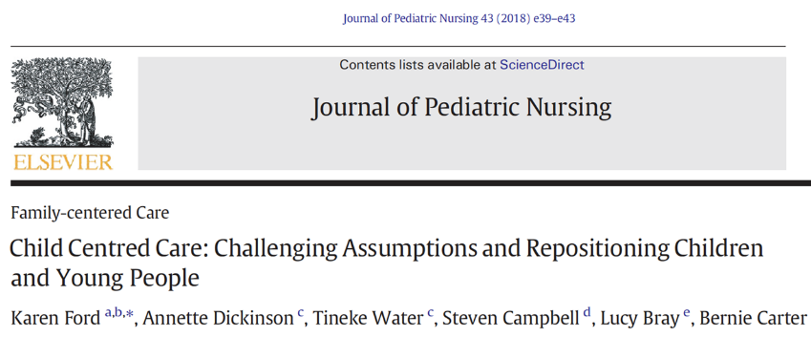
Pre-lecture reading assignment
Notes:
First: Thoughts on this article?
Will relate it to learning objective #5, per next slide

Slide 22
Application to learning objective #5
Review scenario presented in “Tensions Inherent in Practice” section
First, identify some of the tensions depicted
Thoughts on our own emotional reactions to child’s situation? How might the child be feeling?
Give an example of an FCC experience in pediatric hearing clinics
How might an audiology appointment parallel the “shot” scenario?
Expand the example to represent CCC
How do these approaches differ?

Slide 23
In summary
The only recognized active members in FCC model have been parents/carers and healthcare professionals
Child or young person is allocated to a more passive role
Child-centered care is seen as a “further evolution in children’s healthcare”
CCC firstly recognizes the child’s “person-ness”
Secondly recognizes his/her “family-ness”
Table on next slide compares strengths/challenges of models of care

Slide 24
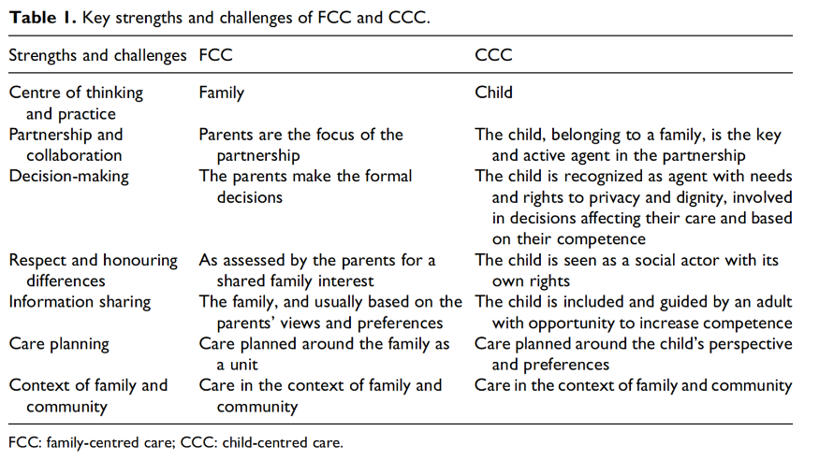
Key strengths and challenges in FCC and CCC
Notes:
Although not intentionally, FCC can result in the child or young person having a more passive role than their parent(s), even when their more active engagement could be possible. By school age, children have an emerging capacity for logical thought and understanding others’ perspectives. Developmentally, children want to develop competence and participate in decision-making; when children’s preferences for inclusion are not met or impeded, they feel powerless and depersonalized (Coyne et al., 2018). As indicated above, CCC does not exclude the family. It does, however, reposition the child from the sidelines to the “heart” of attention, and honors the child’s voice.
Carter et al. (2016) recognize the inherent tension between the two foci of care: “CCC can be considered a further development in the ongoing evolution of FCC or as an extension of the concept of FCC. … The difference is one of emphasis and reflects the extent to which children’s concerns are evidenced in the organization of care. However, neither approach can exclude the other because CCC must take into account the social context in which children live, and FCC must have the health of children as a central concern” (p. 25).

Slide 25
Applying “centeredness” to pediatric hearing care
Very often, “person-centeredness with children” is not a constant in pediatric hearing care appointments
Parents/carers typically accompany their children, ask and answer questions, make decisions regarding child’s care through teen years, with minimal child input
Without question, family-centered care is a highly appropriate model when infants and toddlers are not capable of speaking for themselves (per Figure 1, next slide)

Slide 26
Ages 0-3: FCC
Ages 3-12:
FCC + CCC
(introduce transitions)
Ages 12-17:
FCC + CCC
(continue transitions)
Ages 18+: PCC
A gradual blending of family- and child-centered care becomes appropriate as children develop skills in self-expression (ages 3-12)
When approaching young personhood (ages 12-17), plan transitions
From family/child-centered to family/person-centered care
From family/person-centered care to (independent) person-centered care
Promote, support growth
Provide guided practice with decisions, accountability, self-awareness

Slide 27
Ages 0-3: FCC
Ages 3-12:
FCC + CCC
(introduce transitions)
Ages 12-17:
FCC + CCC
(continue transitions)
Ages 18+: PCC
Figure 1: Suggested ages for planned transition from FCC to CCC to PCC
Reflection/small group discussion question – given this background:
How does a pediatric audiologist practice child-centeredness?
What unresolved questions do you have?
Notes:
Activity 2: Reflection/small group discussion
Ask students to review notes on the three models of health care “centeredness” (person-centered, family-centered, child-centered).
On a piece of paper, provide a response to these queries:
How does a pediatric audiologist practice child-centeredness?
What unresolved questions do you have?
“Pair and share” – discuss thoughts with a classmate.

Slide 28
Pair and share

Slide 29
02.
How to enhance each model of care

Slide 30
Part 2: How to enhance each model of care
Start with a philosophical framework
Regarding child-centeredness
United Nations Convention on the Rights of the Child (1989)
“Children have a right to have their views heard and respected”
Ida pediatric tools: designed to help children/young people
Express their views
Describe their lives
Understand their experiences
Feel heard

Slide 31
Ida Institute resources
PATIENT WHO IS IT FOR? | 0-3 YEARS | 3-6 YEARS | 6-9 YEARS | 9-12 YEARS | 12-18 YEARS | 18+ YEARS
PROFESSIONALS (IN CLINIC) | My Hearing Explained for Children | My World My Hearing Explained for Children | My World My Hearing Explained for Children | Living Well for Tweens My Hearing Explained for Children | Living Well for Teens My Hearing Explained for Children | My Hearing Explained
CHILD / YOUNG PERSON (SELF-ADMINISTERED) |  | Growing up with Hearing Loss age 3-6 | Growing up with Hearing Loss age 6-9 | Growing up with Hearing Loss age 9-12 Ida Telecare for Teens and Tweens | Growing up with Hearing Loss 12-18 Ida Telecare for Teens and Tweens | Transitions Management age 18+ Ida Telecare for Teens and Tweens
PARENTS (SELF-ADMINISTERED) | Growing up with Hearing Loss age 0-3 | My Turn to Talk for Parents Growing up with Hearing Loss age 3-6 | My Turn to Talk for Parents Growing up with Hearing Loss age 6-9 | My Turn to Talk for Parents Growing up with Hearing Loss age 9-12 | My Turn to Talk for Parents Growing up with Hearing Loss age 12-18+
Notes:
This table lists a set of conversation tools, organized by age group. The tools are designed to create a comfortable environment, wherein children and young people are invited to express their views, describe their lives, describe and therefore better understand their experiences.
Earlier we considered the question, how does a clinician help build common ground? These tools provide a means to do so: as the child shares his or her thoughts and feelings, the clinician learns about what really matters to the child and earns a child’s trust.
Following is a preview of 6 tools; these will be explored in detail in upcoming sessions.
Growing Up with Hearing Loss
My World
Living Well for Teens and Tweens
Ida Telecare for Teens
My Hearing Explained (parent, child, teen versions)
My Turn to Talk for Parents

Slide 32
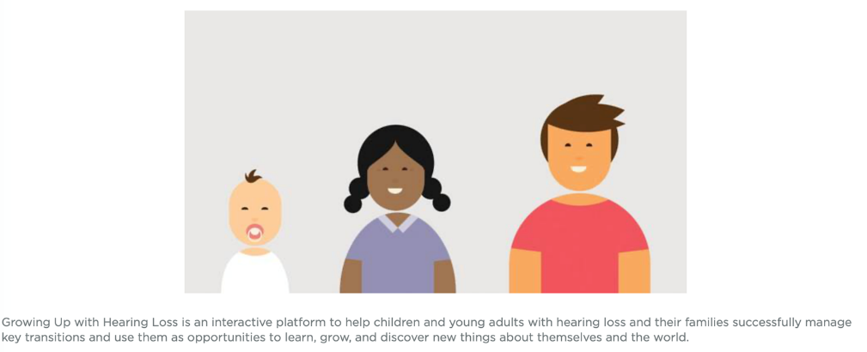
Growing Up with Hearing Loss
Notes:
Growing Up with Hearing Loss is an interactive platform to help children and young adults with hearing loss and their families successfully manage key transitions.
Benefits include enabling children and young adults with hearing loss and their families to:
Learn about their new environment and plan a successful transition
Identify and articulate their needs for professional support
Openly discuss the child or young adult's hearing loss in the family
It provides hearing care professionals with:
A suite of online resources for children, young adults, and their families to help them manage transitions
Key insights into the needs of children and their families to provide appropriate and timely support
A clinical framework based on the principles of self-determination

Slide 33
My World
Notes:
My World is a counseling tool designed to help children talk about their hearing loss. It allows children to show us how they go through their day, and where they have their greatest successes and difficulties. With this information, it is easy to recommend communication strategies, set goals for children to cope with their hearing loss, and recommend appropriate hearing equipment.

Slide 34
Living Well for Teens
Notes:
Living Well for Teens uses different photo sets to help us start a conversation about what’s important to our young clients and how they can communicate more easily.
This non-intrusive approach opens a dialogue and builds a relationship with young clients. If we can identify and understand their priorities and concerns, and involve family members to support communication needs, we are in a better position to recommend appropriate hearing technologies and communication strategies.

Slide 35
Telecare for Teens and Tweens
Notes:
Telecare for Teens and Tweens contains materials to help young people come to their appointment prepared to ask questions, and organize their thoughts living with hearing loss. The process helps young people learn more communication strategies and continue to grow in self-managing their hearing impairment.

Slide 36
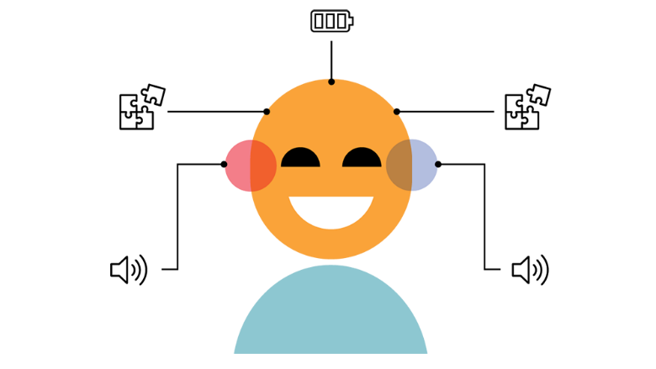
My Hearing Explained for Children
Notes:
The audiogram is a valuable tool for hearing care professionals, but research shows that it can be difficult for family, children, and adult clients to understand. My Hearing Explained for Children is a conversation guide for relaying hearing test results in person-centered terms.
Using easy-to-understand language, this tool helps parents and children understand the hearing loss as it affects daily life and helps them explain the hearing loss to others.

Slide 37
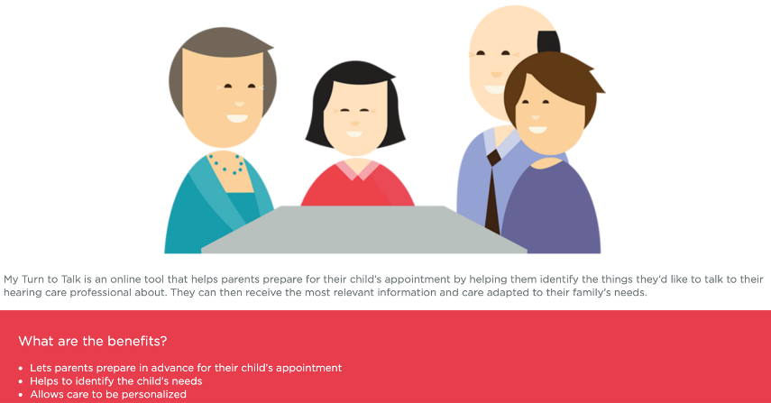
My Turn to Talk for Parents
Notes:
Lastly, a tool designed for parents throughout their child’s development is called My Turn to Talk. Parents of children with hearing loss receive a lot of information about their child’s diagnosis. They may have trouble taking in all the technical details and proposed treatments and will have questions and concerns they’d like addressed during their child’s appointment. That’s why it’s important for them to have the time and space to consider the issues that are most important to them.
My Turn to Talk helps parents prepare for their child’s appointment in advance from the comfort of their home. The tool prompts them to identify who their child communicates with most often and then answer four brief questions. The questions help them communicate their hopes, needs, concerns, and other things they want to talk to their hearing care professional about. The results can be printed out or emailed to their hearing care professional prior to the appointment.

Slide 38
Homework:
Read/be prepared to discuss next reading assignment:
Schmulian, D., & Lind, C. (2020). Parental experiences of the diagnosis of permanent childhood hearing loss: a phenomenological study. International Journal of Audiology, 59(1), 54-60.
Notes:
Homework:
Read/be prepared to discuss next reading assignment: Schmulian, D., & Lind, C. (2020). Parental experiences of the diagnosis of permanent childhood hearing loss: a phenomenological study. International Journal of Audiology, 59(1), 54-60.

Slide 39
References
American Academy of Pediatrics. (2012). Patient- and Family-Centered Care and the pediatrician’s role. Pediatrics, 129(2), 394-404.
Carter, B., et al. (2014). Child-centered nursing: Promoting critical thinking. Thousand Oaks, CA: SAGE Publications.
Coyne, I., et al. (2016). Reframing the focus from a family-centred to a child-centred care approach for children's healthcare. Journal of Child Health Care, 20(4), 494–502.
Coyne, I. et al. (2018). Centeredness in healthcare: A concept synthesis of Family-centered Care, Person-centered Care, and Child-centered Care. Journal of Pediatric Nursing, 42, 45-56.
Curtis-Tyler, K. (2010). Levers and barriers to patient-centred care with children: findings from a synthesis of studies of the experiences of children living with type 1 diabetes or asthma. Child: Care, Health and Development, 37(4), 540-550.
Emanuel, EJ & Emanuel, LL. (1992). Four models of the physician-patient relationship. JAMA, 267(16), 2221-2226.
Entwistle, V., & Watts, I. (2013). Treating patients as persons: A capabilities approach to support delivery of person-centered care. American Journal of Bioethics, 13(8), 29-39.
Ford, K., et al. (2018). Child centred care: Challenging assumptions and repositioning children and young people. Journal of Pediatric Nursing, 43, e39–e43.
Foster, M. (2015). A new model: The family and child centered care model. Nursing Praxis in New Zealand, 31(3), 4-6.
Institute of Medicine. (2001). Crossing the chasm: A new health system for the 21st century. Washington DC: National Academy Press.
James, A., Jenks, C., & Prout, A. (1998). Theorizing childhood. Cambridge: Polity Press.

Slide 40
References
Kuo, D. et al. (2012). Family-centered care: Current applications and future directions in pediatric health care. Maternal and Child Health Journal, 16, 297-305.
Majamanda, M., et al. (2015). Family centered care versus child centered care: The Malawi context. Health, 7, 741-746.
Morgan, S., & Yoder, L.H. (2012). A concept analysis of patient-centered care. Journal of Holistic Nursing, 30(1), 6-15.
Platt, H. (1959). The welfare of children in hospital. Ministry of Health Services Council, London.
Shields, L. (2015). What is “family-centered care”? European Journal for Person Centered Healthcare, 3(2), 139-144.
Söderback, M., et al. (2011). The importance of including both a child perspective and the child’s perspective within health care settings to provide truly child-centred care. Journal of Child Health Care, 15(2), 99–106.
Schmulian, D., & Lind, C. (2020). Parental experiences of the diagnosis of permanent childhood hearing loss: a phenomenological study. International Journal of Audiology, 59(1), 54-60
Stewart, M., Brown, J., & Freeman, T. (2014). Patient-centered medicine: Transforming the clinical method. Abington, UK: Radcliffe Medical Press.
UNICEF. (1989). Convention on the rights of the child. Accessed 18 March 2020: https://www.unicef.org/child-rights-convention/convention-text
Wells, N. (2011). Historical perspectives of family-centered care. Academic Pediatrics, 11, 100-102.
United Nations. (1948). Universal declaration of human rights. Accessed 18 March 2020: https://www.un.org/en/universal-declaration-human-rights/

