Slide 1
Debriefing difficult cases
Clinician wellbeing: Self-care in the hearing clinic
Dunay Schmulian, PhD AuD, MAudSA (CCP)
Notes:
The helping professions can be quite stressful, even when workers are not first-responders in actual acute disaster situations. There are high rates of burnout and turnover by clinicians working in more typical scenarios - outpatient and inpatient environments and community health agencies.
In the same way, hearing healthcare providers are exposed to the very difficult stories and circumstances of some of their clients. As stated in previous lectures, vicarious trauma, or the exposure to the trauma experiences of others, is an occupational challenge in certain cases. People exposed to the suffering of others may change, they may develop PTSD-like symptoms or become more afraid, cynical, or withdrawn OR they may also be more grateful for what they have and appreciative of the resilience of those that they help.
In order to increase the possibility of creating more resilience and gratitude in clinicians, it is important to have a conversation, and more information on the concept and practice of debriefing.

Slide 2
Learning objectives
To understand the need and processes of debriefing.
To increase knowledge in the appropriate timing, confidentiality requirements, duration, formats, and focus areas of debriefing.
To gain experience in selecting and implementing appropriate tools from the debriefing toolkit.
To develop a sustainable debriefing and overall wellness strategy to process difficult encounters and emotional reactivity.
Notes:
In this lecture, we will explore why, when, and how to use debriefing as a protective strategy against vicarious trauma and compassion fatigue. The aim is to provide participants with a foundation from where they can develop and expand their debriefing requirements. It is also important to note that debriefing is one aspect of an overall wellbeing strategy (remember the wellness wheels, and the balancing of work and home life, etc). This information should be used WITH our ability to make our empathy more conscious (see the science of empathy lectures) and not to replace it in any way.

Slide 3
Learning overview
Notes:
By the end of this lecture, you will be familiar with the differences between formal and informal debriefing, and how and why you should always obtain consent before debriefing with a colleague.

Slide 4
Concepts to master
Informal debriefing
Formal debriefing
Limited-impact disclosure
Vicarious trauma
Notes:
The concepts we will master in this lecture are:
Informal debriefing
Formal debriefing
Limited-impact disclosure
Vicarious trauma in the context of unconsented debriefing

Slide 5
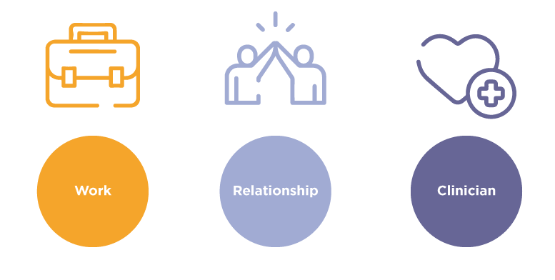
Domains of clinical work
Notes:
As a starting point, it is often useful to review the domains of clinical work:
We have the WORK of the hearing health professional and this could include the detection, diagnosis, prescription, treatment, rehabilitation of hearing- and hearing-related communication restrictions. These are knowledge and skill tools of the trade.
The second domain deals with the RELATIONSHIPS at work: with our clients, families, significant others, and also our colleagues, managers, and the larger public.
Thirdly, we have the SELF or the ME who does the WORK and maintains the RELATIONSHIPS at work.
Let’s review the level of attention given to each of the three domains. Rate it as follows: in your professional education, how much attention has been given to:
The work (0- 3), relationship (0-3) and self-care (0-3).
0: no attention
1: some attention
2. fair attention
3. Majority of attention
Further, if you review the three domains, are they present and defined in your scope of practice, formally captured in your training (exams, courses, certifications), supported by endorsed professional development activities, and do they have clearly described next steps of attainment (entry intermediate advanced), and regular mentoring?
Most of us will acknowledge that there is significantly more attention paid to the WORK, followed by building RELATIONSHIPS and very little attention to the SELF. It is assumed that clinicians are able to take care of themselves, and partly assumed that they have the skills to build and maintain successful relationships.

Slide 6
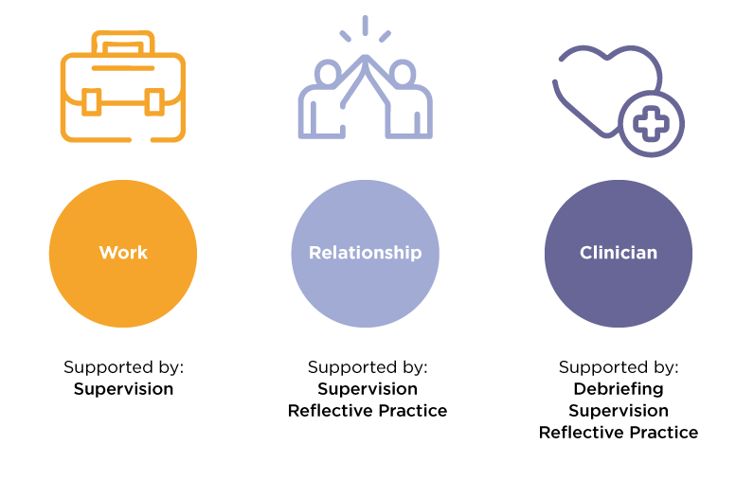
Domains of clinical work
Notes:
We have well-established practices in the WORK domain, and it is usually through formal supervision.
We often develop and expand our RELATIONAL work through supervision but also through written formal, and informal reflective practice.
How do we support CLINICIAN care? In many cases, it falls under supervision, or even reflective practice, but here a debriefing practice where clinicians are able to safely explore any and all aspects of a difficult encounter that lingers with them, would be beneficial.
Activity 1:
Discuss which strategy would best suit the following clinical scenario: supervision, reflective writing or debriefing.
You incorrectly place the headphones during a hearing assessment. (Supervision)
You forget to ask key questions during a case history with a family. (Supervision, reflective practice)
You encounter a client with Kabuki syndrome, and you have no idea what it is. (Reflection)
Your client is angered by the slowness of your assessment. (Supervision, reflective practice)
Because your previous client was so angered by the perceived slowness of your assessment, you find yourself with sweaty palms and panic when you have to assess your next session. (Debriefing)

Slide 7
The current understanding of debriefing
Debriefing is an important but severely neglected part of clinical work.
It is a natural and important process in dealing with challenging clients, clinical scenarios or the clinician’s own concerns.
There are two common kinds of de-briefing:
Informal debriefing: occurs in an ad hoc manner with a flexible location and time of day (staff room, at the end of the workday).
Formal debriefing: a more formal process, scheduled ahead of time and referred to as peer consultation, supervision, or even critical incident stress debriefing.
Notes:
Reactions and responses to vicarious trauma differ from clinician to clinician and from time to time. Every clinician brings their own set of vulnerabilities and strengths to their work. Factors that may make providers more vulnerable to this occupational risk include: prior traumatic experiences; substance use or mental illness; social isolation; difficulty expressing feelings; lack of experience, preparation, orientation, training, and supervision in the work; frequency and intensity of exposure to trauma; and lack of an effective and supportive process for discussing the traumatic exposures.
When clinicians hear and see difficult things in the course of their work, the most normal reaction in the world is to want to debrief with someone, to alleviate a little bit of the burden there are carrying. It is healthy to turn to others for support and validation.
But:
Debriefing is poorly defined (and often confused with supervision)
The timing of when, and why someone would benefit from debriefing is unclear
The format, duration and permissions required are unclear
In reality, many clinicians don’t debrief, or if they do, they don’t always obtain permission from a colleague before debriefing all over them. Are we sharing graphic, unnecessary details of a case with a colleague? Can you still properly debrief if you don't give all the graphic details of the story?
The need for a gentle, effective strategy to support compassion satisfaction while gently preventing your colleagues form telling you too much is possible and will be addressed in the following lecture.

Slide 8
The current approach
Most current experience with processing clinical work is through supervision by a senior clinician, clinical educator or manager.
Supervision supports a student and new graduate’s linear progression from novice to beginner, to independent practitioner.
Debriefing doesn’t occur deliberately.
Notes:
As stated before, most current experience with processing clinical work is through supervision by a senior clinician, clinical educator, or manager.
Supervision supports a student and new graduate’s linear progression from novice to beginner and then to independent practitioner.
But debriefing doesn’t occur deliberately.

Slide 9
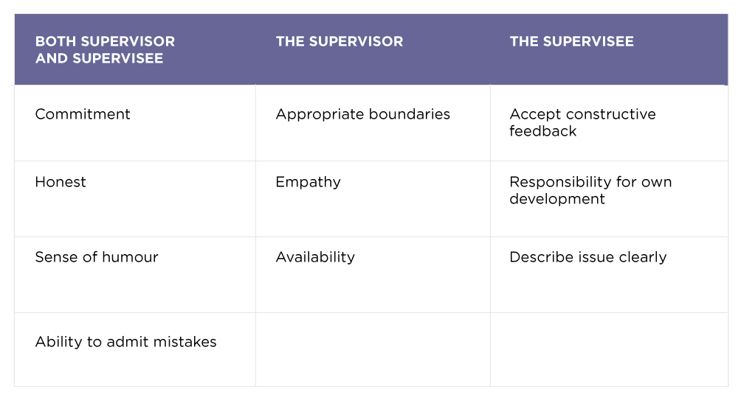
Activity
Notes:
Activity 2:
Often, people draw a blank when asked that they want. As far as supervision and debriefing goes, it is a good idea for everyone in the relationship to know what it is you like them to provide.
Let’s start with the supervisory relationship. Think about the following two questions:
As a supervisee, what skills and qualities would you like your supervisor to have?
As a supervisor, what skills and qualities would you like to see in the people you supervise?
Draw three columns on a white board, and have participants list desirable skills, qualities and attitudes under each column (see slide.)

Slide 10
Supervision
Guidance by a more experienced clinician is a process development to support the welfare of clients
Every supervisory relationship is unique and is often evaluative in nature
Conflict: role ambiguity, expectations
Governed by informed consent and a clear stipulation of the limits of confidentiality
Inadequate supervision, usually due to inadequate time, may lead to a mis-conceptualization of the case
The success of supervision often related to the personality match between supervisor and supervisee
A poor match can result in defensiveness by the supervisee that could risk in withholding client information, thereby jeopardizing client safety
Good supervisors are open interpersonal processing and believe conflict to be developmental
Role clarification, clear delineation of activities, theoretical orientation
Notes:
Activity 2 to be conducted prior to this slide.
To summarize:
The guidance and oversight by a more experienced clinician is a process of personal and professional development, to support the welfare and safety of clients
Every supervisory relationship is unique and is often evaluative nature
Conflict is often a natural occurrence and could be centered around role ambiguity (when someone is both your manager and your team member): expectations of what the session is about (feedback, encouragement, performance management, discipline).
It is governed by informed consent with rights and responsibilities for all parties, and a clear stipulation of the limits of confidentiality
In cases of shallow / inadequate supervision, usually attributed to inadequate time spent may lead to a mis-conceptualization of the case
The success of supervision is often related to the personality match between supervisor and supervisee
A poor match can result in defensiveness by the supervisee that could risk withholding NB client information, thereby jeopardizing client safety
Good supervisors are open to conflict and interpersonal processing, and believe conflict to be developmental
The following is critically important: role clarification, clear delineation of activities, theoretical orientation of the supervisor: often more relevant in psychology or education but could have impact in hearing healthcare (e.g., person-centered or disease-centered)

Slide 11
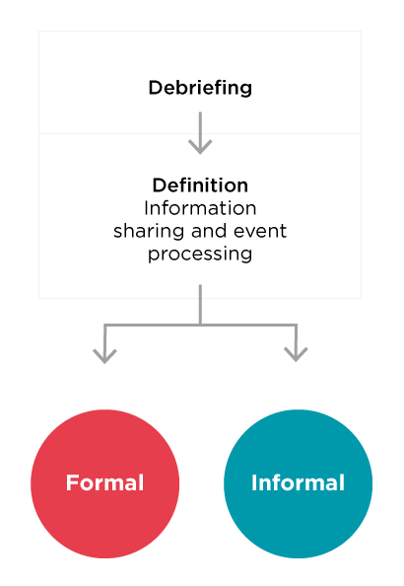
Debriefing
Notes:
Debriefing is an information-sharing and event-processing session conducted as a conversation between a clinician and a peer/ manager.
Debriefing requires a two-way communication process and is different from supervision as it is not just feedback on performance but a communication process that draws out performance explanations and enables clinicians to develop strategies to support future performance and wellbeing.
It is an effective strategy to incorporate and include self-care and relational aspects in a deliberate way. An important aspect of debriefing is that the listener will assess the need for individuals who might benefit from further individual counseling and will make recommendations for individual follow-up.
If there was a specific, triggering event, debriefing could be used to discuss reactions to a specific event, and this occurs soon after the event.
If some time elapses between a difficult encounter and the opportunity to debrief, a clinician may be experiencing some symptoms which could be addressed in debriefing. If needed, a referral to professional counseling or support could be initiated at any stage of the process.

Slide 12
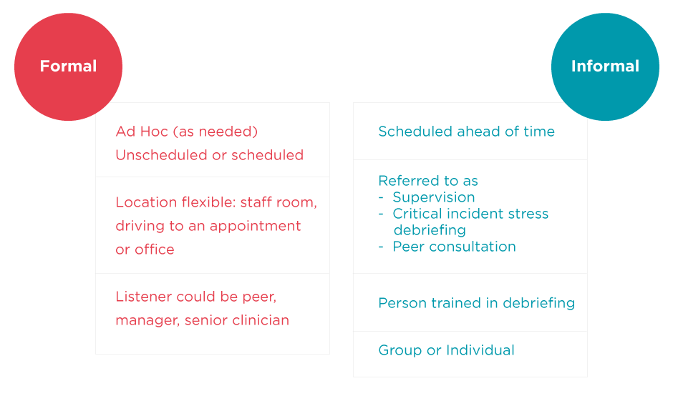
Debriefing
Mathieu, 2012
Notes:
Here are some major differences between informal and formal debriefing. Formal debriefing has its origins in critical incident debriefing (see next slide) and has many names (e.g., psychological debriefing, stress management).

Slide 13
Formal debriefing
Requires time, skill, and a clear focus on the purpose of the formal debriefing.
Originated as a response to a critical incident i.e. any event that is sudden, overwhelming, threatening, or protracted.
May take the form of an assault, a threat, severe injury, death, fire, or a bomb threat.
Part of the critical incident stress management strategy to assist workers to deal with the reactions expected from exposure to critical incidents at the work place.
May be part of supervision, and conducted by a supervisor, but may have a different focus.
Notes:
Many organizations have established formal debriefing processes to deal with critical incidents. It occurs around 3-7 days after a critical incident and may be managed in a group (for example with first responders). It is a structured conversation where trained staff help workers to explore and understand:
The sequence of events
The causes and consequences
The perceptions around the experience
Triggering memories triggered by the incident
Typical expected reactions to critical incidents
Recommendations of specific methods to manage emotional responses resulting from a critical incident

Slide 14
Formal debriefing challenges
The major drawback is the lack of immediacy
Often clinicians require more immediate input: then and there.
A month ahead may be a lifetime away.
Often, clinicians use informal debriefing by unloading on peers, prior to the formal debriefing in an attempt to alleviate the stress.
If a clinician has a poor relationship with a supervisor, debriefing will be ineffective. Requires trust.
Notes:
While formal debriefing is an essential part of many workplaces, many of our clinical triggers do not rise to the level of formal debriefing.
In cases where an organization-specific formal debriefing for clinical work exists, the challenge persists: often when debriefing is offered in a structured way, scheduling may cause a delay between the trigger and the eventual conversation. A month, or even a few days, may feel like a lifetime away if very stressed.
Imagine you were verbally abused by a client, who threatens to sue you for incompetence, and you are only able to process that exchange in 10 days, leaving you with time to stew and worry.
It is very natural for clinicians to bypass or embellish the formal process by grabbing their nearest trusted colleague and debriefing informally with them.

Slide 15
Informal debriefing
Often in clinical practice, informal debriefing is the most appropriate strategy to process events.
It offers more immediate and timely intervention.
It allows the clinician to return to a state of wellbeing and stability relatively soon.
It is case-, and need specific, and used as required.
It avoids unnecessary scheduling and waiting.
The duration of an informal debriefing session may vary.

Slide 16
Informal debriefing
The main challenge of informal debriefing is that the listener rarely has a choice in receiving graphic information.
The listener often is bombarded with difficult information without proper warning and preparation.
The listener is being slimed with difficult information rather than participating in an effective informal debriefing process.
This process if referred to as contagion.

Slide 17
Activity: Knowing yourself
For me, what is the best way to approach learning new things?
For me, what is the best way to manage sudden changes?
For me, what is the best way to approach learning from a difficult experience in the clinical setting?
Based on the test results and this discussion, when do I need to consider debriefing? (Read the section on strengths and particularly weaknesses)
Notes:
Activity 3:
In order to know when to debrief, it is often helpful to have a better understanding of yourself.
Complete the 16 personalities test: https://www.16personalities.com/free-personality-test. This could be completed prior to the lecture or during contact time.
Participants should then group themselves into the 4 broader categories:
Analysts, diplomats, sentinels and explorers.
In the four groups, discuss the following questions:
For me, what is the best way to approach learning new things?
For me, what is the best way to manage sudden changes?
For me, what is the best way to approach learning from a difficult experience in the clinical setting?
Based on the test results and this discussion, when do I need to consider debriefing, or having a debriefing conversation with my supervisor. (Hint: read the section on strengths and particularly weaknesses) E.g. if one of the weaknesses listed is too sensitive (and you agree with this), you could speculate that this weakness may impact on clinical practice in the following way: I may take client frustration or lack of commitment too personally. This could result in me trying too hard – risk for compassion fatigue. Or This could result in me disengaging from the client, becoming more cynical, dreading seeing them and creating opportunities for mistakes.

Slide 18
Informal debriefing challenges
Sharing graphic stories with a colleague can actually spread vicarious trauma to other helpers.
Clinicians often admit that they did not consider the impact of the secondary trauma they unwittingly caused to the recipient of their account of a clinical difficulty.
It can perpetuate a climate of cynicism and hopelessness in the workplace.
Notes:
Don’t be fooled when clinicians state that they’ve heard it all – and that they are desensitized to it – the data on compassion fatigue and vicarious trauma say otherwise!
Activity 4: Take stock
Print out a blank workweek page and ask participants to note all the ways in which they formally and informally debriefed or discussed cases, or where they would have benefitted from formally or informally debriefing.

Slide 19
When to debrief
Recognize the warning signs early
Access organizational support: skill training, mental health days, workload discussion, professional development, and employee assistance
Consider a more consistent debriefing practice
Notes:
When do we debrief? How do you know that you would benefit from debriefing from hearing and seeing difficult things?
Again, we need to focus on several aspects in ourselves: by recognizing early warning signs, by accessing organizational support, and by working preventatively in promoting and establishing a more consistent debriefing practice.

Slide 20
Warning signs
Changes in behavior with client
Changes in reaction to client
Intrusion of client stories in clinician’s lives
Signs of burnout
Feelings of being overwhelmed
Signs of withdrawal
Inability to engage in self-care
(Etherington, 2000)
Notes:
Professor Kim Etherington noted the following as warning signs that a clinician may benefit from engaging in a debriefing conversation:
Changes in behavior with client
Changes in reaction to client
Intrusion of client stories in clinician’s lives
Signs of burnout
Feelings of being overwhelmed
Signs of withdrawal
Inability to engage in self-care

Slide 21
Warning signs
Bodily symptoms
Mood changes
Sleep disturbances
Distractibility
Increased difficulty concentrating
(Killian, 2008)
Notes:
In this multimethod study focused on therapists’ stress and coping in their work with trauma survivors, Killian (2008) conducted semi-structured interviews with 20 clinicians. Interview data demonstrated that therapists detect job stress through bodily symptoms, mood changes, sleep disturbances, becoming easily distracted, and increased difficulty concentrating.
They also mentioned that one of the most effective self-care strategies was processing with peers/supervisor, alongside spirituality, exercise, and spending time with family. This study found that helping professionals should maintain social support, and this might take the form of sustaining an active social network and perhaps processing or debriefing with especially tough cases.

Slide 22
“Let me keep my distance, always, from those who think they have the answers. Let me keep company always with those who say, ‘Look’ and laugh in astonishment, and bow their heads.”
Mary Oliver

Slide 23
References

Slide 24
References
Etherington, K. (2000). Supervising counsellors who work with survivors of childhood sexual abuse. Counselling Psychology Quarterly, 13(4), 377-389.
Killian, K. D. (2008). Helping till it hurts? A multimethod study of compassion fatigue, burnout, and self-care in clinicians working with trauma survivors. Traumatology, 14(2), 32-44.
Mathieu, F. (2012). The compassion fatigue workbook: Creative tools for transforming compassion fatigue and vicarious traumatization. Routledge.
Moore, B. E., & Fine, B. D. (Eds.). (1990). Psychoanalytic terms and concepts. Yale University Press.
Pack, M. J. (2014). The role of managers in critical incident stress management programmes: A qualitative study of New Zealand social workers. Journal of Social Work Practice, 28(1), 43-57.

