Slide 1
Stories and solutions A solution-focused approach
Clinician wellbeing: Self-care in the hearing clinic
Dunay Schmulian, PhD AuD, MAudSA (CCP)
Video available at vimeo.com/530763425/2132e3c1bd
Notes:
Go to vimeo.com/530763425/2132e3c1bd for a video introduction to this lecture by Dr Dunay Schmulian (2 min)
You have gained some knowledge and developed basic skill in applying some narrative techniques. We will now explore the second of the social constructivist models that has potential clinical utility for the person centred (PCC) clinician.
Solution focused brief therapy (SFBT) offers a unique contribution to clinical practice because it is deliberately focused on change, and on the future. SFBT is a pragmatic approach rather than a theoretical one. How it came to be is that the developers observed hundreds of therapy sessions over the course of years, carefully documenting the questions, behaviors, and emotions that allowed clients to verbalize and achieve real-life solutions for their challenges. The questions that proved to be the most reliable related to client progress were incorporated into the solution-focused approach. This approach has become one of the leading schools of brief therapy, as well as a major influence in business, social policy and education.
We will explore how this approach firmly placed the client as the expert and how exceptions, questioning, and scaling are enlisted in supporting the client as he or she sets the agenda, the goals, and the expectations of the appointment.

Slide 2
Learning objectives
To understand and describe the narrative approach and SFBT and its potential application in PCC.
To gain experience in using narrative and SFBT techniques including for example, externalization, seeking unique outcomes, scaling and miracle questions.
To apply these premises and techniques in a guided hypothetical case.

Slide 3
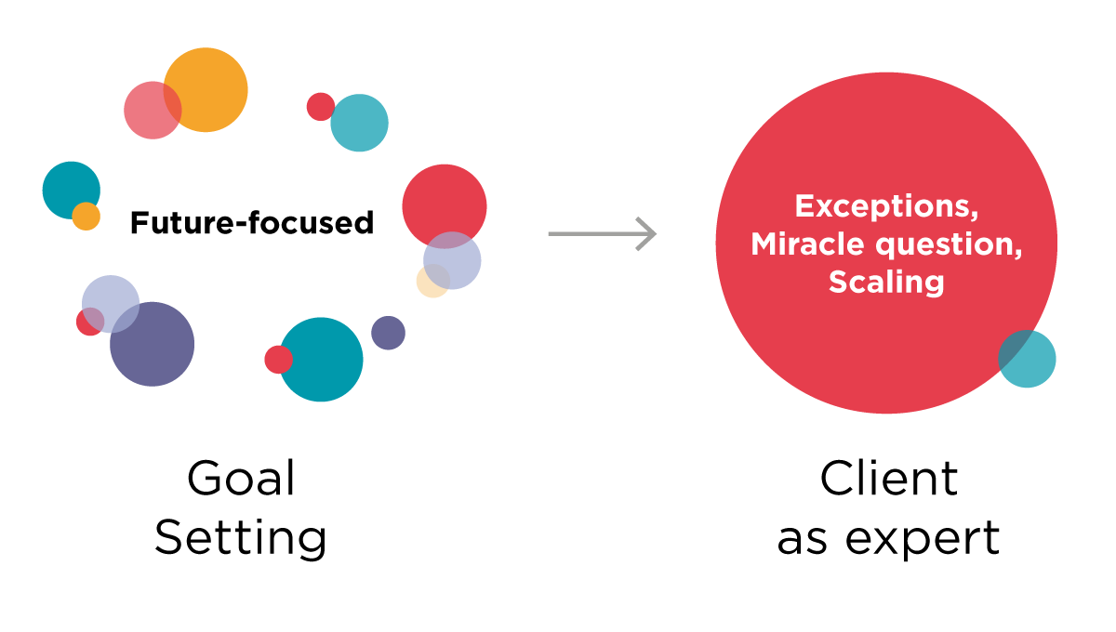
Learning overview
Notes:
SFBT offers a unique contribution to clinical practice because it is deliberately focused on change, and on the future.

Slide 4
Concepts to master
If it ain’t broke, don’t fix it
Goal setting
Miracle question
Rating
Exceptions
Notes:
At the end of this lecture, you will have a clearer understanding of these concepts observed through a solution-focused lens. You will also be able to observe this work in action through some video excerpts and group activities.

Slide 5
Reading assignments
De Shazer, S., & Dolan, Y. (2012). More than miracles: The state of the art of solution-focused brief therapy. Routledge.
Notes:
A useful resource if this material is interesting is a short summary by the developers of SFBT themselves.

Slide 6
Problems and solutions
Problem-seeking approaches are a self-fulfilling prophecy
It is embedded in a model of cause and effect
Discovery of the problem, formulation of an impression, suggestion of a treatment
This is the dominant model in which clinicians approach case interpretation
It is also the simplest to teach and assess
Video available at vimeo.com/530765556/203452f5b0
Notes:
Go to https://vimeo.com/530765556/203452f5b0 to view video of slides 6-12. (7.20 min)
Solution-focused therapies are founded on the rationale that there are exceptions to every problem and through examining these exceptions and having a clear vision of a preferred future, client and counsellor together, can generate ideas for solutions.
Solution-focused brief therapy actively works toward solutions. It helps patients identify what they do well.
Problem-seeking approaches are a self-fulfilling prophecy. Audiology often uses a framework situated around cause and effect: the audiologist discovers as much of the hearing difficulty as possible, formulates a diagnostic impression, and suggests remedial steps to overcome the difficulty. In fact, in the western world, the cause-effect or problem-focused model is the predominant model by which we understand the world and our profession.

Slide 7
Problems and solutions
In the presence of a straight-forward problem with an unambiguous cause this approach is mostly effective.
This strength is its downfall.
When it is ineffective, the solution recedes further and the possibility of improvement dwindles, leaving the client and clinician frustrated and even drained.
Exploring or analyzing the factors that cause or perpetuate a problem does not automatically result in an improvement or alleviation of the problem.
Video available at vimeo.com/530765556/203452f5b0
Notes:
It is very useful in dealing with straightforward problems – if it can be reduced to unambiguous causes: diagnosis + treatment = reduction in difficulty.
Its strength is its downfall: it is heavily problem-focused: a circle of more problems may develop – atmosphere laden with problems and the solution recedes further from and the hope of improvement dwindles – problem-seeking approaches.
Fact: exploring or analyzing the factors that cause or perpetuate a problem does not automatically result in an improvement or alleviation of the problem.

Slide 8
Solution-focused brief therapy
Solution-focused brief therapy (SFBT) concentrates on the strengths that clients bring to the clinic and emphasizes the positives by exploring the solutions more than the problems.
The explicit focus on solutions attempts to create an atmosphere where clients’ strengths are moved into the forefront.
The main premise is that clients have the resources to create their own effective solutions.
Clients already have the skills to overcome problems.
Negative feelings may cause them to overlook their abilities and strengths.
Video available at vimeo.com/530765556/203452f5b0
Notes:
SFBT concentrates on the strengths that clients bring to the clinic and emphasizes the positives by exploring the solutions more than the problems.
The explicit focus on solutions attempts to create an atmosphere where clients’ strengths are moved into the forefront.
The main premise is that clients have the resources to create their own effective solutions.
Clients already have the skills to overcome problems.
Negative feelings may cause them to overlook their abilities and strengths.
From the first session, the focus is on change by discussing solutions that are constructed between the clinician and the client. Without attempting to ferret out why or how a particular problem arose the clinician aids the client in discovering his or her own creative solutions for becoming “unstuck”.

Slide 9
Solution-focused brief therapy
Ironically, many of our good ideas are not new to our clients. Clients have heard them all before.
If we persist in sharing useful, but known ideas as the expert, the clinical encounter can often devolve into a situation where a client rebuts or refutes our well-informed recommendations with evidence that this has not or will not work for them.
Instead, the clinician and client work together to continue change that is already occurring.
The approach encourages clients to rely on their own solutions.
Video available at vimeo.com/530765556/203452f5b0
Notes:
Ironically, many of our good ideas are not new to our clients. Clients have heard them all before.
If we persist in sharing useful, but known ideas as the expert, the clinical encounter can often devolve into a situation where a client rebuts or refutes our well-informed recommendations with evidence that this has not, or will not work for them.
The clinician and client work together to continue change that is already occurring.
The approach encourages clients to rely on their own solutions.
De Shazer refers to this approach as providing clients with “skeleton keys”, i.e. interventions that work for a variety of situations and dilemmas that clients may encounter.

Slide 10
Controversy
Insight into the original problem not always necessary
Exploring or analyzing the factors that cause or perpetuate a problem does not automatically result in an improvement or alleviation of the problem.
Video available at vimeo.com/530765556/203452f5b0
Notes:
SFBT challenges problem-based thinking for both the client and clinician. Clients are encouraged to look for exceptions to the rule, meaning occasions where they were able to manage the problem or the problem wasn't so overwhelming, instead of spending too much time exploring the why and how of the problem. Therefore, insight into the original problem is de-emphasized during the clinical encounter.
SFBT believes that exploring and analyzing factors that perpetuate the problem doesn’t necessarily and automatically reveal the solution. With the focus on change, interventions are intended to disrupt the problem-maintaining behavior patterns, challenge outmoded beliefs, and amplify exceptions to behaviors that were previously thought to be unchangeable.

Slide 11
The 8 principles of SFBT
The client is the expert
What they have tried already to solve the problem
The cause of the problem not needed for the solution
We shift attention, we do not convince, coerce, guilt or manipulate
Change begins with small steps (always)
If something works, do more of it
If it doesn’t work, do something different
Describe exceptions (problem-free states) and make them more conscious
Video available at vimeo.com/530765556/203452f5b0
Notes:
Here are the 8 principles underpinning solution-focused brief therapy. You will note how pragmatic, future-focused and change-oriented the approach is when dealing with clients in a clinical setting.
The client is the expert
What they have tried already to solve the problem
The cause of the problem not needed for the solution
We shift attention, we do not convince, coerce, guilt or manipulate
Change begins with small steps (always)
If something works, do more of it
If it doesn’t work, do something different
Describe exceptions (problem-free states) and make them more conscious

Slide 12
Let’s practice

Slide 13
Principles in hearing healthcare
The client is the expert of his hearing: they have the knowledge of what would make their communication better
Look for client solutions, not problems: what they have tried already to solve the problem: lifestyle, habits, the fact that they are in your office
We do not need to know what caused the problem in order to solve it: noise exposure / ageing / diabetes = not part of the solution
The purpose of interaction is not to convince someone but to shift attention (to exceptions = solutions that may reveal themselves or times when the problem wasn’t as visible): falling asleep with the radio on
Notes:
Activity: Principles in hearing healthcare: Consider reviewing each of the statements as follows:
If the client is the expert of his hearing: what would they have knowledge about?
Have the students brainstorm the information and the instructor add it to a whiteboard.
The second part of the phrase (point 1: they have the knowledge of what would make their communication better) would then be the summary statement at the conclusion of their brainstorming: the client has knowledge on what would make their communication better.
Point 3 for example: instead of building a feedback session around music or noise exposure and how the client “caused” their own hearing problem, focus on how much their decision to start using noise protection more consistently shows behaviors that are positive and that could be employed in deciding how to approach hearing rehabilitation and adjusting to hearing aids, for example.

Slide 14
Problems and solutions
Change begins with small steps: making an appointment
If something works, do more of it: increased tv volume, asking for repetition / preferential seating
If it doesn’t work, do something different: go to the restaurant earlier
Look at differences that make a difference: describe exceptions and make them more conscious using the radio to mask tinnitus, sleeping with the good ear available, joining a partner during appointments, use Skype instead of phone
Notes:
See Lecture 4, Group activity 1 to allow discussion on how the 8 principles may be relevant to the participants’ specific clinical setting.
We often miss an opportunity to acknowledge the clients who decide to change their approach to hearing by embarking on a hearing journey with us. We know that there is a long latency (7 years) between knowing you have a hearing loss and doing something about it (MarkeTrak etc.) and it is worth offering sincere acknowledgement of this step.

Slide 15
Activity

Slide 16
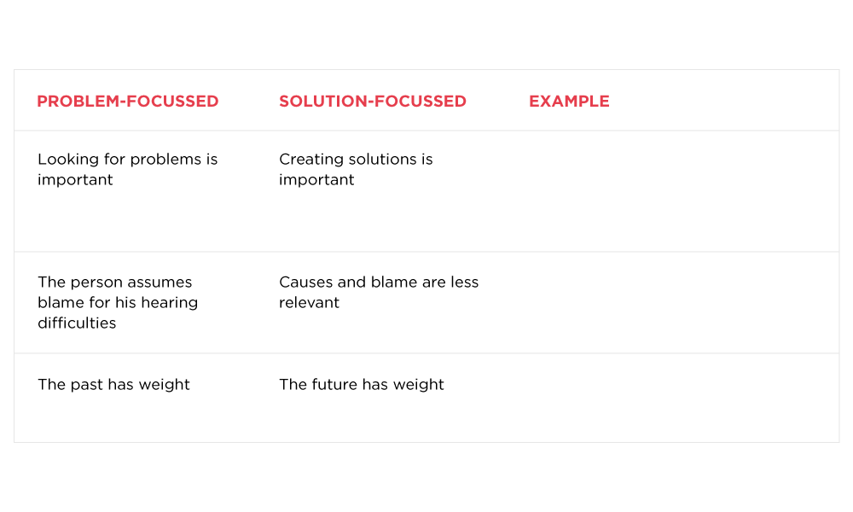
Your client:
Shelley
59, with mild gradually sloping mid to high frequency sensorineural hearing loss and disturbing tinnitus.
Notes:
Contrast problem-focused with solution-focused work:
What would be an example of using a more solution-focused approach with a client with mild hearing loss and noticeable tinnitus?
Use this slide to have the students come up with statements that reflect a solution-focused approach, then share the next slide with possible suggestions.
Proceed to slide 17 and have the participants generate statements that reflect a solution-focused approach and then share slide 18 with possible suggestions.
Discuss the difference as a group.

Slide 17
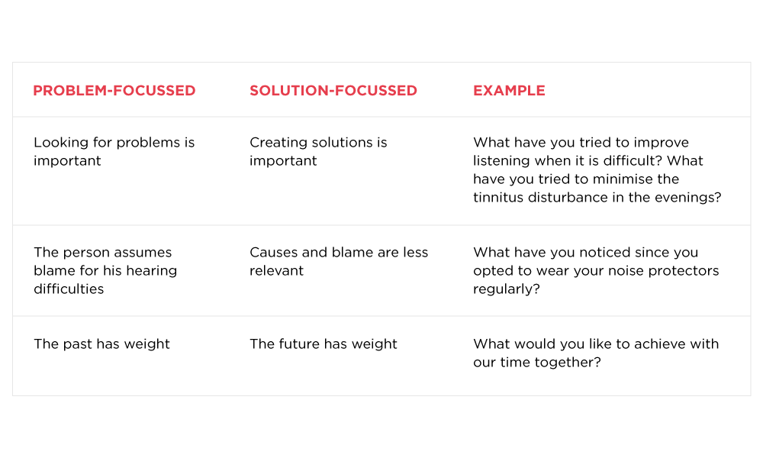
Your client:
Shelley
59, with mild gradually sloping mid to high frequency sensorineural hearing loss and disturbing tinnitus.
Notes:
Add these examples to what the participants were able to offer on their own.

Slide 18
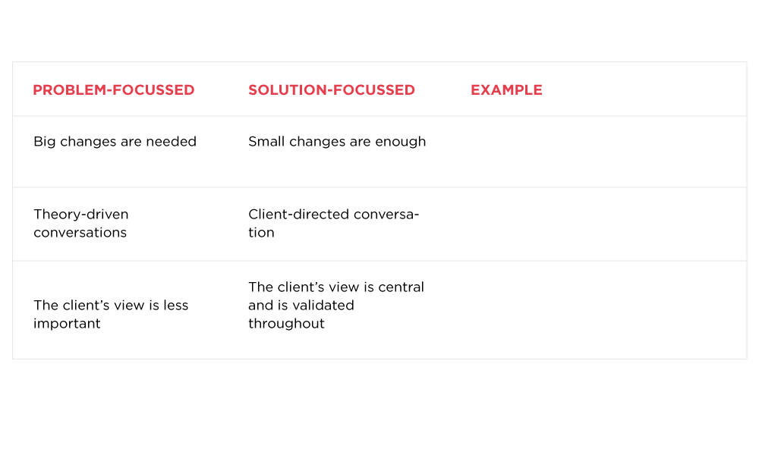
Your client:
Shelley
59, with mild gradually sloping mid to high frequency sensorineural hearing loss and disturbing tinnitus.
Notes:
See Lecture 4, Group activity 2
It is useful to practice key phrases that depict a change in focus from problem to solution.
Think about a client with mild hearing loss and noticeable tinnitus for example.
What would an example be of a more solution focussed approach when reviewing the following statements?

Slide 19
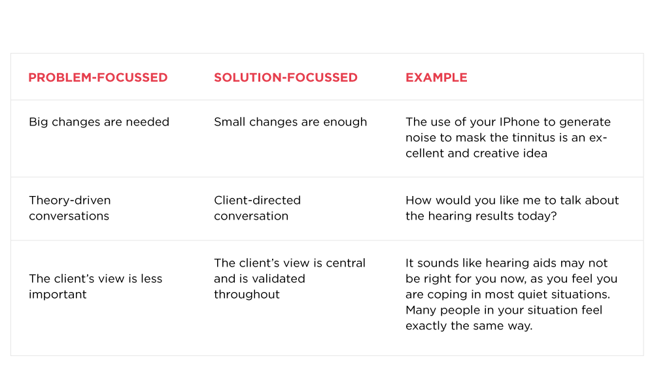
Your client:
Shelley
59, with mild gradually sloping mid to high frequency sensorineural hearing loss and disturbing tinnitus.
Notes:
Add these examples to what the participants were able to offer on their own.

Slide 20
Goal setting
Solution-focused goals are an important component of SFBT.
When possible, smaller goals are preferred over larger goals.
Clients are encouraged to frame their goals as a solution, rather than the absence of a problem.
Setting up the goal as a solution, allows the goals to be rated or scaled.
Video available at vimeo.com/530766362/8ac9ad4ed5
Notes:
Go to vimeo.com/530766362/8ac9ad4ed5 to view video of slides 20-26. (7.11 min)
Here are some examples:
What is the goal of the session for you? Versus what can I do for you / what brings you here today?
What must be accomplished by the end of this session in order for you to be able to say that it has been meaningful and that your goal is reached?
What would you like to see instead of the problem?
What do you hope for after our time together?
What would you like to see to think this hour together was well spent today?

Slide 21
The miracle question
Occasionally, clients have difficulty articulating any specific goal
The miracle question offers a way to ask for a client’s goal that communicates respect for the immensity of the problem, yet simultaneously leads the client to generate smaller, more manageable goals.
Video available at vimeo.com/530766362/8ac9ad4ed5
Notes:
Sometimes we need to drill down a little more in order to set goals with the client, especially if they are accustomed to being told what to do by professionals. On those occasions where clients have difficulty articulating any specific goal, much less a solution-focused goal, the miracle question may be useful. This is particularly relevant for clients who perceive their difficulty as severe such as in for example severe debilitating tinnitus.
The miracle question offers a way to ask for a client’s goal that communicates respect for the immensity of the problem, yet simultaneously leads the client to generate smaller, more manageable goals.
Miracle question:
If, by some miracle, the problem that brings you here has been solved: how would you know and notice that the problem has been solved? What would be different? What would you be doing differently? Where would you be? Who would be there with you?

Slide 22
The miracle question
The precise language may vary but the basic wording is:
I am going to ask you a rather strange question. [pause]. After our appointment you are going to return to work (home, school) and you will do whatever it is you need to do the rest of the day. It will become time to go to bed. You are sleeping in peace.
In the middle of the night, a miracle happens and the problem that we have just discussed is solved!
So when you wake up tomorrow morning, what might the small changes be that will make you think to yourself: “Wow, something must have happened. The problem is gone.” (after Berg & Dolan, 2001)
Video available at vimeo.com/530766362/8ac9ad4ed5
Notes:
The precise language may vary but the basic wording is:
I am going to ask you a rather strange question. [pause]. After our appointment you are going to return to work (home, school) and you will do whatever it is you need to do the rest of the day. It will become time to go to bed. You are sleeping in peace.
In the middle of the night, a miracle happens and the problem that we have just discussed is solved!
So when you wake up tomorrow morning, what might the small changes be that will make you think to yourself: “Wow, something must have happened. The problem is gone.” (after Berg & Dolan, 2001)
In Lecture 4, Activity 2, identify some of the Ida Institute tools that could be used with solution-focused goal setting.
For example:
The Line: https://idainstitute.com/tools/motivation_tools/line/
The Box: https://idainstitute.com/tools/motivation_tools/box/
The People I Talk To: https://idainstitute.com/tools/telecare/prepare_for_your_first_appointment/
Goal Sharing for Partners: https://idainstitute.com/tools/communication_partners/goal_sharing_gps/

Slide 23
Miracle question in action
Video available at vimeo.com/530717843/0319a385d5
Notes:
Go to https://vimeo.com/530717843/0319a385d5 to revisit the case video.
Let’s look at the example of the miracle question and the surprising outcome it reveals on how the client would see her life as easier. Hint: it has nothing to do with her hearing loss!
Discuss the video excerpt and identify where the use of the miracle question and the rating question enhanced understanding of the client’s world.
Discuss the nature of the client’s miracle and the implications for hearing rehabilitation.
Explore some of the Ida Institute clinical tools (such as The Line) and reflect on how the Ida tools may be used when applying a solution-focused approach.
Further, students could reflect on a comfortable wording of the miracle question in their own words and identify circumstances where it could be most useful to them in their immediate clinical context.

Slide 24
Rating / scaling questions
When the client gives specific goals directly or via the miracle question, an important next intervention in SFBT is to scale / rate each goal.
This allows the client and clinician to measure progress.
There are three occurrences from one session (and one rating) to the next:
The problem may improve
The problem may remain the same
The problem may worsen
Video available at vimeo.com/530766362/8ac9ad4ed5
Notes:
The problem may improve. Compliment the client; solicit extensive details describing how the client was able to make these changes. This leads to the obvious nudge to do more of the same.
The problem may remain the same. The client may be complimented for maintaining their changes, or for not letting things worsen. Questions such as: how did you keep things from getting worse? This may lead to a description of changes that the client made, in which case the clinician may support and encourage more of that change.
If the problems worsened, it is time to ask a client if they would like to work with you to try something else.

Slide 25
Rating / scaling questions (continued)
If the problem worsens, the clinician would be able to ask questions around how the client managed to cope with the situation, for example:
“This sounds frustrating. How are you managing to cope with this to the degree that you are?”
This line of questioning may provide suggestions for interventions based on the client’s revealed strengths and previous solutions.
Video available at vimeo.com/530766362/8ac9ad4ed5

Slide 26
Rating questions
Video available at https://vimeo.com/530766362 and at https://vimeo.com/530717843
Notes:
Were you surprised at the severity of rating of the client re her frustration?
Don’t anticipate a straight answer from the audience here. Often it is met with intellectual discussion, but watch for body language (e.g. wrapping arms around the body, and for hands heading to the throat and mouth). It is confronting to think about hearing assessment as trauma.
How would you approach a solution for a 7/10 problem?
At this stage, having the principles of PCC would be a helpful prompt and to encourage students to ask very practical questions, and not to shy away from closed questions, especially since it is such a high rating.
During the example, my actual questions were: What makes it 7/10 for you: is it the preparation for coming to the appointment (logistics/ childcare)? Or the thoughts going through your head? Could the room and environment contribute? Here, the client could offer guidance as to which direction the discussion should take – anything asked empathically, and within the working alliance is often okay. Remember, the best scenario is for you to not know where the conversation is going as it creates true collaboration.
Then I would develop the problem story around the most pressing aspect and ask how could we work together to take this from a 7/10 to a 5/10 – what would that look like? Using a favor of the miracle questions, I would ask: What would you see differently in your (e.g., preparation), or (e.g., thoughts around the test), or (e.g., the environment).
Thinking about the 8 principles, how would you support a client in developing a solution for her 7/10 problem?
This would allow you to then reflect back on the collaborated solution by saying: what I am hearing is that this is a big deal, a 7/10 problem, and it affects mostly your preparation for the test and your comfort during the test. We discussed that having an early morning appointment with a familiar clinician would address some of the concern, by being informed during the test of how things are progressing, and also opening the booth door and having face to face contact would assist greatly in lessening the trauma from 7/10 to 5/10. Is there anything else we could look at to ensure a better experience for you?

Slide 27
References

Slide 28
References
Bannink, F. (2010). 1001 solution-focused questions: Handbook for solution-focused interviewing. WW Norton & Company.
De Shazer, S., & Dolan, Y. (2012). More than miracles: The state of the art of solution-focused brief therapy. Routledge.
Egan, G. (2010). The Skilled Helper with Exercises. Cengage.
Stebnicki, M. A. (2007). Empathy fatigue: Healing the mind, body, and spirit of professional counselors. American Journal of Psychiatric Rehabilitation, 10(4), 317-338.
White, M. K. (2007). Maps of narrative practice. WW Norton & Company.
Notes:
Homework:
Review lecture notes and references
Seek examples of narrative-focused and solution-focused messaging in your environment: e.g. someone is fighting cancer (externalized), healthy aging versus getting old (solution-focused).
Select one of the techniques (see concepts to master) and apply in the clinical setting.
Reflect on how this technique impacted on your knowledge of the client, your clinical skill development and your confidence as a clinician. Use the Ida Institute Reflective Journal to document your experience: https://idainstitute.com/fileadmin/user_upload/documents/Tool_PDFs/Reflective_Journal.pdf

