Slide 1
Building a therapeutic relationship: Empathy is the key
Samantha Tai
Notes:
This is unit 3 of the ”Applying PCC in an Appointment” module in the Ida University Course. This module helps lecturers guide students in hearing care, rehabilitation, and teaching to translate person-centered care from theory into practice.

Slide 2
Learning objectives
Overview of today’s goals
#01
Review the role of empathy in building a therapeutic relationship with patients and the current state of play in clinical practices.
#02
Identify the key communication behaviors to convey an empathetic response.
#03
Create a safe peer-learning environment to practice communication skills and offer descriptive feedback.

Slide 3
Story
Notes:
Let’s begin with a story told by one of the characters from the TV series “The West Wing.”
“A person was walking along a path when he falls in a hole. It’s dark and the walls are so steep, the person can't get out. A doctor passes by and the person shouts up, ‘Hey! Can you help me out?' The doctor writes a prescription, throws it down in the hole and moves on. Then a priest comes along and the person shouts up, 'Father, I'm down in this hole can you help me out?' The priest says a prayer, and moves on. Then a stranger walks by and the person shouts, 'Hey, I’m stuck, can you help me out?’ The stranger jumps in the hole. The person says, 'Are you nuts?! Now we're both down here.' The stranger says, 'Yeah, but I've been down here before and I know the way out.’”
This story is akin to us jumping into the hole to help our patients. We possess a great deal of professional knowledge that can guide our patients through the right path to lead them out. If we distance ourselves and ‘write a script’, the person may not be able to work themselves out. But when we allow ourselves to stand with our patients, we can view things from their perspectives. Putting yourselves in another person’s shoes is the essence of empathy.
http://westwing.bewarne.com/queries/story.html

Slide 4
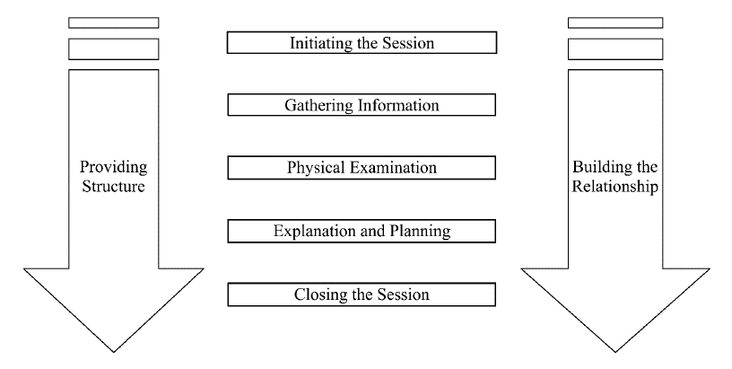
Calgary-Cambridge guides
Kurtz, S., Silverman, J., Bensons, J. Draper, J.(2005). Marrying content and process in clinical method
teaching: Enhancing the Calgary-Cambridge Guides. Academic Medicine,78(8),802-809.
Notes:
In the Calgary-Cambridge Guides, building the relationship occurs throughout the entire appointment. This presentation will specifically address how we can establish a therapeutic relationship with our patients, because when we demonstrate care and compassion for our patients it leads to rapport building and patient satisfaction. This requires clinicians to identify patients’ emotions and respond to them appropriately.

Slide 5
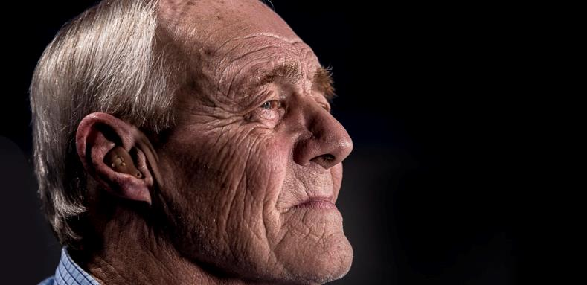
Missing emotional cues
Observational studies showed audiologists rarely acknowledge patients’ emotional concerns.
Students and clinicians tend to feel more comfortable with information counseling than personal adjustment counseling.
Notes:
Observational studies on audiologist-patient interactions showed audiologists rarely acknowledge patients’ emotions or offer empathetic responses when patients expressed psychosocial concerns.
Research has shown that both students and experienced clinicians tend to feel more comfortable with information counseling than personal adjustment counseling that includes dealing with patients’ emotional concerns about their hearing impairment. For audiology students, the technical assessments can sometimes overshadow patient interactions, creating missed opportunities to demonstrate empathy (Tai et al, 2018). The good news is, we can learn how to respond appropriately to the patient’s emotions and further improve our interactions.
References
Ekberg, K., Grenness, C., & Hickson, L. (2014). Addressing patients' psychosocial concerns regarding hearing aids within audiology appointments for older adults. American Journal of Audiology, 23(3), 337-350.
English, K. (2005). AuD students' concerns about interacting with patients and families.
Meyer, C., Barr, C., Khan, A., & Hickson, L. (2017). Audiologist-patient communication profiles in hearing rehabilitation appointments. Patient education and counseling, 100(8), 1490-1498.
Meibos, A., Muñoz, K., Schultz, J., Price, T., Whicker, J. J., Caballero, A., & Graham, L. (2017). Counselling users of hearing technology: A comprehensive literature review. International Journal of Audiology, 56(12), 903-908.
Tai, S., Woodward-Kron, R., & Barr, C. (2018). Audiology Students' Perspectives of Enacting and Learning Clinical Communication: A Qualitative Interview and Video Reflexivity Study. American journal of audiology, 27(2), 219-230.

Slide 6
Demonstrate empathy
Be open to patients’ emotions
Discern empathetic opportunities
Express empathy
“Empathy begins with understanding life from another person’s perspective. Nobody has an objective experience of reality. It’s all through our own individual prisms.”
- Sterling K. Brown
Notes:
Our ability to demonstrate empathy is key in building the relationship with our patients. “Empathy begins with understanding life from another person’s perspective. Nobody has an objective experience of reality. It’s all through our own individual prisms.” This quote by Sterling Brown recognizes the essence of empathy which is to stand in someone else’s shoes but also the recognition that an individual’s experience is shaped by their own unique perspectives.
When we interact with patients, we need to be self-aware of our own beliefs and communication behavior so that we are prepared to respond to our patients.
According to the Four Habits model, demonstrating empathy requires three components: i) being open to the patient’s emotions, ii) discerning empathetic opportunities, and iii) expressing empathy. The next few slides will go through these areas in detail.

Slide 7
Be open to patients’ emotions
Being open to our patients’ emotions can add depth in the relationship building
Patients appreciate empathetic responses
Not acknowledging patients’ emotional concerns can negatively impact hearing care
Responding to patients’ emotions is part of scope of practice in many countries
Clinicians must be open to learning and adopting skills to respond to patients in an empathetic manner
Notes:
In most clinical appointments, the clinician is working under a highly time-pressured environment to complete a range of assessments. If we want to provide person-centred care, we must be open to our patients’ emotions, as it can add depth to the relationship building.
This means that we need to prepare ourselves to respond empathetically to our patients. Clinicians may tiptoe around their patient’s emotional concerns as they worry about not knowing what to say or fear that their patients will get more distressed. Not acknowledging patients’ emotional concerns can be a detriment to their hearing care, which is why responding to patients’ emotional concerns are within the professionals’ scope of practice in many countries.
There are ways to respond appropriately to patient emotions, and it is the responsibility of the clinician to be open about learning and adopting empathetic skills in clinical practice.

Slide 8
Discern empathetic opportunities
Active listening
Focus on not interrupting or finishing other peoples’ sentences
Affirm responses with ‘I see’, ‘mm’, ‘I understand’ etc.
Observations
Observe non-verbal cues
E.g. body posture, facial expression, tone of voice
Notes:
Before we convey empathy, we must first identify patients’ emotions. This is where we gain an in-depth understanding of the patient experience through active listening, that is, focusing on what the patient is saying.
We also want to closely observe the patient’s gestures, facial expressions, and tone of voice. Making good eye contact, rather than focusing on our computer or clinical notes can help patients pick up these cues.
Note to instructor:
Ask the class what type of emotions they are likely to encounter from patients in the clinic. This can be written on the whiteboard.
Examples:
Anger, annoyance, anxious, comfortable, confused, depressed, embarrassed, frustrated, happy, hopeful, insecure, loneliness, lost, motivated, nervous, overwhelmed, relieved, sad, scared, self-conscious, shocked, suspicious, terrified, uncomfortable, worried etc.
This will demonstrate a range of emotions that are portrayed by patients and we need to identify these emotions in order to respond appropriately.

Slide 9
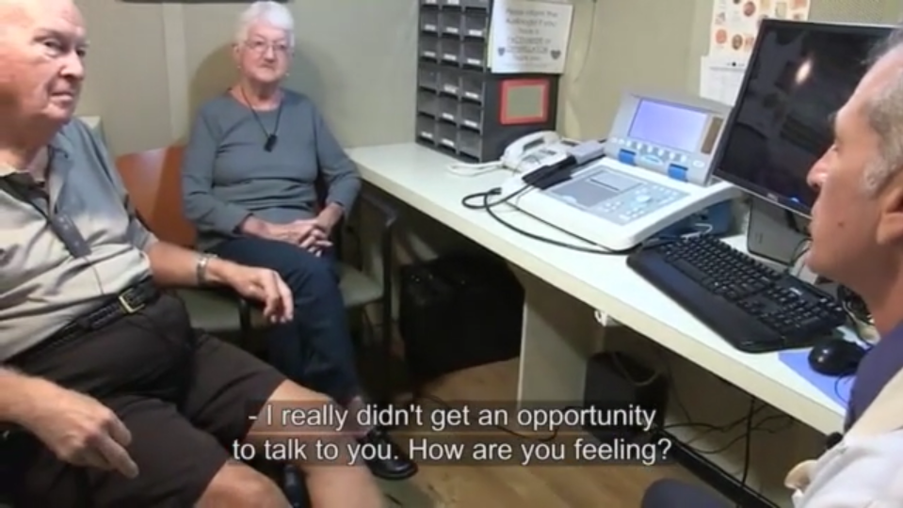
Empathy in action
Notes:
“Oscar and the Steins”
In this video we see how Oscar expresses empathy in an appointment with a couple where one of them is struggling with illness. After the appointment the couple talks about what the appointment meant to them and the audiologist reflects on his experience.
To view the video, click on the image above or find it in the “videos” section of the Ida University Course

Slide 10
Activity 1: Guess the emotion
Two groups
Discuss the importance of
identifying patient emotions
Use of verbal information, body
language and facial expressions
Notes:
Note to instructor:
This is a fun, competitive game that involves being aware and identifying the right emotion.
Split the class into two groups (A and B).
A volunteer from each group will come up and be given an emotion to act out in front of his/her group (e.g. disgust, affection, fear, anxiety, embarrassment, anger, determination, etc). You can also use the emotions identified by the class in the previous activity.
The rest of the group will need to guess the emotion within a given timeframe (e.g. 1 minute). If the emotion is correct, the team will receive 10 points.
Now ask a volunteer from Group B to act out an emotion; award points as appropriate.
Rotate the acting opportunities between the two groups.
Each team can have five goes each. The group with the most number of points at the end wins.
* If there is a tie, ask a volunteer from each group to come up together. Give them the same emotion to act out in front of their group, the group that guesses it first wins.
Adapted from: https://www.trainingcoursematerial.com/free-games-activities/communication-skills-activities/guess-the-emotion

Slide 11
Express empathy
Examples of empathetic responses
Naming: “I can see you are upset”
Encourage: “I’m glad you shared that with me. Tell me how you are feeling about…?”
Legitimation: “That must be hard. I’m sorry this is happening to you”
Support: “What can I do to help?”
Respect: “Sounds like you are managing very well”
Notes:
Once we have identified patients’ emotions through observations and active listening, we need to acknowledge their feelings and respond appropriately.
The types of empathetic responses are: naming, legitimation, encourage, and respect.
We can encourage patients’ expression of their emotions by using open-ended questions such as ‘Tell me more…’
Similar to the observations of our patient’s non-verbal behaviors, we also need to reflect on our own behaviors to convey empathy, such as body language, gaze, tone of voice, and facial expressions.
Reference
Cohen-Cole SA, Bird J. Building rapport and responding to patient’s emotions. In: Cohen-Cole SA. The medical interview: the three-function approach. St Louis, MO: Mosby Year Book; 1991. p. 21-7.

Slide 12
Example: Angry patient
P: Well, it started the day before yesterday when…
HCP: Oh dear, I’m sorry to hear that. Tell me more about what’s happening with your hearing aids and what I can do to help.
HCP = hearing care professional
P = patient
Notes:
Note to instructor:
Click through and read the dialogue between the HCP and patient to the students. This was one of the examples from the last unit’s role-play.
In this example, the HCP used ‘naming’, ‘legitimation’, ‘encourage’ and ‘support’.

Slide 13
Preparation for role play: Group engagement
All participants in the exercise are encouraged to offer input and
suggestions, by acting out those suggestions. You can contribute by:
Hot Seating - Build a patient profile, develop a character sketch
Life Line - Role-players can pause and ask others for help
Alter Ego - Use to understand what may be going on in the heads of the clinician and patient as the conversation unfolds
Adapt from Role-Play session 2:
https://idainstitute.com/tools/time_and_talk/get_started/role_play_session_2/
Notes:
Note to instructor
The following group role-play activity is adapted from the Time & Talk workshop in the Ida toolbox. You can find detail information from the link below:
https://idainstitute.com/tools/time_and_talk/get_started/role_play_session_2/
To ensure a positive learning experience for all participants, a collaborative learning environment needs to be created. All participants in the exercise are encouraged to offer input and suggestions. This can be done by ensuring that the role-players are not always at the center of attention. Students are encouraged to contribute by:
HOT SEATING
Description: Build a patient profile by having observers ask questions of the person who will play the patient.
Questions could include age, work situation, feelings about their life with hearing loss, family relations, or how they spend their free time.
Purpose: Hot-seating is a way to involve all learners in a session from the start. It provides the entire group with an opportunity to practice their interview skills. This makes for a more interesting and realistic character sketch and can be quite lighthearted.
LIFE LINE
Description: The role-players can pause at any time to ask the audience for a suggestion on what to do next. The audience can encourage the role-players to continue as they were doing or suggest that they take a completely new direction.
When to use it: If the role-players are uncertain about how to respond in a certain situation or lack confidence to continue, asking the group can be a useful way to gain new inspiration or regain the courage to keep going.
Purpose: This activity allows the role-players to take a break and seek help from their peers. It also provides the group an active role and a stake in the further development of the scenario. This contributes to a healthy collaborative learning environment.
ALTER EGO
Description: During the role-play, a participant is asked to come to the front and put a hand on the shoulder of the person playing the clinician or the patient. He/she will be asked to say out loud, using the first person pronoun, what he/she really thinks or feels but is not saying. For example, the clinician may think: “The patient is getting very emotional and I’m worried about making him/her more upset.”
The method can be further developed by asking the alter egos of both participants to speak to each other using their “honest” voices.
When to use it: If the role-players get stuck or are unsure about how to handle a particular situation, this group activity may be elective. It may also be useful if you want to bring in other members of the group to highlight a learning point which is not overt or explicit.
Purpose: The Alter Ego helps participants understand what may be going on in the heads of the clinician and the patient as the conversation unfolds. This new understanding of each character’s "train of thought” enables them to take appropriate next steps in the conversation. It may also reveal any “hidden” agendas under the surface.
Note to Instructor: The following are tips to help you better engage students during role-play.
ENGAGE OBSERVERS
To involve the whole group and maximize the learning outcome of the session, you can give observers a task to complete while they are watching the role-play. For example, you can ask observers to identify and call out
different aspects during the role-play:
-Body language
-Tone of voice
-Looking out for open-ended or close-ended questions
-Looking out for empathic responses

Slide 14
Activity 2: Video example of class role-play
Notes:
Note to instructor:
This slide is optional. If this activity has not been done before, please watch the role play video that provides an example of the role-play structure.
Use the following link, go to the section called “Time and Talk” and play the Manipulative Patient video (11:43): http://idainstitute.com/toolbox/university_course/videos_and_handouts/unit_ii/
This short video starts out with the student who is going to role-play a scenario being asked which scenario she wants to work on.
Notice that she then steps out of the room, and then the class works with a simulated patient to build his character. This is a place in which students can help in the role-play by giving dimension and a personal history to the patient. There is an advantage to this, because the student who role-plays the patient is not held responsible for making this up on their own.
Notice also, that they use the Hot Seat technique to interview the simulated patients questions like: “What job do you do?” “What do you spend your money on?, “When do you see your children?”, “Where do you live?”, “Is that where you want to live?” “Where do you want to live?” “Do you enjoy your job?”etc. The point of all these questions is to get the patient a background. Additionally, it is important to be curious about the possible patient’s life and ask questions in the Hot Seat that you would never ask in real life.
At this point, the clinician comes back into the room and starts the role play. It takes her a little while to get into the scenario but eventually she gets right in. At around 5:35 minutes into the video the student playing the clinician stops the action and asks for a Life Line, because she doesn’t know where to go from there. At this point the student observers volunteers’ ideas of where to take the action or go from there. They go on for about a minute when she becomes stuck again and stops the action. At this point the instructor suggests using the Alter Ego technique, in which a different student (her alter ego) stands behind her, with her arm on her shoulder and says what the clinician is really thinking, using “I” statements. This helps the clinician focus in on what needs to be addressed.
At around 10:20 the class begins the reflection, and they go around reflecting on what went on. Different students were tasked with focusing on different aspects of the interaction. Some were tasked with focusing on non-verbal language, and others with different communication skills shown in the Calgary-Cambridge Guide.

Slide 15
Activity 2: Class role-play
Divide the class into two groups:
clinician and patient
You can use an outside individual or an actor as a
simulated patient if available
Notes:
Divide the class into two groups: clinician and patient. If a simulated patient is available, he/she will be allocated in the patient group.
Note to instructor
Please see instructor’s guide for details of this class activity.
The following group role-play activity is adapted from the Time & Talk workshop in the Ida toolbox. You can find detail information from the link below:
https://idainstitute.com/tools/time_and_talk/get_started/role_play_session_2/
Reflections:
What did students feel they did well? And what did students feel needed to improve?
We practice empathy in our everyday lives, some of the skills in this presentation can be applied outside of clinic. Start observing people’s emotions around you and practice your empathetic responses.

Slide 16
Feedback prompts
Areas to Improve
Good
Amazing!
Clinician shows no interest in patient’s emotional state and/or discourages or cuts off the expression of emotion by the patient (signals verbally or nonverbally that it is not okay to express emotions).
Clinician shows relatively little interest or encouragement for the patient’s expression of emotion; or allows emotions to be shown but actively or subtly encourages patient to move on.
Clinician openly encourage/is receptive to the expression of emotion (e.g., through use of continuers or appropriate pauses (signals verbally or nonverbally that it is okay to express feelings).
Clinician makes no attempt to respond to/validate the patient’s feelings, or possibly belittles or challenges them (e.g., It’s ridiculous to be so concerned about ...)
Clinician briefly acknowledges patient’s feelings but makes no effort to indicate acceptance/validation.
Clinician makes comments clearly indicating acceptance/validation of patient’s feelings
(e.g., I can see how that would worry you ...)
The clinician tries to identify the problem(s) using primarily closed-ended questions.
Clinician makes brief reference to patient’s feelings, but does little to explore them by identification or labeling.
Clinician makes clear attempt to explore patient’s feelings by identifying or labeling them (e.g., How does that make you feel? It seems to me that you are feeling quite anxious about ...).
Clinician’s nonverbal behavior displays lack of interest and/or concern and/or connection (e.g., little or no eye contact, body orientation or use of space inappropriate, bored voice).
Clinician’s nonverbal behavior shows neither great interest or disinterest (or behaviors over course of visit are inconsistent)
Clinician displays nonverbal behaviors that express great interest, concern and connection (e.g., eye contact, tone of voice, and body orientation) throughout the visit.
Adapted from: Krupat, E., Frankel, R., Stein, T., & Irish, J. (2006). The Four Habits Coding Scheme: validation of an instrument to assess clinicians’ communication behavior. Patient education and counseling, 62(1), 38-45.
Notes:
Note to instructor
Encourage the Observer in the group to provide detailed feedback to the Clinician. Emphasize that we want to promote an encouraging learning environment where students can help each other better prepare for real-life clinics.
The Observer is to describe approximately two areas the Clinician did well and two areas the Clinician can improve on with suggestions on how that can happen. Students can use the feedback description as a guide.

Slide 17
Upcoming sessions
Unit I:
Introduction
Unit II:
Invest in the beginning
Elicit the patients’ perspectives
Unit III:
Demonstrate empathy
Unit IV:
Invest in the end
Unit V:
Putting it all together

