Slide 1
Walk the walk: Make time to talk
Samantha Tai
Notes:
This is unit 1 of the ”Applying PCC in an Appointment” module of the Ida University Course. This module helps lecturers guide students in hearing care, rehabilitation, and teaching to translate person-centered care from theory into practice.

Slide 2
Acknowledgements
Samantha Tai, Lecturer, Audiologist, and PhD candidate at the University of Melbourne co-created this course with the Ida Institute.
We would like to acknowledge helpful contributions from:
Dr. Caitlin Barr
Dr. Nerina Scarinci
Notes:
Thank you!

Slide 3
Learning objectives
Overview of today’s goals
#
#
#
01
02
03
Review the concept of person-centered care and define the key components of person-centered communication in hearing care and rehabilitation.
Revisit the Calgary-Cambridge Guides and introduce The Four Habits to facilitate a person-centered interaction.
Review key communication skills that are fundamental in any hearing care or rehabilitation scenario.
Notes:
These are the learning objectives in this unit:
We will first review the concepts of person-centered care and define the key components of person-centered communication in hearing care and rehabilitation.
We will revisit the Calgary-Cambridge Guides and introduce The Four Habits to facilitate a person-centered interaction.
We will also review the key communication skills that are fundamental in any hearing care or rehabilitation scenario.

Slide 4
Person-centered care
A holistic approach to care
Benefits for patients
Benefits for HCPs
Greater satisfaction with care
Better results of treatment
Easier to follow recommendations of the HCP
Need for fewer diagnostic tests
Time saved in appointments
Increased client satisfaction
Better clinical outcomes
Increased employee satisfaction
Notes:
Person-centered care is a holistic approach to care whereby a person’s biological, psychological or emotional functioning and social aspects are considered as part of our approach to hearing or rehabilitation care.
The biopsychosocial model is recommended across many health and rehabilitation professions, including audiology and speech pathology (collectively referred to as “hearing care professionals” or “HCPs” throughout this presentation) as it is associated with a number of patient benefits such as adherence to treatment recommendations, positive patient health outcomes and improved patient satisfaction.
The clinician also benefits from an increase in overall job satisfaction.
This is why person-centered care is being recognized across professional bodies internationally and incorporated into the scope of practice.
Further reading:
Laplante-Lévesque, A., Knudsen, L. V., Preminger, J. E., Jones, L., Nielsen, C., Öberg, M., ... & Kramer, S. E. (2012). Hearing help-seeking and rehabilitation: Perspectives of adults with hearing impairment. International journal of audiology, 51(2), 93-102.
Michie, S., Miles, J., & Weinman, J. (2003). Patient-centredness in chronic illness: what is it and does it matter?. Patient education and counseling, 51(3), 197-206.
Poost-Foroosh, L., Jennings, M. B., Shaw, L., Meston, C. N., & Cheesman, M. F. (2011). Factors in client–clinician interaction that influence hearing aid adoption. Trends in Amplification, 15(3), 127-139.
Zolnierek, K. B. H., & DiMatteo, M. R. (2009). Physician communication and patient adherence to treatment: a meta-analysis. Medical care, 47(8), 826.

Slide 5
Person-centered clinicians
Person-centered care
Person-centered communication
Respect for patients’ values, preferences, and needs
Information to facilitate independence and self-care
Joint decision-making
Emotional support and empathy
Information gathering
Information providing
Shared decision-making
Emotional responses
Therapeutic relationship
Notes:
The principles of person-centered care advocated by the Ida Institute include showing respect for the patient’s values, preferences and needs, information to facilitate independence and self-care, joint decision-making, and emotional support and empathy.
Communication is the tool we use to enact person-centered care during our interaction with patients.
While there are a number of definitions of person-centered communication, information gathering, information providing, shared decision-making, acknowledging patients’ emotional responses and building a therapeutic relationship are readily cited in the medical literature and considered the key communication functions to enact person-centered care.
https://idalearninghall.fuseuniversal.com/learning/plans/getting-started-with-person-centered-care?skip_promo=true
De Haes, H., & Bensing, J. (2009). Endpoints in medical communication research, proposing a framework of functions and outcomes. Patient education and counseling, 74(3), 287-294.

Slide 6
Preference for person-centered interaction
Modified Patient-Practitioner Oriented Scale (PPOS) to investigate audiologists’ preference for person-centered interactions
Questionnaire subscales
Sharing:
power-balance; share information and decisions
Caring:
patient emotions, holistic approach
Do you think HCPs prefer person-centered interactions?
Notes:
To investigate hearing care professionals’ preference for person-centered care in their clinical encounters, a number of studies have used the modified Patient-Practitioner Oriented Scale (PPOS) questionnaire.
The two subscales in this questionnaire are sharing, which focuses on sharing of information and decisions regarding treatment with the patient; and caring, which focuses on the patient’s emotions and a holistic approach to care.
Ask the class: Do you think hearing care professionals prefer person-centered interactions?

Slide 7
Studies on person-centered preferences
Notes:
The PPOS has been administered to audiologists in Australia, Portugal, India, Iran and Malaysia, as well as undergraduate Speech and Hearing Science students in Lamar University in the US.
The figure show the mean total PPOS scores including the sharing and caring subscales.
Collectively, while cultural factors may account for variations in person-centered preferences across different countries, audiologists generally showed a moderate preference for person-centered interactions (ranging 3-4.5 out of 6).
Ali, A., Meyer, C., & Hickson, L. (2018). Patient-centred hearing care in Malaysia: what do audiologists prefer and to what extent is it implemented in practice?. Speech, Language and Hearing, 21(3), 172-182.
Dockens, A. L., Bellon-Harn, M. L., & Manchaiah, V. (2016). Preferences to patient-centeredness in pre-service speech and hearing sciences students: a cross-sectional study. Journal of audiology & otology, 20(2), 73.
Laplante-Lévesque, A., Hickson, L., & Grenness, C. (2014). An Australian survey of audiologists’ preferences for patient-centredness. International journal of audiology, 53(sup1), S76-S82.
Manchaiah, V., Gomersall, P. A., Tomé, D., Ahmadi, T., & Krishna, R. (2014). Audiologists’ preferences for patient-centredness: a cross-sectional questionnaire study of cross-cultural differences and similarities among professionals in Portugal, India and Iran. BMJ open, 4(10), e005915.

Slide 8
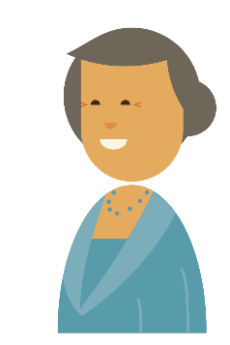
Do person-centered preferences translate into practice?
Observation studies of audiologist-patient interactions suggests that preference for patient-centred
interactions may not translate
into practice
Impact patient outcomes:
Hearing aid uptake
Patient satisfaction
Adherence to recommendation
Notes:
Do HCPs’ person-centered preferences translate into practice?
Observational studies looking at audiologist-patient interactions during actual clinical appointments showed that despite self-reported preferences towards person-centered care, HCPs had a tendency to interact with their patients biomedically.
This may negatively impact patient outcomes such as hearing aid uptake, patient satisfaction and adherence to recommendations.

Slide 9
Barriers to person-centered care
Assessments form a big part of ongoing hearing healthcare appointments and protocols
Uneven weighting on teaching and assessing person-centered skills compared with technical skills in audiology education
Perceived challenges when communicating with patients
Audiologists are more than just good technicians
It’s important to learn about person-centered communication skills
Notes:
A number of factors exist that may hinder the hearing care professional to enact in a person-centered manner.
In audiology:
You may have noticed that audiologists perform many assessments that require a substantial amount of technical skills. When audiology course coordinators were interviewed, it was acknowledged that more emphasis was placed on teaching and assessing technical competencies than person-centered interactions.
When audiology students were interviewed, they reported placing a greater focus on technical tasks such as performing a hearing test and often felt ill-prepared when communicating with patients.
Although technical skills are important, our scope of practice goes beyond just being good technicians. Hence, it is important to foster person-centered communication skills to build a therapeutic relationship with our patients.
English, K. (2005). AuD students' concerns about interacting with patients and families.
Meibos, A., Munoz, K., White, K., Preston, E., Pitt, C., & Twohig, M. (2016). Audiologist practices: Parent hearing aid education and support. Journal of the American Academy of Audiology, 27(4), 324-332.
Tai, S., Barr, C., & Woodward-Kron, R. (2018). Competing agendas and other tensions in developing patient-centred communication in audiology education: A qualitative study of educator perspectives. International journal of audiology, 57(4), 274-282.
Tai, S., Woodward-Kron, R., & Barr, C. (2018). Audiology Students' Perspectives of Enacting and Learning Clinical Communication: A Qualitative Interview and Video Reflexivity Study. American journal of audiology, 27(2), 219-230.

Slide 10
Communication can be tought and learned
Communication is a skill that can be taught and cultivated
Training can improve how we respond to patients’ emotions
Practice and individual feedback plays a key role in communication training
Notes:
Communication is a skill that can be taught and cultivated.
In the medical discipline, research has shown that doctors who have undergone person-centered communication training were better able to identify and handle their patient’s emotions than doctors without training.
Practice and individual feedback support the active learning of communication skills.
Throughout this module, students will be encouraged to participate in activities and provide feedback to one another to aid each other’s learning.
Aspegren, K. (1999). BEME Guide No. 2: Teaching and learning communication skills in medicine-a review with quality grading of articles. Medical teacher, 21(6), 563-570.
Levinson, W., Lesser, C. S., & Epstein, R. M. (2010). Developing physician communication skills for patient-centered care. Health affairs, 29(7), 1310-1318.
Lewin, S., Skea, Z., Entwistle, V. A., Zwarenstein, M., & Dick, J. (2001). Interventions for providers to promote a patient‐centred approach in clinical consultations. Cochrane database of systematic reviews, (4).
Smith, S., Hanson, J. L., Tewksbury, L. R., Christy, C., Talib, N. J., Harris, M. A., ... & Wolf, F. M. (2007). Teaching patient communication skills to medical students: a review of randomized controlled trials. Evaluation & the Health Professions, 30(1), 3-21.

Slide 11
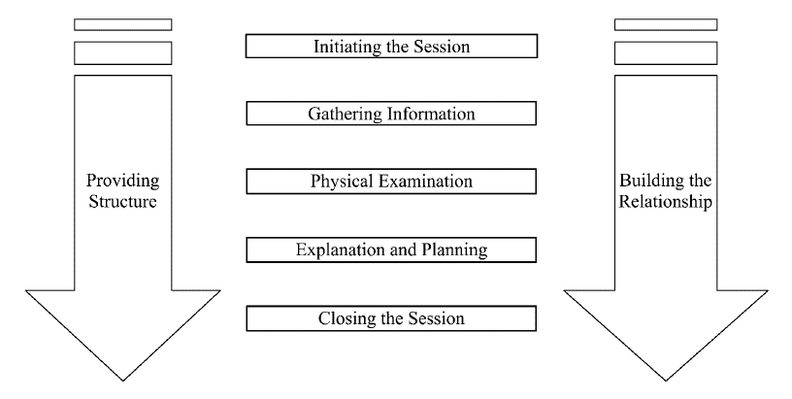
Calgary-Cambridge consultation guide
Kurtz, S., Silverman, J., Bensons, J. Draper, J.(2005). Marrying content and process in clinical method
teaching: Enhancing the Calgary-Cambridge Guides. Academic Medicine,78(8),802-809.
Notes:
You may recall the Calgary-Cambridge Guides introduced in the Time and Talk unit, that talk about how we can integrate clinical with communication skills during the medical interview.
The framework contains a sequence of interview tasks that begins with initiating the session, followed by gathering information, performing a physical examination, explanation and planning, and closing the session.
The Calgary-Cambridge Guides also highlight the importance of building the relationship throughout the appointment to develop trust and rapport.
Additionally, in any clinical appointment, having a structure will guide your patients’ expectations and give structure to the appointment.
The Calgary-Cambridge Guide’s comprehensive list of 71 communication processes are based on a medical setting and therefore may not all be applicable to all hearing care scenarios. Therefore, we will introduce The Four Habits Model to inform the key communication tasks that are relevant for audiology and speech language clinicians and transferable across different hearing care cases.
The Time and Talk unit of the University Course is in module 2 “The Audiologist’s Perspective”: https://idainstitute.com/tools/university_course/module_2/time_and_talk/

Slide 12
The four habits
These habits are based on empirical evidence from the medical literature.
Each habit includes descriptions of key communication tasks that are associated with positive patient outcomes.
1. Invest in the beginning
2. Elicit the patient perspective
3. Demonstrate empathy
4. Invest in the end
Notes:
The Four Habits are based on empirical evidence and synthesis of research on medical interviews. The key communication skills are clustered into four habits that are associated with positive patient outcomes. These habits are i) Invest in the beginning, ii) Elicit patient perspectives, iii) Demonstrate empathy, and iv) Invest in the end.
These habits are fundamental to interactions both within and outside hearing care, and offers a descriptive means to think about how clinical interactions are structured.
The Four Habits have been adopted as a teaching tool to guide feedback and assessment.
In subsequent units, we will use the communication tasks within the Four Habits across different hearing healthcare scenario.
Frankel, R. M., & Stein, T. (1999). Getting the most out of the clinical encounter: the four habits model. Perm J, 3(3), 79-88.
Krupat, E., Frankel, R., Stein, T., & Irish, J. (2006). The Four Habits Coding Scheme: validation of an instrument to assess clinicians’ communication behavior. Patient education and counseling, 62(1), 38-45.

Slide 13
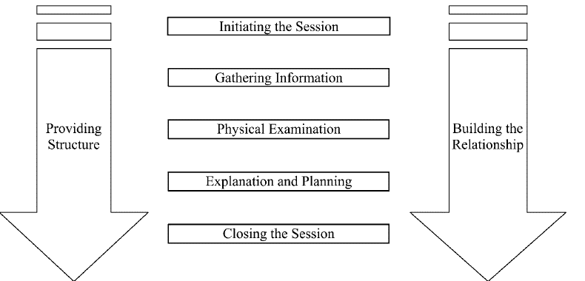
Calgary-Cambridge Guides
The Four Habits
1. Invest in the beginning
Create rapport quickly
Elicit patient concerns
Plan the visit with the patient
2. Elicit the Patient Perspective
Ask for patient’s ideas
Explore impact on patient’s life
3. Demonstrate Empathy
Be open to patient’s emotions
Discern empathetic opportunities
Express empathy
4. Invest in the end
Deliver diagnostic information
Provide education
Involve patient in making decisions
Complete the visit
Kurtz, S., Silverman, J., Bensons, J. Draper, J.(2005). Marrying content and process in clinical method teaching: Enhancing the Calgary-Cambridge Guides. Academic Medicine,78(8),802-809.
Frankel, R. M., & Stein, T. (1999). Getting the most out of the clinical encounter: the four habits model. Perm J, 3(3), 79-88.
Notes:
The communicative tasks in the Four Habits exhibit a number of overlaps with the Calgary-Cambridge Guides.
For instance, the first habit of Invest in the beginning contains the tasks: create rapport quickly, elicit patient concerns, and plan the visit with the patient. This shares similarity with Initiating the session in the Calgary-Cambridge guides of establishing patient rapport and identifying reasons for the consultation.
The second habit of Elicit the patient perspective focuses on gathering information from the patient. The third habit in demonstrating empathy sits within building the relationship in the Calgary-Cambridge guides. Finally, the fourth habit of invest in the end corresponds to the explanation of the diagnosis and closing the session.
Of note is that each habit also looks at providing structure and forms part in building the relationship with the patient.

Slide 14
Walking with our patients
Hearing loss can impact a person’s quality of life
What does it mean to walk with our patients through
their hearing journey?
Listen to the person’s story
Sharing experiences
Guiding them through the right path
Notes:
Having a permanent hearing loss can impact a person’s quality of life. To help our patients achieve better hearing outcomes, we have an important role in providing support and walking with them through their hearing journey. If we think about the person living with a hearing impairment, he or she is likely to go through different states of emotions as they walk through their hearing rehabilitation journey, such as denial, frustration, fear, acceptance, persistence and relief.
We can assist the person through their journey by listening to their story and getting an in-depth understanding of what they are experiencing and feeling. We can share experiences and guide them through the process.

Slide 15
Listening
The essence of effective communication
Set yourself aside
Reduce misunderstanding
Build rapport
Opportunity to understand and learn from our patient

Slide 16
Activity 1: Active listening
Listen carefully to the passage
There will be a question at the end
You are allowed to take notes on a piece of paper
if you wish
Notes:
Let’s put our listening skills into practice. This is a fun but tricky activity that will require you to listen very carefully.
Instructor: You are going to read them a long passage and at the end there will be a question for them.
Students are allowed to get a pen and paper to take notes if they wish.
Start by saying “You (i.e. they) are the bus driver and you stop at stop no.1. A woman with a red coat walks in and takes a seat at the second row from the back. Then at stop no.2, a man with a green bag sits across from her. At stop no.3, three students around the age of 14 climb out of the bus, and 2 old men get in. At the next stop, a boy with an ice-cream and his mother get in, and the woman with a red coat steps off the bus. At stop no.6, a family of five walks in and gets off two stops later. At stop no.7, a woman carrying a yellow umbrella gets on the bus. At stop no.8, a teacher carrying a suitcase sits at the front of the bus.”
At the end of the story, ask students ”What is the age of the driver?” Only the people who have really listened will be able to answer this.
There are also other similar listening games on this website:
https://plentifun.com/listening-games-for-adults.amp

Slide 17
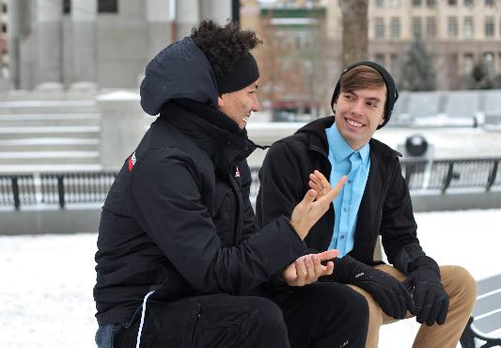
Activity 2: Being present
Really listening
Paying attention
Notes:
Note to instructor:
Spell out the CAPITAL writing below.
When we talk to someone, it is easy to get distracted about what we want to ask, or we think of something and want to interrupt them before the person has had a chance to finish what they are saying. So in this next activity, we want to emphasize the importance of being present and really listening to the person.
This is a fun game from Matt Abrahams, who is a lecturer at Stanford Graduate School of Business. In this game, I want you to “S-P-E-L-L E-V-E-R-Y-T-H-I-N-G Y-O-U S-A-Y T-O Y-O-U-R P-A-R-T-N-E-R”
Ok, to translate, you will get into pairs, and I want you to talk about something fun that you plan to do today, but you will do so by spelling it.
You have 1 minute each: S-P-E-L-L something fun you would like to do today. The person will also respond by S-P-E-L-L-I-N-G I-T.
After 2 minutes, O-K, W-O-N-D-E-R-F-U-L. P-L-E-A-S-E T-A-K-E Y-O-U-R S-E-A-T-S.
Ask students what they have noticed during that exercise. What did they have to do? Focus and listen! You cannot think ahead, therefore you are more present in the moment and in responding to the person.

Slide 18
Reflective practice
Person-centered communication requires
self-awareness
Reflective practice
Life-long learning
Notes:
A big part of communicating in a person-centered manner is to develop your own self-awareness in your own interaction with the patient.
Reflective practice is a way we can reflect on how the interaction went and find ways to improve it.
We will encourage you to perform self-reflective practices throughout these units to promote life-long learning.

Slide 19
Activity 3: Reflective exercise
5. What can you do next time
1. What happened?
4. What didn’t go so well?
2. How did you feel?
3. What went well?
Notes:
Adopting Gibbs’ Reflective Cycle (1988), we want you to think about an interaction you had with a patient that was challenging or didn’t go according to plan. It could be a patient getting confused with an explanation, or perhaps a very chatty patient.
On a piece of paper, describe what happened. Then describe how the situation made you feel. Now dissect the scenario and write down what went well and what didn’t go well. And finally, come up with strategies for what you can do next time to improve the situation.
Invite students to share their reflective statements and facilitate a class discussion around similar experiences, and strategies for improvement.
Gibbs, G (1988) Learning by doing: a guide to teaching and learning methods. Oxford: Further Education Unit, Oxford Polytechnic.

Slide 20
Reflective journal
Notes:
In the Ida toolbox you will find a tool for reflective practice, the Reflective Journal. The Reflective Journal will help you gain deeper insight into your clinical practice and to help you understand your own behavior.
By looking back at what occurred during an appointment, you can find ways to improve in future. Spend five minutes on reflection after each appointment, or as often as you can, and use the journal to document what happened.
Reflecting on your practice can help you become more person-centered, reduce stress in your workday, and become more time efficient with clients.
Prompts in the reflective journal:
-What happened in the session?
-Describe one or two things which went well in the session
-Why do you think they went well?
-How did you feel? Why do you think you acted as you did?
-Describe one or two things which went less well in the session.
-Why do you think they did not go well?
-How did you feel? Why do you think you acted as you did?
-What can you do differently next time?
https://idainstitute.com/tools/self_development/get_started/reflective_journal/

Slide 21
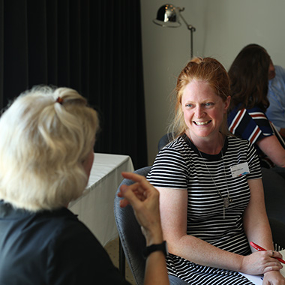
Activity 4: Role-play
Working in pairs:
Share the scenario described in your reflective statement
with your partner OR
Come up with a scenario you anticipate would be difficult
in the clinic.
Notes:
Ask the students to get into pairs and if they are comfortable, share with each other the scenario they described in their reflective statement. Alternatively, they can come up with a scenario that they anticipate would be difficult to handle in clinic.
Ask students to role-play the scenario described in their reflective statement (activity 3) or a different scenario they’ve encountered in the clinic.
Working in pairs, one student will be the clinician and the other will role-play the patient.
Discuss the case and build the patient’s character.
Have students use their own smart phones to record their interaction role-playing as a clinician. This is a baseline to be used in later modules.
Note to instructor
Refer to the associated instructor’s guide for details.
This activity will take approximately 30 minutes. If there is not enough time, students could do one role-play scenario in the classroom and the other scenario as homework. Please refer to the role-play rules and guidelines in Ida Time and Talk: https://idainstitute.com/tools/time_and_talk/get_started/#page2
Please ensure you cover the ground rules in the next slide before students start the activity.

Slide 22
Activity 4: Ground rules for a safe
learning environment
Ground rules
Confidentiality (what happens in the group stays in the group)
Observing is just as important as role-playing
Respect each other
Do not interrupt each other
The group takes joint responsibility for each role-play session
Give constructive, non-judgmental feedback
Freely ask for support from the group
Watch Group Rules – Creating a Safe Environment, by Dr. Leslie Jones
Notes:
Note: Students are more likely to share their experiences and feel comfortable in role-play situations when the learning takes place in a safe environment. It is important that we create this environment by setting ground rules early on in the learning session. This will help everyone feel at ease during role-play and feedback situations.
The ground rules are shown above. These ground rules also exist in a handout that should be given to the students and these ground rules should be discussed in detail. Please watch Dr. Leslie Jones discuss the ground rules in the video “Group rules – creating a safe environment”:
Video and hand-out can be found in the section of the University Course website called “videos and handouts”:
https://idainstitute.com/tools/university_course/videos_and_handouts/module_6/
Note to Instructor: This section provides suggestions on how you can effectively plan role-play sessions
Note to Instructor: Before moving on it will be important to ask the students whether they all agree to the ground rules above.

Slide 23
Upcoming sessions
Unit I:
Introduction
Unit II:
Invest in the beginning
Elicit the patients’ perspectives
Unit III:
Demonstrate empathy
Unit IV:
Invest in the end
Unit V:
Putting it all together

