Slide 1
IDA TELECARE: ENGAGING CLIENTS BEFORE & AFTER APPOINTMENTS FOR IMPROVED OUTCOMES
Cherilee Rutherford, AuD
Senior Audiologist, Ida Institute
Denmark
Notes:
In this section you will learn more about the Ida Telecare tools and learn how to use them in your work with persons with hearing loss and their families.

Slide 2
OVERVIEW
Tool Overview
Preparing patients for their appointment
2.1 Living Well Online
2.2 My Turn to Talk
2.3 Why Improve My Hearing
2.4 Tinnitus Thermometer
3. Everyday Life with Hearing Loss
4. Telecare tools for Teens & Tweens
5. Hands-on
6. Reflection
Notes:
The module will provide and overview of 6 online tools with descriptions, videos and demonstrations to help you get started with Ida Telecare. There will be opportunities to try out the tools, discuss with your peers & lecturers, and reflect individually and collectively about how you might implement these into clinical practice.
The module will start with a broad overview of the tools and the context it was developed from. It will then provide a description of the various tools that are available to help prepare patients for the first and follow-up appointments, and move into a description of additional tools that can be used to help support patients’ communication in daily living. We will introduce you to tools that have been adapted for teens & tweens, provide some activities that require you to use the tools yourself, and then facilitate some discussion around your thoughts & reflections about the tools.

Slide 3
IDA TELECARE – ONLINE RESOURCE FOR PATIENTS
An online, interactive framework for patients structured by the steps in the clinical journey
Tools and resources to help patients:
Prepare for appointments and important decisions
Involve their families
Live good lives with hearing loss
Notes:
Ida Telecare is an engaging, online platform that offers persons with a hearing loss easy-to-use tools and resources to help them prepare for appointments and successfully manage daily communication and important decisions related to hearing.
With Ida Telecare you, as a hearing care professional you will:
Extend your services beyond appointments in the clinic
Focus conversations and save time in the appointment
Increase motivation and satisfaction
Develop a long-term, trusting relationship and
Empower self-management
Here is a short animation explaining the Ida Telecare resource.
1.43 Mins.

Slide 4
IDA TELECARE OVERVIEW VIDEO
Notes:
Please watch the “Ida Telecare Overview” video.
Find the video on the “Module 5: Handouts and Videos” page: https://idainstitute.com/tools/university_course/videos_and_handouts/module_5/

Slide 5
THREE STEPS TO IDA TELECARE
1. Prepare for your First Appointment
Living Well
My Turn to Talk
Why Improve My Hearing
Tinnitus Thermometer
2. Prepare for Follow-Up Appointments
Living Well
My Turn to Talk
Tinnitus Thermometer
3. Everyday Life with Hearing Loss
Communication Strategies
Dilemma Game
Notes:
There are three steps in Ida Telecare for a person with a hearing loss to undertake.
The first, Prepare for your first appointment
Second, Prepare for Follow-Up
Third, Strategies for everyday life
1,Prepare for your first appointment:
Think about situations that you find difficult to hear and communicate in
Name the people it is most important for you to communicate with
Think about why it is important for you to improve your hearing
Talk to your partner or children about how well you communicate today
Think about what you will do if the hearing test is positive
2. Prepare for Follow-Up
What you can do to prepare:
Think about what it's like to wear the hearing aids
Ask the people close to you if they notice any changes
List concrete situations that you would like to improve
Think about what other support you might like to have
Write down your questions and prepare to discuss them in the appointment
3. What you can do right now:
Plan how to deal with important communication situations at the start of each day
Think about when communication is most easy and build on that
Tell people that you have a hearing loss and how they can support you
Involve your family and people close to you
Ask for help when you need it

Slide 6
PREPARING FOR APPOINTMENTS

Slide 7
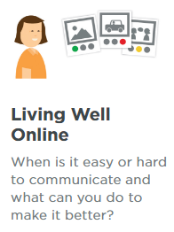
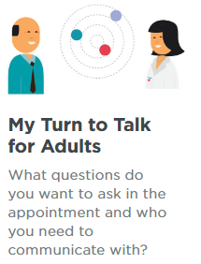
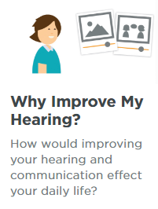
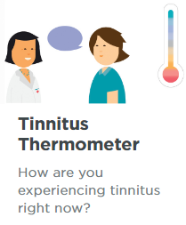
PREPARE FOR APPOINTMENTS
www.idainstitute.com/telecare
Notes:
There are 4 tools that can help your patient to prepare better for their hearing care appointments:
Living Well Online
My Turn to Talk
Why Improve My Hearing and
The Tinnitus Thermometer
Living Well is designed to help you explain where and when it is most important to communicate well. Choose different communication situations and describe how you manage them. This tool is aimed at anyone who has a hearing loss, or who thinks they may have a possible hearing loss and their spouse/close family members and friends.
My Turn to Talk can help you prepare for your next appointment and asks you to think about the people in your social network with whom you communicate on a regular basis. It also prompts you to think about your needs, hopes, concerns and any other topic that you would like to discuss with your audiologist, ahead of your first appointment. This tool can be used by anyone who has a hearing loss, or who thinks they may have a possible hearing loss and their spouse/close family members and friends.
Why Improve My Hearing can help you think about how important it is for you to improve your communication. You will choose situations where you have difficulty hearing, then answer a few short questions about how important it is for you to do something about it. This tool can be really helpful for someone who is feeling a little unsure about taking the next steps in managing a potential hearing and communication loss.
The Tinnitus Thermometer is a tool to help you explain to your hearing care professional how you’re experiencing tinnitus right now. It is aimed at persons for whom their tinnitus has become problematic and who would like to seek some professional advice about managing it.
Let’s explore each of these tools in further detail.

Slide 8
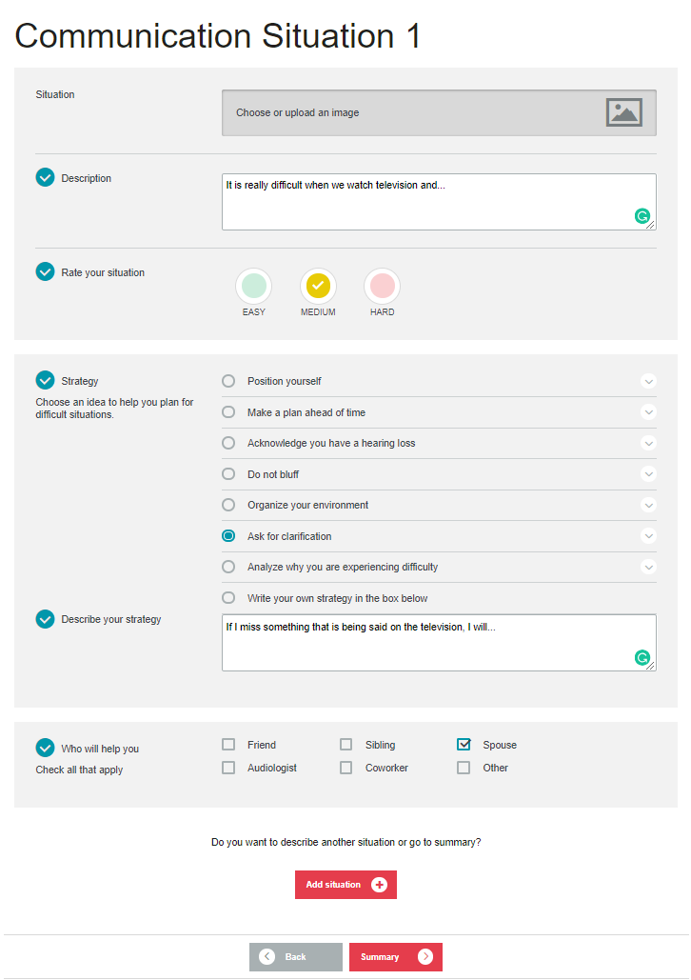
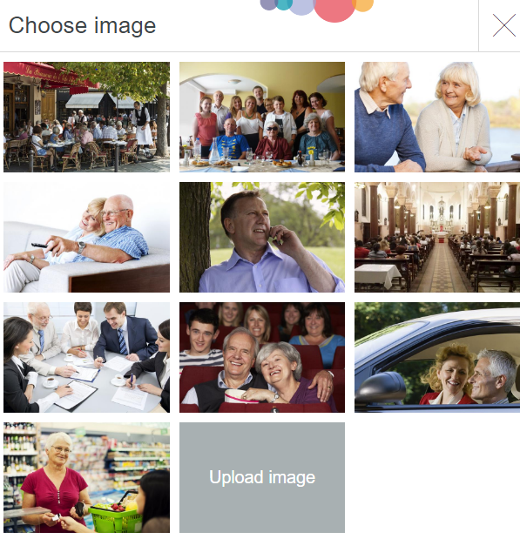
LIVING WELL ONLINE
Notes:
The Living Well Online Tool, helps a person with a hearing loss identify where and when it is most important for them to communicate well. They are asked to identify and describe 3 different communication situations. So they complete the tool, three times.
The tool can be completed at home, with someone close to them (such as a spouse) who might have a different point of view.
The session can be saved to the home computer and emailed to their hearing care professional. Or it can be printed it out to brought to the first appointment.

Slide 9
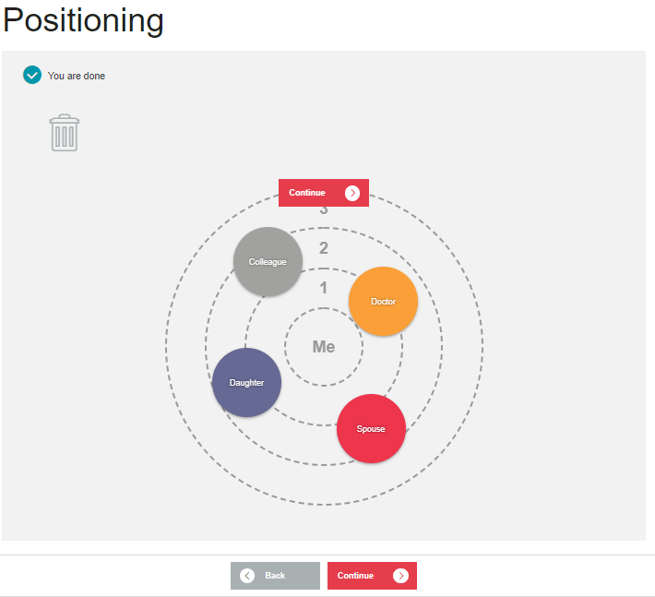
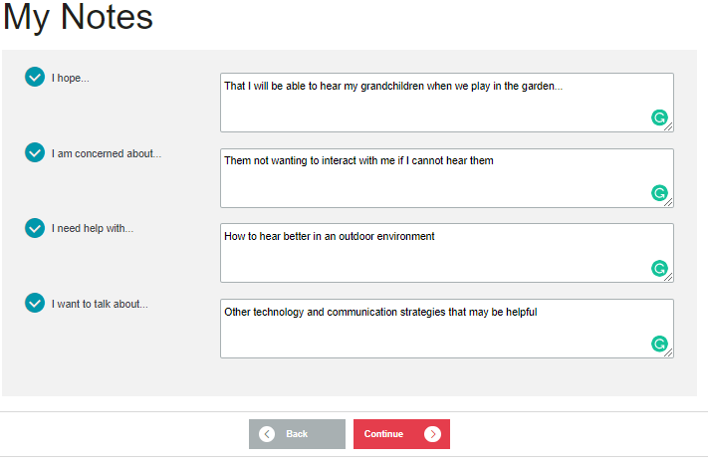
MY TURN TO TALK
Notes:
The second online tool is the My Turn To Talk tool.
This first part of the tool asks the person with a hearing loss to identify the most important communication partners, by placing the coloured circles on the rings. The closer they are to the “ME” circle, in the middle, the more important they are.
The second part of the tools asks them identify their needs and concerns so they can be addressed. The questions are designed to help the patient and their families to reflect on important aspects of their hearing & communication before they attend the appointment, e.g.
1. I hope …..
2. I am concerned about….
3. I need help with…..
4. I want to talk about…..

Slide 10
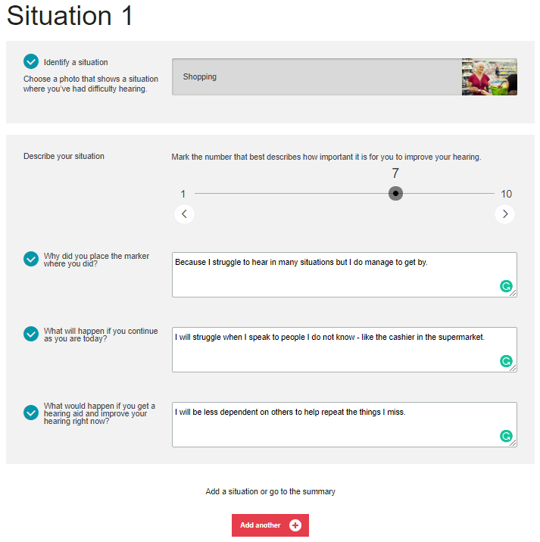
WHY IMPROVE MY HEARING?
z
Notes:
A third tool, which is used for preparing a person with a hearing loss for their first appointment, is - Why improve my hearing?

Slide 11
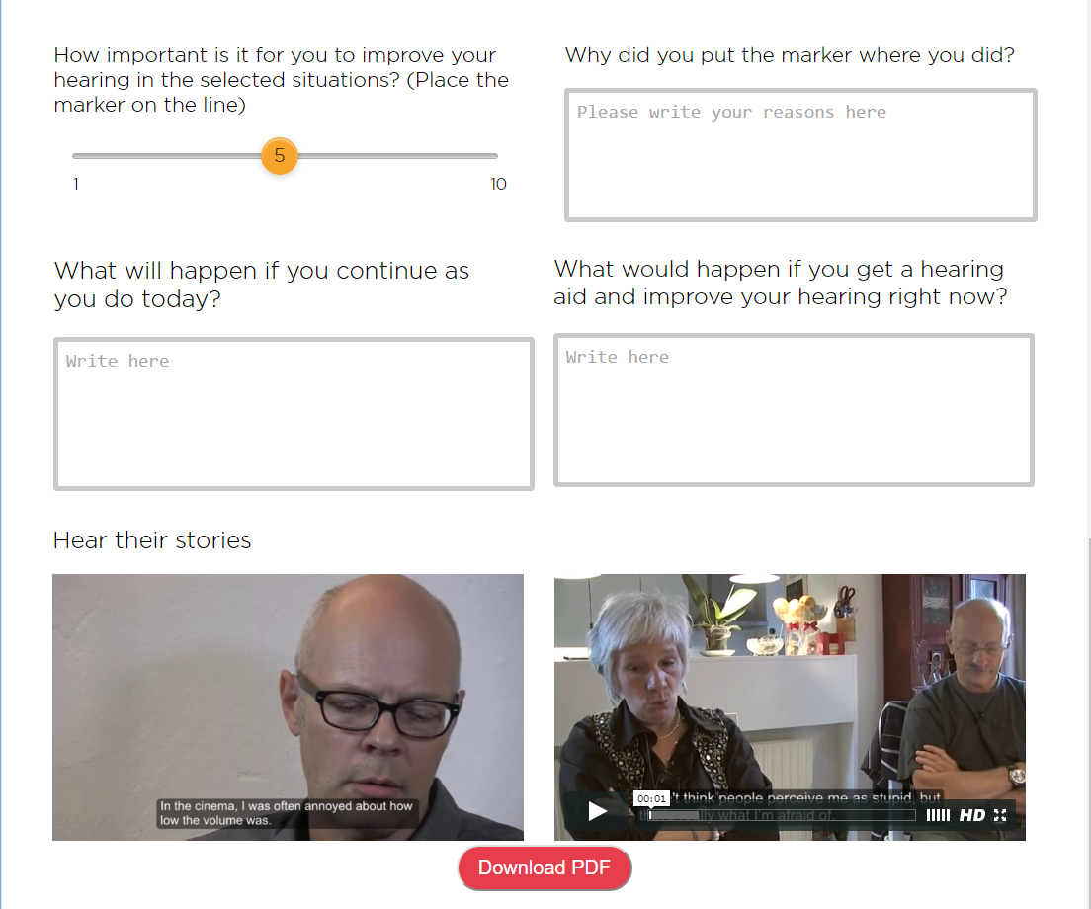
WHY IMPROVE MY HEARING?
Effective tips and tricks for successful communication
Listen to others with a hearing loss to hear how they apply the methods
Notes:
This tool can help the person with a hearing loss think about how important it is for them to improve their hearing.
When patients access this tool, they are asked to identify some situations that are important for them to hear well in. They can do this by selecting from a range of images that reflect that situation, or, they could upload their own. Following that, patients are asked to rate how important it is to them to improve their hearing / communication, and they are challenged to think about what would happen if things stayed as they are, or if they decided to get help with their hearing. These are adaptations of the Line & the Box tools that you may be familiar with already. By providing these questions before the first appointment, patients are already invited to think more deeply about their needs and allows for richer conversations with their hearing care professional in the first appointment.
It can be printed out and brought to their first appointment. It can also be emailed it to the hearing care professional before the appointment.

Slide 12
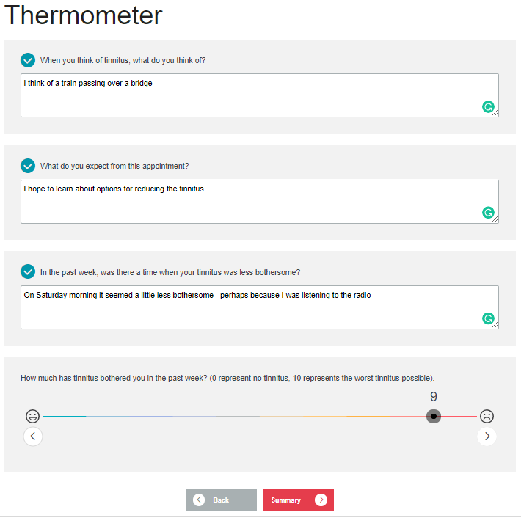
TINNITUS THERMOMETER
Notes:
The Tinnitus Thermometer is a tool to help patients explain how they are experiencing their tinnitus at the time of their appointment. It recognizes that patients might feel tinnitus and its effects differently from time to time, so it is important to start each session as a new beginning. This tool can be used in every appointment.
The rating scale used in the Tinnitus Thermometer is adapted from the Tinnitus Distress Rating Scale that builds on self-rating scales for pain such as the VAS.
The Tinnitus Thermometer tool consists of three questions to help you structure conversations and measure how patients are experiencing their tinnitus in a particular moment.
The first question is, “When you think of tinnitus, what do you think of? Say one or two words that describes how you feel about tinnitus.”
We know from psychology that people can retain only a few important beliefs about any one topic. If we can discover what a person's beliefs are, we can tailor our information and counseling to their priorities.
The second question is, “What do you expect from this appointment?”
This question is important because it focuses on the patient's needs in a specific moment. It also helps explore options and adjust expectations for the outcome of the appointment.
The third question is, “During the last week, was there a time when your tinnitus was less bothersome?”
If the patient cannot think of a situation, you might ask, “Is there anything you know of that might help with your tinnitus or helped someone else?”
The third question emphasizes what positive experiences, if any, have occurred in relation to your patient's tinnitus. Focusing on positive experiences can also contribute to strategizing what could help your patient in the future, whether it's psychotherapy, training in mindfulness, or sound therapy, among other options.
The questions can also help you find out how your patient experiences tinnitus: As a sound or as a physical and/or an emotional pain. This could be further explored by asking the patient to close their eyes and imagine what they see when they think of their tinnitus, and to asking them to describe what that looks like.

Slide 13
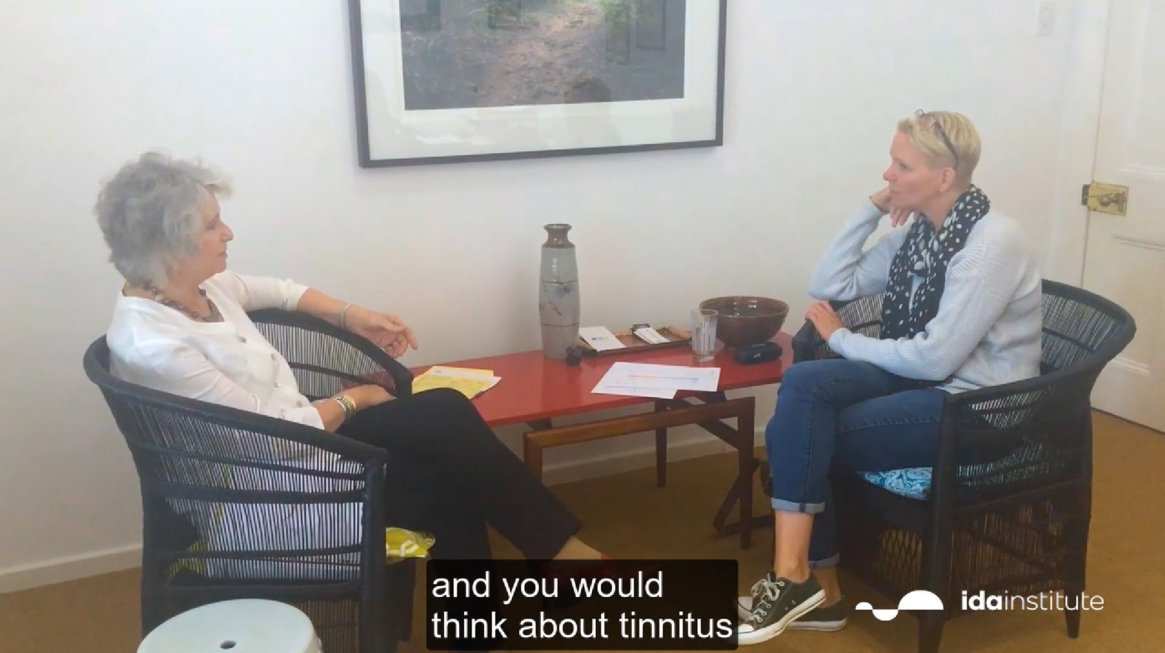
TINNITUS THERMOMETER DEMO
Notes:
In this video you will see a real-life example of how the Tinnitus Thermometer could be used in clinic with a patient.
Please watch the “Clinical Demonstration of The Tinnitus Thermometer” video.
Find the video on the “Module 5: Handouts and Videos” page: https://idainstitute.com/tools/university_course/videos_and_handouts/module_5/

Slide 14
THREE STEPS TO IDA TELECARE
1. Prepare for your First Appointment
Living Well
My Turn to Talk
Why Improve My Hearing
Tinnitus Thermometer
2. Prepare for Follow-Up Appointments
Living Well
My Turn to Talk
Tinnitus Thermometer
3. Everyday Life with Hearing Loss
Communication Strategies
Dilemma Game
Notes:
So far, We have covered the tools used in preparing for the first appointment and preparing for follow up appointments.
Another resource in the Telecare package, is everyday life with hearing loss strategies.
This tool provides five tips for managing conversations well in daily life.
There is also shared experiences from others with a hearing loss on what they do to communicate well.
The communication strategies resource, helps with what can be done right now.

Slide 15
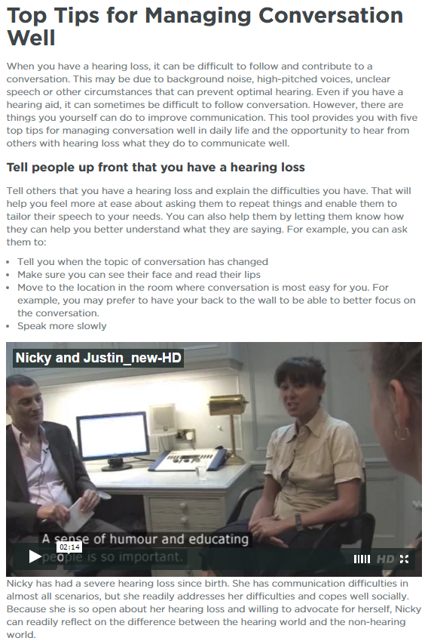
EVERYDAY LIFE WITH HEARING LOSS
Tips and tricks for managing conversation well in daily life
Patients can:
Read about five different communication strategies for improved communication in daily life
Watch videos of other patients sharing how they apply the strategies
Reflect on their daily dilemmas and how to solve them
Notes:
Everyday life with Hearing Loss is a set of resources that can be provided to patients by their hearing care professional to provide ongoing support outside the clinic.
The resource consist of helpful tips & tricks for managing conversations, as well as video reflections from other patients who have implemented these successfully and who are sharing their stories.

Slide 16
CONVERSATION MANAGEMENT STRATEGIES
Tell People you have a Hearing Loss
Keep up with Conversation
Plan your Day
Include you Partner
Join a group
Go to the place ahead of time so you know the environment
Ask others who have been there before for advice
Ask for a table in the quietest part of the restaurant when you make the reservation
Think about where at the table you want to sit to hear best
Example for: Plan your Day
Notes:
In this resource, there are 5 example areas in which the person with a hearing loss can review to help their own experience.
Tell People You Have A Hearing Loss
Strategies include:
Tell you when the topic of conversation has changed
Make sure you can see their face and read their lips
Move to the location in the room where conversation is most easy for you. For example, you may prefer to have your back to the wall to be able to better focus on the conversation.
Speak more slowly
2. Keep up with conversation
Strategies include:
Ask the person to repeat what they said using other words
Let the person know which bits you did get and which you did not
Check that you have understood by repeating their points
Watch the person’s body language, face and gestures to help you
3. Plan your day
Strategies include:
Go to the place ahead of time so you know the environment
Ask others who have been there before for advice
Ask for a table in the quietest part of the restaurant when you make the reservation
Think about where at the table you want to sit to hear best
4. Include your partner
Strategies include:
Tell your partner when you find it most easy to communicate with them and why
Ask your partner when they find communication with you most easy
Discuss what you can do together to improve communication
Talk about how your partner can support you in large groups or background noise
Ask your partner how your hearing loss affects them
5. Join a group
Strategies include:
Explore possible technologies and how to use them
Manage communication in places with a lot of background noise
Tell others that you have a hearing loss
Invite your friends and family to support you
Highlight example.

Slide 17
PLAN YOUR DAY
Notes:
Please watch the “John is strategic about coping with his hearing loss” video.
Find the video on the “Module 5: Handouts and Videos” page: https://idainstitute.com/tools/university_course/videos_and_handouts/module_5/
In this video……
John has had a severe hearing loss for many years and got cochlear implants late in life. This has improved his hearing and made it easier for him to communicate.
As a lawyer, he plans his day so that he can be sure to understand what his clients are saying.
Here he talks about examples in how he plans for his hearing loss when purchasing an office space and day to day meetings.
While watching this video, reflect on your own experiences in providing advice to a person with a hearing loss.
2.20 mins.

Slide 18
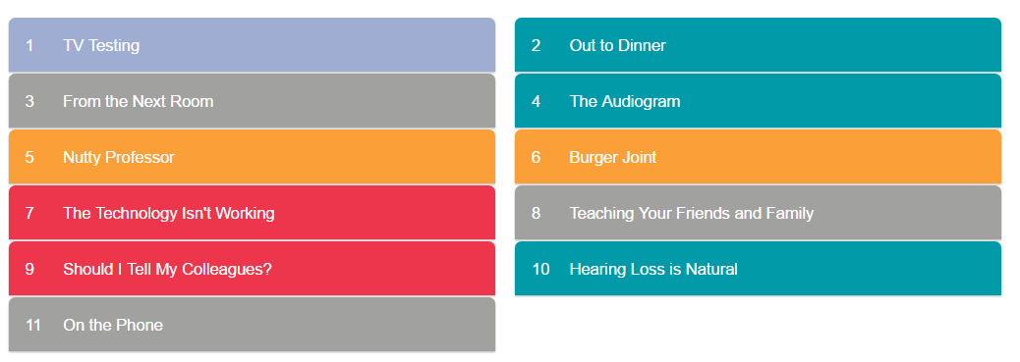
DILEMMA GAME
Notes:
The Dilemma Game is a series of cards that describe possible challenging hearing scenarios for people of different walks of life. There are three possible solutions for each situation, with the understanding that there might not be a perfect solution.
With no right or wrong answers, the Dilemma Game encourages reflection, critical thinking, and strategy to make communication easier for you and the important people in your life.

Slide 19
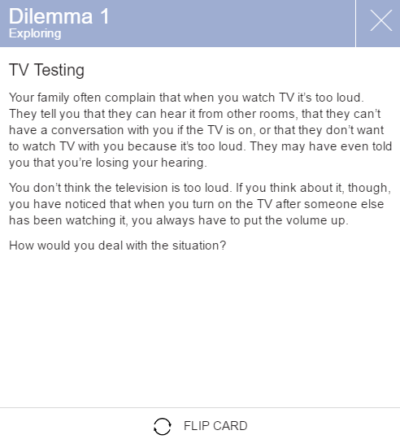
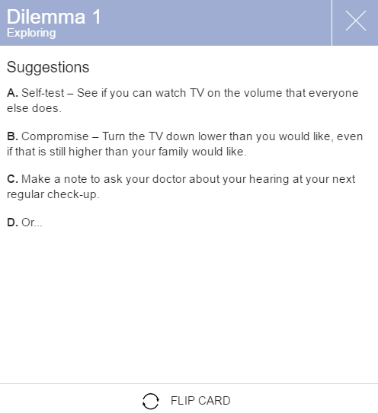
DILEMMA: TV TESTING

Slide 20
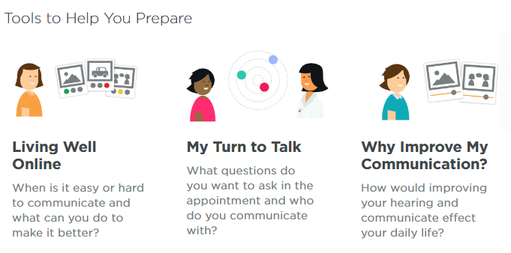
IDA TELECARE FOR TEENS AND TWEENS
Notes:
The Ida Telecare tools have also been adapted to suit teens & tweens. The tools are intended to help young people with hearing loss to get ready for their next appointment, make sure that they discuss the things that are most important to them to help them communicate better in daily life, with no time wasted on unrelated topics.
These tools offer a way for teens & tweens to organize their thoughts about their successes and challenges with their hearing loss. This will help ensure that their needs and concerns are taken care of. Their answers will also help the audiologist so that they can recommend the best treatment, whether that's new technology, communication strategies, or additional support from family, teachers, and friends.
The tools work in the same way as the adult looks that we explored previously, however, the examples and images have been adapted to reflect issues that apply to teens & tweens.

Slide 21
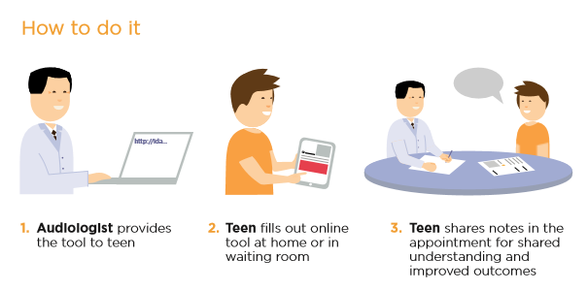
USING THE IDA TELECARE TOOLS WITH PATIENTS
Notes:
Explain the process as per slide.

Slide 22
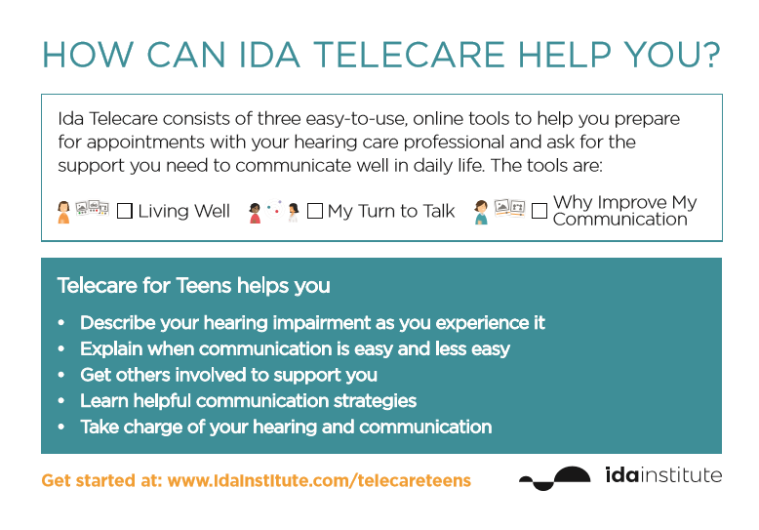
SHARE TOOLS VIA E-MAIL OR POSTCARD

Slide 23
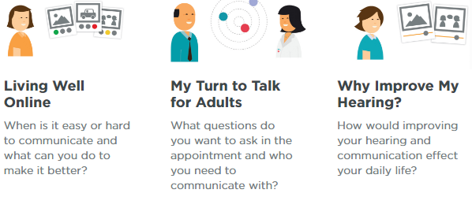
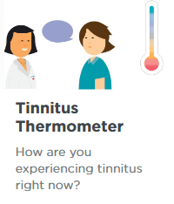
TRY OUT THE IDA TELECARE TOOLS
Go to: www.idainstitute.com/telecare on your smartphone
Choose ”Prepare for first appointment”
Select an Ida Telecare tool and try it out
Notes:
Activity – 15 mins

Slide 24
ROLEPLAY AN APPOINTMENT
Roleplay:
Turn to the person next to you and decide who will be the patient and the audiologist
Pretend to have an appointment based on your notes from the tool
Notes:
Activity

Slide 25
DISCUSSION
How might you use the Ida Telecare Tools in your daily practice?
Discuss with the person next to you
Notes:
Discussion – 15 mins

Slide 26
PERSONAL REFLECTION: MY IDA MOMENT

Slide 27
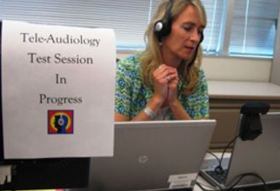
MY IDA MOMENT
How can telehealth help change and support your practice?
Notes:
Reflection – 10 mins. Written or Discussion.

