Slide 1
TELE-AUDIOLOGY: A RECIPE FOR SUCCESS
Frances Lockhart

Slide 2
LEARNING OBJECTIVES
Goal:
To investigate which “ingredients” are needed to successfully implement tele-audiology in a modern audiology clinic or practice.
In order for a tele-audiology or tele-health service to be truly person-centered, effective, efficient, and manageable there are many factors that need to be considered prior to incorporating this style of care into a clinic.
Notes:
Goal:
To investigate which ‘ingredients’ are needed to successfully implement tele-audiology in a modern audiology clinic or practice.
In order for a tele-audiology or tele-health service to be truly person-centered, effective, efficient, and manageable there are many factors that need to be considered prior to incorporating this style of care into a clinic.
We will investigate each of these factors separately and then develop a plan to implement tele-audiology in your local area in the last section.
In this section we aren’t trying to solve all of the problems or acquire the things that we need to have in order to implement tele-audiology, the method of this will come later, this section is to explore what is needed, so don’t get overwhelmed with detail, let’s just gather the information at this stage.
*Distribute the ‘Tele-audiology investigation guide‘ document before progressing. Each student should keep it available for the remainder of this section as they will be partly populating it as the presentation goes.

Slide 3
INGREDIENT 1: PATIENT FACTORS
Things to consider:
What do your patients want from you?
How do your patients currently get access to your services?
How do they currently access their other health care services?
What stage of the Circle are most of your patients and potential patients at currently?
Notes:
The most important part of person-centered care is the patients that we see, so this is the first ingredient that needs to be explored. There are the patients you currently see, and the group of patients who aren’t yet seeing an audiologist or audiology service, but have hearing loss, tinnitus, or other communication difficulty, and would benefit from your support. These are the patients and potential patients who are at the heart of WHY we provide our services and we want to make sure any service provided to them addresses those issues that improve the patient experience and provide it in a way and at a time that suits them.
So the attributes of these patients is the first thing that needs to be investigated. There is a fair bit of information gathering that needs to be done prior to implementing a tele-audiology service and every clinic will be different. Here are some things that you may want look at and consider as the first ingredient. You can and should however add as many others as you can, even if you don’t know the “right” answers yet.
Things to consider:
What do your patients want from you?
(What type of services do you currently offer? What have they asked for?)
How do your patients get access currently to your services?
(Do they drop by, do they ring do they check out your website or get referred from others, etc?)
How do they currently access their other health care services.
(Do they drive to appointments, do they have tele-health appointments already with other specialists, etc?)
What stage of the Circle are most of your patients and potential patients at currently?

Slide 4
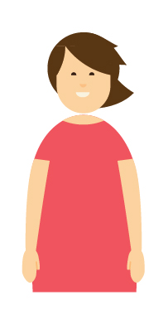
INGREDIENT 1: PATIENT FACTORS
What type of technology do your patients or potential patients currently have access to?
How often do they use these and other technology?
How far do your patients need to travel in order to see you face-to-face?
How is the age group of your patients broken up? What are the other demographics?
Notes:
What type of technology do your patients or potential patients currently have access to?
(Aid types/internet/smart phones/apps/laptops etc.)
Some hearing aid manufacturers also now have tele-services built into their hearing aids that can be access via an app. Is this something already available to your patients?
AND how often do they use these and other technology(daily/weekly/monthly)?
How far do your patients currently need to travel in order to see you face-to-face?
How is the age group of your patients broken up? What are the demographics? ( Infants/children/under 65 years/over 65 years etc.)

Slide 5
INGREDIENT 1: PATIENT FACTORS
Activity:
Fill in the Investigation Guide section labeled: “Patient wants and needs”
Notes:
Fill in what you can in the investigations sheet section “Patient wants and needs” and then consider how you might find out what else you need to know about your patients. Add in as many extra rows in the spreadsheet as you like as you think of other factors that need to be considered.
Consider a survey to your patients to find out some of this information, maybe via surveymonkey (free) or a paper survey to gather the rest of the information. National census data can also tell you information about your local area. If these opportunities are not available, an educated guess based on your knowledge of your patients is also a good start.

Slide 6
INGREDIENT 2: PROVIDER FACTORS
What are your goals re: providing a tele-audiology service?
What additional skills do you and/or your staff require in order to implement your goals?
Where are you located, and do you have sufficient equipment?
Notes:
Now that you are aware of what your patients need from you, you can start to develop some goals for your practice around what type and style of services you can provide. Think about all of the stages of the Circle and consider how you might be able to “fill in the gaps” to cover some or all of the stages of change, or enhance your current service by using tele-audiology. The knowledge that you discover from ingredient 1 (patient factors) will also guide you as to what your first few goals should be.
You may also want to consider those additional skills, such as learning to use equipment, creating/editing a website or social media page, or starting a blog.
Things to consider:
What are your goals in regards to providing a tele-audiology service?
i.e.: Do you need to develop a more user friendly or interactive website? Do you want to start offering appointments using tele-audiology or an SMS battery order service, etc.?
What additional skills do you or your staff require to implement your goals?
Examples might be: learning how to update a website; use a video otoscope or connect up a webcam.
Where are you located? Is it appropriate? Do you need more equipment?

Slide 7
INGREDIENT 2: PROVIDER FACTORS
Activity
Some research suggests that provider attitude can be an important aspect of successful tele-audiology implementation.
Read these articles to help generate your ideas and identify your concerns:
-Provider attitudes to tele-audiology
-A review of telehealth applications in audiology
Examine your own beliefs and experience with tele-audiology.
How do you feel about implementing a tele-audiology service?
What are you most concerned about?
Think about what could go wrong if this doesn’t work?
What could go right if it does?
Notes:
Access the articles either directly from the links, or via your university/ institution:
https://www.tandfonline.com/doi/abs/10.3109/14992027.2014.921736
https://www.liebertpub.com/doi/abs/10.1089/tmj.2009.0111

Slide 8
INGREDIENT 2: PROVIDER FACTORS
A focus on perspective taking: Perspective taking is the ability to understand a situation from the perspective of another person. It involves placing yourself, in your mind’s eye, in the physical or emotional position of the other person.
Perspective taking and theory of mind
Notes:
Perspective taking is the ability to understand a situation from the perspective of another person. It is complementary to emotional intelligence but often is more useful. It involves placing yourself, in your mind’s eye, in the physical or emotional position of the other person
For further reading on perspective taking and Theory of Mind: http://psycnet.apa.org/fulltext/2014-44745-002.html
THE BEHAVIOR ANALYST TODAY VOLUME 5, ISSUE NO. 1, 15
Perspective-Taking and Theory of Mind: A Relational Frame Account, by Yvonne Barnes-Holmes, Louise McHugh, & Dermot Barnes-Holmes at the National University of Ireland, Maynooth

Slide 9
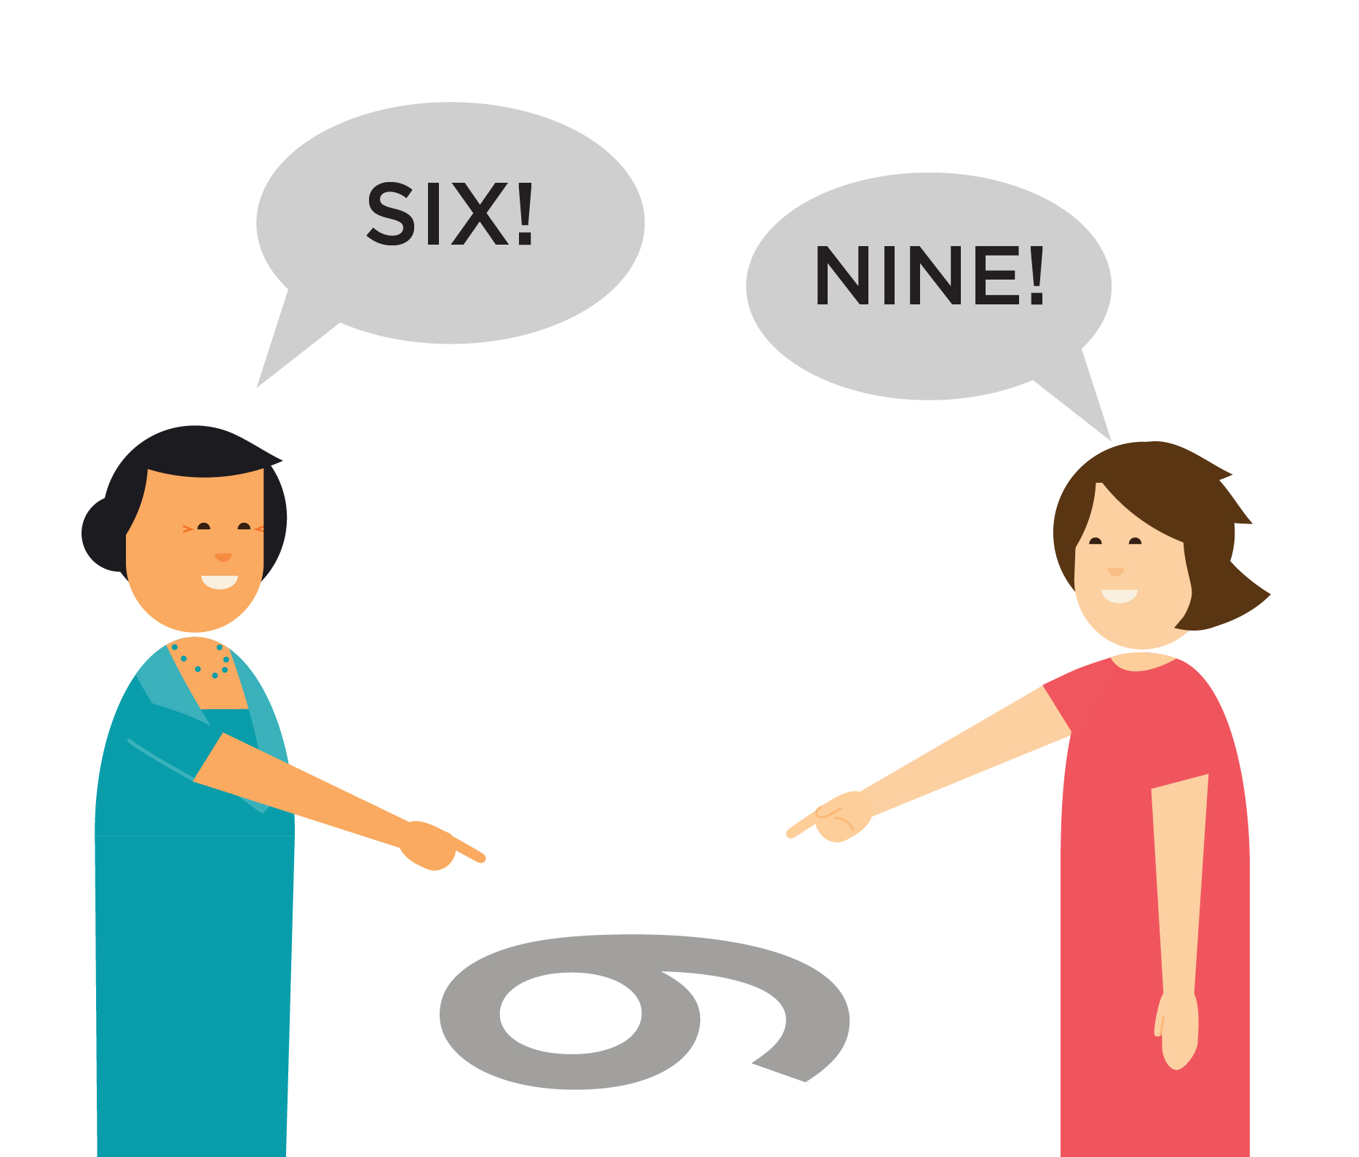
INGREDIENT 2: PROVIDER FACTORS
Perspective taking is an essential skill
“Perspective-taking skills can help bridge cultural divides within the workplace, including divides between younger and older workers. They also can help build understanding between patients and carers.”
-W. Lewis Johnson, Ph.D
Notes:
Anthropologists, ethnographers, and other social scientists have identified perspective-taking skills as critical for promoting understanding between people of different cultural backgrounds. Perspective-taking skills can help bridge cultural divides within the workplace, including divides between younger and older workers. They also can help build understanding between patients and carers.
-From “To Attract and Retain Millennial Talent, Develop Your Perspective Taking Skills,” by W. Lewis Johnson, Ph.D. : https://www.alelo.com/2015/10/to-attract-and-retain-millennial-talent-develop-your-perspective-taking-skills/

Slide 10
INGREDIENT 2: PROVIDER FACTORS
The ability to take the perspective of another individual is considered by most mainstream cognitive and developmental psychologists to be a complex and critical set of cognitive abilities.
In tele-audiology we take this skill to the extreme as we need to place ourselves in the physical as well as cognitive space of our patients.
See: L. Mchugh, Y. Barnes-Holmes, & D. Barnes-Holmes
Notes:
This is all based on a modern behavioral approach to human language and cognition called Relational Frame Theory. According to this approach, the relational frames of I-YOU, HERE-THERE, and NOW-THEN are central to the development of complex perspective-taking.
For example, two individuals seated opposite each other have alternative perspectives on the same picture (e.g., of an elephant) placed in front of them. One individual will see the elephant the right way up, whereas the other (seated opposite) will see the elephant upside down
Obtain and read a copy of the following article for your reference:
[The Psychological Record, 2004, 54, 115-144 PERSPECTIVE-TAKING AS RELATIONAL RESPONDING: A DEVELOPMENTAL PROFILE LOUISE MCHUGH, YVONNE BARNES-HOLMES, and DERMOT BARNES-HOLMES National University of Ireland, Maynoot]
https://opensiuc.lib.siu.edu/cgi/viewcontent.cgi?referer=https://www.google.dk/&httpsredir=1&article=1224&context=tpr

Slide 11
INGREDIENT 2: PROVIDER FACTORS
Think about the user experience:
What does the service look like from the patient’s perspective? Can you put yourself in your patient’s ‘shoes’ and imagine what their experience is like?
Is it easy or hard to access and engage with your service?
Do you need additional staff?
Technology assistants in order to operate the remote equipment in-person with the patient
A website designer or app developer to help you build the functionality that you require?
Do existing staff need to learn new skills?
Notes:
Additional skills such as high levels of perspective taking and clear speech by the clinician are essential for a tele-audiology service to be successful. Do you have enough staff or the right staff in order to provide this service?
Things to consider:
Think about the user experience-- what does the service look like from the patients perspective? Can you put yourself in your patients ‘shoes’ and imagine how they would find the service? Is it easy or hard for them to access and engage with the service?
Do you need any additional staff?
Examples might be: Technology assistants in order to operate the remote equipment and be available for patients at the site where the clients attend
You may need to employ a website designer or app developer to help you build the functionality that you require. Maybe you can just use existing staff that you have, and teach them new skills?

Slide 12
INGREDIENT 2: PROVIDER FACTORS
Are your current premises suitable for providing a tele-audiology service?:
Do you need to locate and arrange a remote site? Do you need additional rooms or facilities?
Is your current setup comfortable enough for a clinician to spend extended periods of time at the computer?
Do you have the right (or enough) equipment?
Consider: a webcam, an additional set of clinical equipment for the remote site, a video otoscope
Do you have the right type of hearing aids with features that allow you to adjust them remotely?
Notes:
If you want to start providing a service at a site you currently only visit occasionally or that has no service currently, you may need to consider how the patients will arrive and get transport to that site. Can you utilize other health services clinics in the area? Is your current clinic set up for you to be able to sit at a computer monitor for extended periods of time to provide remote services?
Do you have a monitor, webcam, and a video otoscope for the remote site? Consider what you need at your local site and at your remote site.

Slide 13
INGREDIENT 2: PROVIDER FACTORS
Activity:
Fill in the “Service provider considerations” section of the Investigation Guide
Notes:
Part of this section may relate to other issues such as IT or equipment as well, so think about what you currently have here and what else you might need. It doesn’t matter if it repeats itself, that just shows that it is a vital part of the recipe.

Slide 14
INGREDIENT 3: STAKEHOLDERS
Things to consider:
Who else can you work with that may need access to some or all of these technologies/services?
Do you need to work with other hearing service providers or manufacturers in order to provide the best services? Could you coordinate services or share resources?
Are there data security or patient security issues with other providers? Are there IT firewalls that prevent you from web calling in to see patients at their sites?
Notes:
Ingredient 3: STAKEHOLDERS
Consider where your services are really needed and provide them via tele-audiology. Maybe your specialty services are unique in a particular remote location. For example, maybe a particular hospital provides diagnostic services, but not rehabilitative services. Maybe a health care service in a particular town sees babies, but not older children or adults, etc. These are potential collaborators.
Things to consider:
Who else do you work with that may need access to some or all of these technologies or services. (i.e.) hospitals schools/ other providers etc.
Other hearing service providers or manufacturers, do you need to work with them to provide the best services. Could you co-ordinate services or link into their resources?
Are there data security or patient security issues with other providers (esp. say hospitals or colleges). Are there IT firewalls that prevent you from web conferencing in to see patients at their sites.
This is such a highly variable aspect that only asking and possibly trialing services with potential partners or collaborators will answer all of your questions.

Slide 15
INGREDIENT 3: COLLABORATIONS & PARTNERSHIPS
Activity:
Fill in the “Collaborations and Partnerships” section of the Investigation Guide
Notes:
You may need to contact your stakeholders or do some investigations around the type of infrastructure or services they provide if relevant. You may not need this section at all if you work alone and don’t co-ordinate your activities or services with other healthcare or audiology providers.

Slide 16
INGREDIENT 4: GOVERNMENT & LICENSING REQUIREMENTS
Things to consider:
Would your tele-audiology service be available within the same state/province/territory/country, or across lines?
Are there state-funded or government-funded services available to support your service?
Are there audiology-specific licenses that you need in order to work within other states/provinces/territories/countries?
Are there tele-health specific licensing requirements for your local state or territory?
Notes:
This step may require communicating with the government or professional bodies section in the area that has tele-health governance and licensing responsibility in order to find out if there are any restrictions or compliance requirements. Start by doing an online search for tele-health in the state/territory you will be working in.
Things to consider:
Would your tele-audiology service be available within the same state/province/territory/country, or across state/province/territory/country lines?
Are there state-funded or government-funded services available to support your service?
Are there audiology-specific licenses that you need in order to work within other states/provinces/territories/countries?
Are there tele-health specific licensing requirements for your local state or territory?

Slide 17
INGREDIENT 4: GOVERNMENT & LICENSING REQUIREMENTS
Activity:
Fill in the “Government/ licensing requirements” section of the Investigation Guide

Slide 18
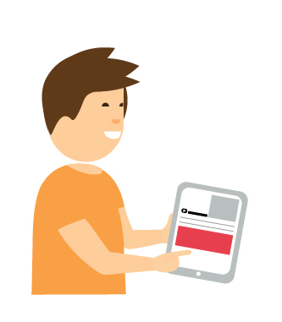
INGREDIENT 5: IT
Things to consider:
Internet and telephone coverage
Cable/ADSL or 4G and 5G services are optimal
Compatibility of your devices
Additional IT applications or software?
Additional equipment?
Notes:
Things to consider:
Internet and Telephone coverage. Some more remote areas don’t have internet or even quality phone coverage. If they do, it may be intermittent or only available o certain days. Others have mobile but not landline services. Cable/ADSL or 4-5G services are optimal.
Software needed: What additional IT applications might you need in order to provide your service? These might be web conferencing software/apps/ desktop sharing requirements. Some of these may require you to purchase user licenses. Who will maintain these and ensure versions are updated?
What technology do your patients have; is it compatible?
What technology do your patients have and is it compatible?
Is your website or service compatible to be viewed and accessed on those devices? Consider what type of internet and communication services your patients have access to. This is key to ensuring your service is compatible with what is available to your patients. For instance, accessing certain apps or even websites isn’t always possible on every type of device, as it depends on what version of the device and operating system is used (IOS vs Android for instance). Maybe you can do a web conferencing session on a PC but not on a Mac? Maybe your patients only have smart phones but not a computer? Whichever you choose has to match up with what your patients can access.
What additional equipment might you need? (webcams, video otoscope, additional clinical equipment etc.)
Sometimes you may have to ensure a full set of clinical equipment is available at the remote site in order to provide the service. Is this something you could transport back and forth, or would it be better to have it secured at the remote site? If you are seeing the patients at their home they may need a specific hearing device that has remote adjustment capability, or it could be that just video such as FaceTime or Skype is enough to do some auditory training and discussion.

Slide 19
INGREDIENT 5: IT
Activity:
Fill in the “IT Considerations” section of the Investigation Guide
Notes:
This is probably the most essential part of this process to ensure that you understand what additional skills and software/hardware are required.

Slide 20
REVIEW YOUR INVESTIGATION GUIDE
Now have a look at your nearly-complete Investigation Guide and add in any extra considerations you have thought of throughout the course.

