Slide 1
Health Literacy and Hearing Healthcare
Barbara E. Weinstein, Ph.D.
Jennifer Gilligan, B.A.
Samantha Morgan, B.A
Deborah von Hapsburg, Ph.D.

Slide 2
GOALS
Goal 1: To define health literacy and introduce how low health literacy is linked to patient outcomes
Goal 2: To examine how health literacy impacts patient behaviors such as:
self management
behavior change and internal motivation
Self efficacy
Goal 3: To introduce methods clinicians can use to assess health literacy across multimodal domains
Goal 4: To learn the importance of using appropriate health literate patient materials, including counseling and decision aids, across multimodal domains for diverse populations
Notes:
Today we will introduce the topic of health care literacy. In the previous lecture on patient-centered care, the biopsychosocial model of medicine was introduced as one that is more consistent with person-centered care. We defined person centered care as one in which the physician or healthcare provider interacts with the patient in a way that they can elicit the patient’s story, understand the patient perspective, and together with the patient establish goals and plans to address the patient’s needs. From this perspective one of the key factors in practicing person-centered care is establishing clear communication, and verifying that the patient has understood what the healthcare provider is communicating. That requires that we understand something about health care literacy.
In this lecture we will consider definitions of health care literacy. We will define health care literacy and also will discuss how health literacy impacts patient behaviors such as self management, behavior change, and self-efficacy.
Additionally, we will introduce methods clinicians can use to assess health literacy across different domains.
And finally we will discuss the importance of having clear materials, including counseling aids and decision aids, so that our treatments are understood by the patients we serve, and so that the patient is maximally in control of their own health care.

Slide 3
Single Item Literacy Screener (SILS)
How often do you need to have someone help you when you read instructions, pamphlets or other materials provided by your doctor or pharmacy?
Always
Often
Sometimes
Rarely
Never
Modified from:http://champ-program.org/static/SILS_Tool.pdf
Notes:
Today we are going to be talking about health literacy. Before we begin discussing the specifics on health care literacy, we would like to have have each student take this literacy screener, called the Single Item Literacy Screener (SILS).
Please have the student answer the question on the slide: How often do you need to have someone help you when you read instructions, pamphlets or other materials provided by your doctor or pharmacy. The student may answer Always, Often, Sometimes, Rarely, Never.
If a student answers with either “never” or “rarely”, they “pass”, and this means they don’t need modifications.
If a student answers with either “always” “often” or “sometimes” this is considered a positive result and suggests that health care literacy skills are such that they will require a clinician to modify the way in which they present information. This is the results we may be more likely to see in patients.
It should be noted how quickly this screening was performed. Please have the students keep this information for themselves and have them reflect on how they could incorporate this in their daily clinical routines. We will refer back to this screener throughout the lecture and reflect on its usefulness.

Slide 4
Class Activity
Reflect on a time in which you visited a physician or healthcare provider and your diagnosis, test results, or treatment plan was discussed in unfamiliar terms.
What factors contributed to you not understanding what the health professional communicated?
How did that make you feel? And why?
Notes:
Before we get into the lecture, we will explore the patient mindset by reflecting on our own personal experiences with health care, and a possible mismatch in communication between patient and provider.
Please get into groups of two or three and reflect on a time in which you visited a physician or a healthcare provider and the health care practitioner (Physician, Surgeon, Nurse, Dentist, etc) discussed your diagnosis, test results, or treatment plan in terms with which you were not familiar.
Have students write on sticky notes or on a whiteboard, how this experience made them feel, and what factors contributed to that feeling.
To help students begin thinking about this have them consider any of the following scenarios:
Consider a time in which you received written test results that used technical medical jargon with which you were not familiar.
Consider a time in which the doctor discussed a treatment plan in terms in which you did not understand, either verbally or in written format.
Have students answer the following questions about their experience:
How did his experience affect your: (a) ability to understand your own health issue, (b) state of mind around the health issue (how did it make you feel?), (c) your own level of trust for the healthcare practitioner, and (d) your compliance with doctor recommendations?
Finally, consider your SILS screening result in the context of the experiences you have had. Would you adjust your SILS answer based on this exercise?
Please have the student discuss their answers and share them with the class. This activity is meant to engage all of the students by sharing personal experiences of medical encounters in which person-centered care was not practiced because shared meaning was not established between patient and practitioner.

Slide 5
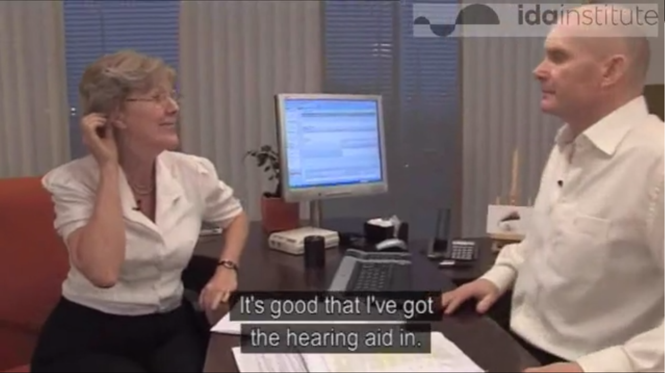
Ethnography/Re-Enactment
Notes:
Now lets consider a case in our own field of study. This video re-enactment shows the interaction between an older patient, Sophia, and her audiologist, James in January of 2009. In this interaction we can see that the patient is returning to the audiologist approximately 5 months after having been fit with hearing aids. However, the patient seems to show some level of confusion about the actual use and manipulation of the hearing instruments.
Note to instructor: Please log in to the Ida website, use the following link, go to the section called “Health Literacy” and play the video called “In a Pickle”: http://idainstitute.com/toolbox/university_course/videos_and_handouts/unit_ii/
Please watch this re-enactment and listen specifically for evidence that Sophia does not understand aspects of her hearing aid function. Please answer the questions in the associated handout.
Guided Discussion points:
There seems to be a mismatch in terminology being used by the audiologist and the patient around the terms ‘calm’, ‘more information’, and ‘volume’, causing some confusion between the client and the audiologist.
Sophia, the patient does not seem to understand the difference between the ‘programs’ she has available in her hearing aids, or how to access them, and shows very little understanding or awareness of distinguishing one program from the next. After approximately 5 months of using hearing aids, her understanding has not improved.
What can you infer about the oral or written materials that may have been used to counsel her during the hearing aid fitting process? (that she did not understand what was said or given to her)
How do you think Sofia feels about her lack of understanding regarding use of the hearing aids? (She may feel embarrassed, ashamed, frustrated, at her wits end).
What do you predict may happen with Sofia’s use of hearing aids if her difficulties are not addressed appropriately? (She may stop using the hearing aids altogether, may go see a different audiologist, may not recommend hearing aids to her friends).
This re-enactment was meant to show how communication between patient and audiologist can break down, and was meant to highlight the factors that may contribute to this frustrating experience. As we begin the lecture on health literacy, keep this clinical encounter and your own personal encounters with healthcare providers at the forefront of your mind.

Slide 6
Literacy and Its Components
Contexts
Literacy
Cultural and Conceptual Knowledge
Listening
Speaking
Writing
Reading
Numeracy
Oral Literacy
Print Literacy
Oral Literacy: listening and speaking skills
Print Literacy: reading and writing abilities
Numeracy: competency when working with numerical values
Cultural and conceptual knowledge: familiarity with the social and conceptual constructs of a given context
Notes:
In order to communicate information effectively, health care practitioners must provide information in a format (verbal, written, etc) that is understood by patients. A client’s literacy levels affects how information is received and interpreted. Therefore, a client’s literacy levels should be taken into account by clinicians for effective communication.
Lets begin by defining literacy. Literacy is defined as a person’s ability to read, write, speak and compute and solve problems at levels necessary to function on the job, achieve one’s goals, and develop one’s knowledge and potential. Literacy involves a number of different domains, not just reading and writing (print literacy). Literacy also includes listening and speaking skills. Additionally literacy also covers competency with numbers, known as numeracy. Interestingly, up to 50% of adults have been identified as having poor numeracy skills, and this will affect how well they understand a number of medical and audiological results.
According to the United Nations a literate person is (i) one who can both read and write and understand a short, simple statement related to his/her everyday life. (ii) A person is functionally literate who can engage in all those activities in which literacy is required for effective functioning of his/her group and community and also for enabling him/her to continue to use reading, writing and calculation for his/her own and the community’s development. Persons who do not fulfill (i) or (ii) are termed illiterates or functional illiterates.

Slide 7
What Does Literacy Look Like Globally?
→ The global literacy rate has been estimated at 84%
Countries in which Literacy rates are below 50% | Regions in which average Literacy rates are above 90%
Afghanistan Benin Burkina Faso Central African Republic Chad Côte d’Ivoire Ethiopia Guinea Haiti Liberia Mali Mauritania Niger Sierra Leone | Central and Eastern Europe Central Asia East Asia The Pacific Latin America The Caribbean
UNESCO (2014)
Notes:
Literacy varies extensively throughout the world. One measure of literacy within nations is known as literacy rate, and refers to the percent of individuals who possess, at minimum, basic reading and writing skills. Adult literacy rate is an indicator calculated by counting the number of literate individuals age 15 years and over, then dividing that number by the total number of adults age 15 and over, multiplying the result by 100 to yield a percentage.
Many parts of the world have literacy rates below 50% ( these being in some Asian and African countries). Other parts of the world enjoy higher levels of literacy and those areas tend to have increased access to healthcare and information. Thus, clinicians must tailor their communication styles to the culture and demographic populations they serve.
One important thing to remember is that regardless of the literacy levels found in countries, within countries and cultures, literacy levels can also vary widely, thus healthcare providers must adapt to each individual’s literacy levels.
http://www.uis.unesco.org/literacy/Documents/fs-29-2014-literacy-en.pdf

Slide 8
What Is Health Literacy?
Health Literacy is:
The degree to which individuals have the capacity to obtain, process, and understand basic health information and services needed to make appropriate health decisions
Notes:
Health literacy refers to the degree to which individuals have the capacity to obtain, process, and understand basic health information and services needed to make appropriate health decisions.
In order to make appropriate health decisions, patients need to understand instructions that are pertinent to their health. For example, during the hearing aid fitting process, patients need to understand how to insert hearing aids into their ears, and the materials given to them that show how to do this. They must learn how to change batteries, and must be able to understand written and oral instructions that shows how to do this. They must understand how to turn on and off a hearing aid, and how to properly operate the hearing aids once they are in place. To do this requires that they can read and understand written materials and also be able to understand oral instructions.
In the video re-enactment with Sophia and James, it was clear that Sophia did not understand or process information about how many programs she had in her hearing aid, what they were for, or how to switch from one to another. This lack of understanding interfered with her ability to select the right listening program for daily living listening situations, even though she is likely a person who can read and write.

Slide 9
Content and Context
Content and context each have an impact on health literacy
Different health contexts require different knowledge bases
A patient with above-average health literacy may have poor health literacy skills when confronted with a new health context that contains novel content.
A new patient, regardless of low literacy risk factors, should be counseled using plain language and material consistent with low health literacy levels, as the contect and context of the situation may be novel. McCaffery et al. (2012)
I need a cochlear WHAT?
Notes:
Can a person be literate and still have low health literacy? Yes. It is crucial to remember that health literacy is content and context dependent. High literacy in one context may not carry over to novel contexts. When we have patients who have high levels of education, we must remember not to assume that they will understand terminology in our field.
In the article titled ‘a prescription to end confusion’(Institute of Medicine Committee on Health Literacy (2004). In L. Nielsen-Bohlman, A.M. Panzer, D.A., Kindig, D.A. (Eds.), Health literacy: A prescription to end confusion. Washington, DC: National Academies Press) it is suggested that “even people with strong literacy skills may have trouble obtaining, understanding, and using health information: a surgeon may have trouble helping a family member with Medicare forms, a science teacher may not understand information sent by a doctor about a brain function test, and an accountant may not know when to get a mammogram.”
An important rule of thumb is: that all patients should be counseled using plain language and materials consistent with low literacy levels, as the content and context of the situation may be novel. This will reduce the likelihood of miscommunication. Approaching patients with healthcare literacy in mind, and providing health-literate materials, should be seen as a “universal precaution.
Think back to the score you received on the SILS. If you indicated that you even rarely need help with materials provided by your doctor and pharmacy, try to think of what these materials were. It is likely that the materials you find you need assistance with pertain to areas of medicine or pharmacology that you are not particularly well aquainted with. In some scenarios (i.e. audiology) you may fully understand everything said to you by a doctor (i.e. an ENT) but in another scenario, in which the content/context is unfamiliar, you may need more help. As we cannot always know how familiar our patient is with the idea of a hearing aid or with hearing loss, we should utilize our best health literacy skills to ensure all patients come to understand the information we work to impart.

Slide 10
Health and Literacy
Literacy impacts:
Health knowledge
Health status
Access to health services
Health outcomes
Variety of Stakeholders: patient, providers, governments, manufacturers of medical equipment, society, etc.
Several socioeconomic factors impact health status:
Income level
Occupation
Education
Housing
Access to medical care
Poor health literacy is a stronger predictor of a person's health than age, income, employment status, education level, and race
Schillinger (2002)
Notes:
The relationship between literacy and health is complex. This is an issue that has received much attention across the world. Research has established that literacy impacts a number of factors related to health including:
Health Knowledge This includes a person’s general knowledge about health topics. Thus, low literacy may decrease a person’s general knowledge of health. Example: A person may be less likely to understand medical labels, and may result in person’s making errors in how they take their medicine
Literacy also impacts what is known as health status: Health status can be defined as an individual's general health. According to Schillinger (2002) people with low literacy tend to suffer from more health problems, and are more likely to be hospitalized and experience a negative outcome. In fact, limited health literacy increases odds of experiencing an adverse outcome by 1.5 to 3 times as compared to those with adequate health literacy skills. This may lead to more chronic conditions in persons with low literacy levels.
Access to health services can also be problematic for persons with low literacy, as they may not be able to find health care providers, or know about services available to them. Persons with low levels of health literacy may not make use of available preventive care (i.e. screenings).
Health outcomes- have been shown to be poorer in individuals with low literacy. Schillinger reports that low HCL is linked to higher mortality rates in these individuals.
In addition to the patient and provider, there are a number of different other stakeholders in health literacy, such as public health officials, insurance companies, administrators, government agencies that can benefit from improved health literacy, and alternatively bear the economic cost of low health literacy.
In general several socioeconomic factors are known to influence health status. These include income level, occupation, education, housing, and access to medical care.
However it is important to remember that poor health literacy is a stronger predictor of a person’s overall health than age, income, employment status, education level, and race.
Schillinger, D. (2002). Association of Health Literacy With Diabetes Outcomes. JAMA, 288(4), 475. doi:10.1001/jama.288.4.475

Slide 11
Health Literacy Affects People’s Ability To:
Navigate the healthcare system, including locating providers and services and filling out forms
Share personal and health information with providers
Engage in self-care and chronic disease management
Adopt health-promoting behaviors, such as not smoking and eating a healthy diet
Act on health-related news and announcements
Adopt preventative measures
Notes:
For those lacking basic literacy skills, navigating the healthcare system may be very difficult. If reading is an issue, online databases or phone books may not be easily accessible. Once clients have located a service, poor literacy skills will prevent individuals from being able to fill out necessary forms, and as a result, they will be unable to provide the proper information to providers.
Poor literacy will affect individuals ability to engage in maximal self-care, and may interfere with management of chronic illness. One must remember the impact of content and context on health literacy. If a requirement of care is not presented in a health literate way, those individuals with sound literacy skills may face the same struggle as the patients lacking literacy skills. If a patient cannot understand what is required of them , or what is being asked of them, an immediate discord between patient and physician is established.
This is an issue particularly for patients with chronic diseases, such as hearing loss. A lack of understanding in regards to medical directives makes self-care and self-management extremely difficult. Additionally, if a patient does not understand the risk associated with a behavior, how can they be expected to avoid it?
If providers are not communicating clearly, outcomes for the patients may be poor, especially for those who are managing chronic illness, like hearing loss. There are many examples of patients like Sophia, who are not managing their hearing healthcare because the information they were given was not clearly conveyed. This can result in costly return visits, and patient non-compliance, etc.

Slide 12
Health Literacy Across the Globe
Australia:
60% of adults were below Level 3 health literacy skills
The percentage of individuals with low health literacy skills increased with age.
Canada:
60% do not have the necessary skills to manage their health adequately.
United States:
>43% of adults have literacy levels below what they need to understand even basic written health information
33 % of older patients have limited health literacy
Europe
47% of Europeans have limited health literacy
Limited health literacy varies from country to country (ex: Limited HL = 29% for Netherlands and 62% for Bulgaria) World Health Organization
Notes:
In general health literacy is lower than literacy across the globe. Much of the literacy research has taken place in the US and in English speaking countries, where readability formulae have been developed. In 2006, the Adult Literacy and Lifeskills Survey (ALLS) in Australia measured the literacy of adults aged 15-74 years including their health literacy. Skill levels ranged from Level 1 (lowest) through to Level 5 (highest). Skill Level 3 is regarded as the minimum required to allow individuals to meet the complex demands of everyday life.
Their results showed that approximately 20% of individuals had very low skill levels (Level 1). Additionally, 40% of adults had level 2 health literacy skills. Thus approximately 60% of individuals had health literacy levels that were below the minimum required to allow individuals to meet the complex demands of everyday life(Level 3). These individuals had difficulty with numeracy tasks such as: locating information on a bottle of medicine about the maximum number of days the medicine could be taken, and drawing a line on a container indicating where one-third would be (based on other information on the container).
Another interesting point is that the percentage of individuals with low health literacy skills increased when stratified by age. Thus “health literacy decreases with an increase in age”. This is important for us to understand, as the baby boomer population is growing, and accounting for a large portion of our current and future caseloads across the globe.
The situation in Canada, the United States, and Europe is not much different than that found in Australia: with the majority of Canadians and Americans not having the necessary skills to manage their health adequately.
Across the globe, within countries, there is a large percentage of the population that is multicultural, multilingual and from diverse backgrounds. These factors tend to reduce health literacy, as individuals may not be proficient in the main language of the countries in which they reside.
→ http://www.abs.gov.au/AUSSTATS/abs@.nsf/Lookup/4102.0Main+Features20June+2009 that is the direct link to where age stratification is discussed
http://www.who.int/healthpromotion/conferences/7gchp/Track1_Inner.pdf
Health literacy: A Prescription to End Confusion - Institute of Medicine. (2004). Retrieved from http://www.iom.edu/Reports/2004/Health-Literacy-A-Prescription-to-End-Confusion.aspx.
American Medical Association. (2006). An ethical force program consensus report: Improving communication–improving care. Chicago (IL): AMA.
Health Literacy: The Solid Facts. World Health Organization:http://www.euro.who.int/__data/assets/pdf_file/0008/190655/e96854.pdf

Slide 13
Low Health Literacy: At-Risk Populations
Factors placing people at risk for low health literacy:
Speech, language, hearing, vision disorders
Cognitive or mental disorders
Non-native speakers
Elderly
Ethnic minority
Poverty
Homelessness
IOM (2004)
Audiologists face a special challenge:
Many patients have an existing or underlying communication disorder
Many patients also belong to one or more risk categories
Literacy
Health knowledge
Income level,
Occupation, Housing
Health status
Access to medical care
Access to health services
Notes:
Who is at risk for low health literacy? Research has shown that several factors place certain populations at higher risk for having low health literacy. The factors that seem to be associated with low literacy are:
speech, language, hearing, and vision disorders.
Cognitive and mental disorders
Non-native or low proficiency speakers of a language
The Elderly (as mentioned in previous slides)
Ethnic minorities
Poverty
Homelessness.
It is important to note that many people may belong to multiple categories mentioned above, increasing their risk for low health literacy. For example, elderly individuals who are showing evidence of age-related cognitive declines, vision, and hearing problems may be at higher risk for low literacy than other individuals who do not have multiple risk factors.
In the video re-enactment Sophia may have several of these factors going on. Recall that she has a vision disorder, and mentions this adds to the difficulty level she is experiencing. In addition, she may have some cognitive decline associated with aging and hearing loss, putting her at a disadvantage for being able to maximally understand information that may have been presented at a level that was clearly outside of her ability to understand.
With an increasing elderly demographic, audiologists may see many patients who meet several of the above criteria, very much like Sophia. By adapting communication and instruction materials to meet the needs of your patients you will increase the likelihood that you are practicing person-centered care.

Slide 14
Low Health Literacy: Implications for Hearing Health
Person unaware of audiology services; unable to locate a provider
Unable to effectively report/describe symptoms and psychosocial impact of hearing loss
Can not take care of hearing aid; poor self advocacy for hearing loss
Difficulty implementing aural rehabilitation; poor use of strategies for communication and coping
Mislead by advertising; misunderstanding of expectations and prognoses
May not use hearing protective devices
Notes:
In general health literacy is lower than literacy across the globe. Much of the literacy research has taken place in the US and in English speaking countries, where readability formulae have been developed. In 2006, the Adult Literacy and Lifeskills Survey (ALLS) in Australia measured the literacy of adults aged 15-74 years including their health literacy. Skill levels ranged from Level 1 (lowest) through to Level 5 (highest). Skill Level 3 is regarded as the minimum required to allow individuals to meet the complex demands of everyday life.
Their results showed that approximately 20% of individuals had very low skill levels (Level 1). Additionally, 40% of adults had level 2 health literacy skills. Thus approximately 60% of individuals had health literacy levels that were below the minimum required to allow individuals to meet the complex demands of everyday life(Level 3). These individuals had difficulty with numeracy tasks such as: locating information on a bottle of medicine about the maximum number of days the medicine could be taken, and drawing a line on a container indicating where one-third would be (based on other information on the container).
Another interesting point is that the percentage of individuals with low health literacy skills increased when stratified by age. Thus “health literacy decreases with an increase in age”. This is important for us to understand, as the baby boomer population is growing, and accounting for a large portion of our current and future caseloads across the globe.
The situation in Canada, the United States, and Europe is not much different than that found in Australia: with the majority of Canadians and Americans not having the necessary skills to manage their health adequately.
Across the globe, within countries, there is a large percentage of the population that is multicultural, multilingual and from diverse backgrounds. These factors tend to reduce health literacy, as individuals may not be proficient in the main language of the countries in which they reside.
→ http://www.abs.gov.au/AUSSTATS/abs@.nsf/Lookup/4102.0Main+Features20June+2009 that is the direct link to where age stratification is discussed
http://www.who.int/healthpromotion/conferences/7gchp/Track1_Inner.pdf
Health literacy: A Prescription to End Confusion - Institute of Medicine. (2004). Retrieved from http://www.iom.edu/Reports/2004/Health-Literacy-A-Prescription-to-End-Confusion.aspx.
American Medical Association. (2006). An ethical force program consensus report: Improving communication–improving care. Chicago (IL): AMA.
Health Literacy: The Solid Facts. World Health Organization:http://www.euro.who.int/__data/assets/pdf_file/0008/190655/e96854.pdf

Slide 15
Discussion point
Having identified risk factors/red flags of low health literacy, which of these characteristics are well represented within your patient population?
Notes:
Let’s stop and take a moment to reflect on the demographics of the patient population you serve or will serve. What risk factors for low literacy are represented in the population you serve?
Have students indicate red flags, as mentioned in previous slides, that may exist within their patient population.

Slide 16
Discussion point
What characteristics might older adults with hearing impairment have that put them at risk for low health literacy abilities; or older deaf adults?
Notes:
Let’s stop and take a moment to reflect on the demographics of the patient population you serve or will serve. What risk factors for low literacy are represented in the population you serve?
Have students indicate red flags, as mentioned in previous slides, that may exist within their patient population.

Slide 17
Medical Vocabulary Knowledge
Of 125 hospitalized patients…
22% of patients understood the word
‘nerve’
18% of patients understood the word
‘malignant’
33% of patients understood the word
‘orally’
13% of patients understood the word
‘terminal’
98% of patients understood the word
‘vomit’
Williams et al. (2002)
Notes:
Thus far we have talked about health literacy and its impact on patients and their health. Now we will turn our attention to what clinicians and manufacturing companies do to exacerbate the problems encountered by patients with low health literacy.
The reality is that health literacy is generally low across people all over the world. Yet, clinicians all over the world tend to communicate with their clients without accounting for this fact. Thus we speak to clients with an assumption that they have the same level of familiarity with medical terminology as we do, and that therefore, they must understand.
Within a literature review, Willimas et. al (2002) reported on an older, yet still relevant study (Medical vocabulary knowledge among hospital patients) which evaluated 125 transcripts of patient-physician interviews between physicians and hospitalized patients. Results of the study revealed that much of what a patient is told is not understood by the patient, due to the manner in which the information is delivered. The use of medical jargon/ complicated vocabulary that surpasses the comprehension level of most patients, prevents many patients from achieving a full understanding of their medical situation.
Note to instructor: review the results in the bubbles above.
These results highlight the discrepancy between what practitioners think patients understand and what patients actually understand. Think back on your own experiences as a patient and to the video re-enactment of Sophia and James. The confusion evidenced by Sophia regarding her programs and many of the terms used by James may provide a barrier to positive outcomes, as it is clear Sophia was not understanding what James meant, or what it means for her choosing one program over another.
If on your SILS answer you noted you sometimes need adaptations, consider whether reason for this may be due to excessive use of jargon.

Slide 18
Recall, Comprehension & Health Literacy
Patients remember and understand less than half
of what is explained to them by clinicians.
40-80% of medical information received is forgotten immediately
~50% of the information retained is incorrect
Sources: Kessels (2003); Anderson et al. (1979); Dewalt et al. (2010)
It is essential to check and confirm patient understanding across oral, printed and web-based sources of information.
Notes:
The results of the study reviewed in the previous study revealed that much of what a patient is told by a clinician, is not understood by the patient, due to the manner in which the information is delivered by clinicians. Although we cannot change patient literacy levels, we can improve health literacy by communicating in ways we know we are being understood.
In fact multiple studies have determined that information retention and comprehension are very poor among patients, regardless of their age or education level.
Research has shown that patients remember and understand less than half of what is explained by clinicians.
Specifically 40-80% of medical information received is forgotten immediately.
And even then, 50% of the information retained is incorrect.
Thus, it is essential to check and confirm patient understanding across oral, printed, and web-based sources of information.

Slide 19
Ethnography: What Did Kathleen’s Mother Understand?
Notes:
Let’s consider the patient perspective once more by watching an ethnographic video and reflect on how Kathleen’s mother remembers being counseled about her daughter’s hearing loss. Notice the ways in which the lack of clear information affected her and the family.
Note to instructor: Please log into the Ida Institute website, click on the following link, go to the section called “Health Literacy” and watch the video of Kathleen and her family: http://idainstitute.com/toolbox/university_course/videos_and_handouts/unit_ii/
Possible discussion points: Notice how frustrated Kathleen’s mom looks when she recalls how the audiogram was explained to her. Also, notice that she states they mentioned “Megahertz”, etc… and how she just didn’t understand what her daughter could hear. She goes on to say, if someone said she had trouble with /sh/ that is something she could understand. So, here Kathleen’s mom gives a perfect example of unclear and clear language within audiologic appointments.
Additionally, she mentions that when she didn’t understand the terminology, she felt silly or embarrassed. At some point, when patients feel this way, they may stop asking question because they may not want to show their embarrassment. This could create negative outcomes, if clarification, and understanding is not confirmed by the audiologist.

Slide 20
Health Literacy: The Right to Understand
“It is neither just, nor fair, to expect a patient to make appropriate health decisions and safely manage his/her care without first understanding the information needed to do so.”
AMA (2007)
Notes:
Source: Reducing the Risk by Designing a Safer, Shame-Free Health Care Environment. AMA, 2007

Slide 21
Impact of Health Literacy on Patient Understanding & Counseling in Audiology
What is the predicted health literacy of patients receiving audiological services?
Are there significant differences present in the level of language used by patients and the average level of reading among U.S. adults?
Are there significant differences present between the level of language used by audiologists and patients?
Are there significant differences present in the level of patient education materials (i.e. hearing aid instruction guide) and the level of language used by audiologists?
Are there patient demographic variables present that are good predictors of the language used by audiologists?
Nair & Cienkowski (2010)
Notes:
As we begin or continue our training in Audiology, it is important to understand several aspects of our patient’s literacy and health literacy and to examine those in the context of how we communicate in clinical situations. In the next set of slides we will review a recent research article that was published by Nair & Cienkowski, whose main focus was to understand the impact of health literacy on patient understanding and patient counseling in Audiology, as it is typically done. That is, their goal was to examine what we say during hearing aid orientation counseling, and what the materials we give our clients for support say, in the context of client literacy status.
Are the words we use in oral and written format at a level that clients understand? This is important for us to understand because in this course we will be exploring mismatch in communication between clinician and client. This is one area where a mismatch in communication exists.
The research questions they asked were as follows:
What is the predicted health literacy of patients receiving audiological services?
Are there significant differences present in the level of language used by patients and the average level of reading among U.S. adults?
Are there significant differences present between the level of language used by audiologists and patients?
Are there significant differences present in the level of patient education materials (i.e. hearing aid instruction guide) and the level of language used by audiologists?
Are there patient demographic variables present that are good predictors of the language used by audiologists?
We will discuss the main findings of this study.

Slide 22
Methods
3 experienced audiologists from the university clinic
12 adult hearing impaired participants
Each participated in a hearing aid orientation appointment. The dialogues were videotaped and transcribed.
Some were given printed educational materials (Hearing aid guides).
Transcribed dialog was analysed using the Flesch-Kincaid grade level formula (FKGL)
The formula translates writing samples into a U.S. grade level equivalent; theoretically, specifying the education level generally required to understand the sample. For example, a score of 5.3 would indicate that the writing sample should be understood by an average fifth grade student.
Nair & Cienkowski (2010)
Notes:
The clinical encounters of 3 experienced audiologists with 12 adult hearing impaired participants during hearing aid orientation appointments were video taped and transcribed. Of these audiologists, only two had graduate level counseling courses. This is an important point. Of audiologists currently practicing, each may have had a very different education in regards to counseling. Depending upon the highest degree obtained by the audiologist and the institution where that degree was obtained, exposure to counseling modules may greatly vary. Some may have not had availability to any formal counseling training.
All of the patients were hearing aid users, about half were experienced users and about half were new users. The average age of the participant was ~70 years old and the average PTA was ~36 dB HL. Please remember that there are risk factors associated with age and reduced health literacy.
The hearing aid orientation appointments were videotaped and transcribed. Some patients were given hearing aid guides provided by the hearing aid manufacturers and these were analyzed as well.
The transcripts of the sessions were analyzed using the FKGL formula. The approximate grade level of the transcripts and any written material given to the patient was determined. The number calculated equals the grade level required for understanding the spoken language in that session. So, if the FKGL level determined was 5.3, that indicates that the sample should be understood by an average fifth grade student (in the USA).

Slide 23
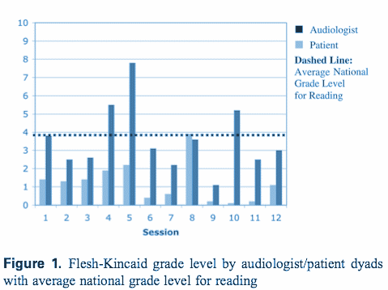
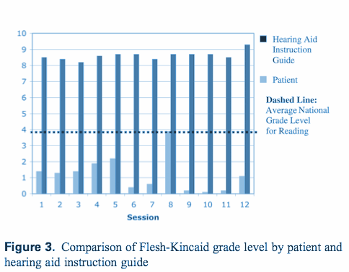
Results
Figure 1. Flesh-Kincaid grade level by audologist/patient dyads with average national grade level for reading
Figure 2. Comparison of Flesh-Kincaid grade level by
patient and hearing aid instruction guide
Nair & Cienkowski (2010)
Notes:
The results for each of the 12 sessions are shown in the above figures. Figure 1 shows the grade level on the Y-axis and the predicted grade level for each Audiologist-Patient dyad. The dark blue bars show the grade level being used by the Audiologist and the predicted grade level of the patient is shown in the light blue bar, based on the transcripts. The dashed line shows the Average National Grade Level for Reading as being the 4th grade for USA.
There are some important things to note from this figure:
When looking across dyads (1-12) all of the patients had predicted literacy that was below a fourth grade reading level. In fact, the grade level seems to be between 1-2 for these patients.
The language used by the audiologists varied widely across dyads, but not between audiologists (when statistically analyzed). When comparing the dyads, one thing to note is that there is a STATISTICALLY SIGNIFICANT mismatch in the grade level of the language used by audiologists and the grade level of the patient, with all but one of these showing that audiologists language was significantly higher than that of the patient. This can lead to misunderstanding of information, as was noted with Sophia and James.
Figure 2 shows the results of the analysis for the Hearing Aid Orientation materials given to the patients in comparison to the patient’s literacy level.
Again here, there is a significant mismatch in the level used by the hearing aid and the patient’s level. The average predicted health literacy level of the orientation materials was in the range of 8-9th grade, significantly exceeding that of the client!! This degree of mismatch all but guarantees that these particular patients will not understand the majority of the material given to them as support for hearing aid orientation.
Main conclusion:Audiologist counseling vocabulary and the materials provided by the manufacturers are at a level far above what the average patient can comprehend. As audiologists, we need to work to ensure our patients are able to comprehend what we tell them. According to this study, we are doing a much better job than the manufacturers in presenting material appropriately. However, it is important to note that audiologists are still above the level needed for understanding.

Slide 24
Hearing Aid User Guides: Suitability for Older Adults
Caposecco, Hickson and Meyer (2012) investigated the suitability of hearing aid user guides for older adults. Rationale encompassed the following:
Research shows that easy-to-read materials are preferred by all readers regardless of literacy level, with benefits including improved comprehension and shorter reading time (Davis et al, 1996).
Well designed health-care materials that the reader is able to understand enhance self-efficacy (Doak et al, 1996). Self-efficacy refers to an individual’s belief that they have the ability to perform the skills needed to be successful at a particular behaviour (Bandura, 1997).
Several readability formulae were utilized to determine mean reading grade level
The Suitability Assessment of Materials (SAM) (Doak et al, 1996) instrument was used to assess the content and design of each user guide.
36 hearing aid user guides from 9 manufacturers were examined
Caposecco, Hickson & Meyer, 2012
Notes:
We will now review a more recent study that examined in more detail the suitability of hearing aid user guides for older adults.
The rationale for the study is shown above
Caposecco et al. (2014) analyzed the content, literacy demand, readability, graphic content, layout, interactivity and cultural appropriateness of 36 printed hearing aid user guides from nine manufactures to determine their suitability for older adults. Readability was assessed using four reading ease/grade level algorithms, shown in the Tool column above. The table shows what these algorithms are called, who developed them, what they calculate and how they are scored. All four are widely implemented across a number of disciplines (including health care) to ascertain the complexity of written language used.
Davis T.C., Bocchini J.A., Fredrickson D., Arnold C., Mayeaux E.J. et al. 1996. Parent comprehension of polio vaccine information pamphlets. Pediatrics, 97, 804–810.
Doak C.C., Doak L.G. & Root J. 1996. Teaching Patients With Low Literacy Levels, Philadelphia: J.B. Lippincott.
Nair E.L. & Cienkowski K.M. 2010. The impact of health literacy on patient understanding of counseling and education materials. Int J Audiol, 49, 71-75.
Weintraub D., Maliski S.L., Fink A., Choe S. & Litwin M.S. 2004. Suitability of prostate cancer education materials: Applying a standardized assessment tool to currently available materials. Patient Educ Couns, 55, 275–280.

Slide 25
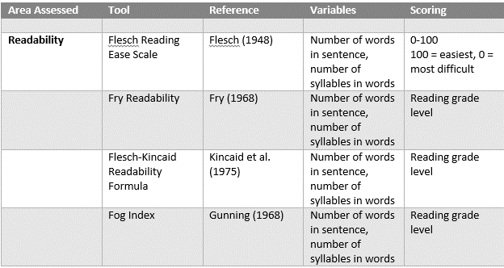
Hearing Aid User Guides: Suitability for Older Adults
36 hearing aid user guides from 9 manufacturers
Mean reading level was grade 9.6
Too complex
Caposecco, Hickson & Meyer, 2012
Notes:
Readability was assessed using four reading ease/grade level algorithms, shown in the Tool column above. The table shows what these algorithms are called, who developed them, what they calculate and how they are scored. All four are widely implemented across a number of disciplines (including health care) to ascertain the complexity of written language.
It is typically recommended that several of these tools be used. In the above study, the mean reading level required to understand the hearing aid instruction materials is 9.6. This is greater than the average reading level in the US, by 4 grade levels, and is considered too complex.

Slide 26
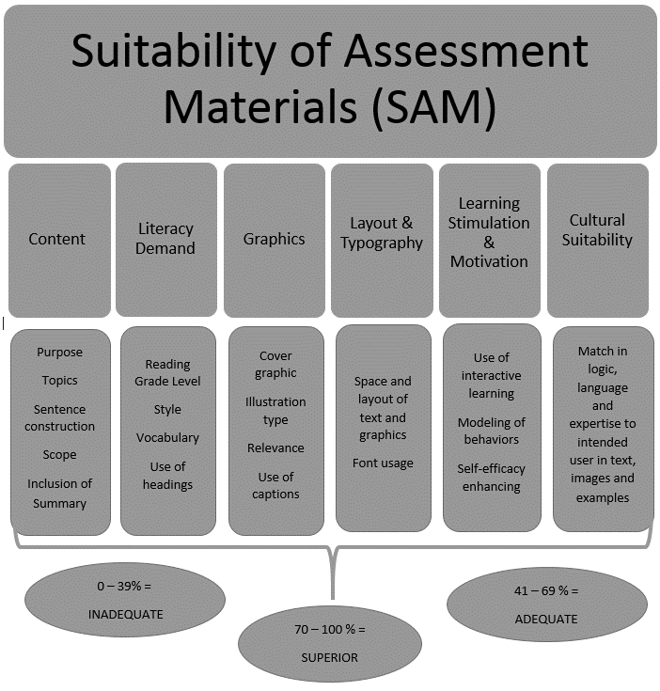
Results Caposecco, Hickson & Meyer, 2012
User guides not optimal
Major weaknesses based on the SAM analysis:
Inclusion of too many models in each user guide
Frequent use of uncommon vocabulary
Small text size and graphics
Excessive technical jargon
Problems with layout
No interactive stimulation
No option for visually impaired people
Notes:
Caposecco et al. evaluated more than just ease of readability and reading grade level. They also used the Suitability of Assessment Materials kit to uncover the multi-dimensional elements (i.e. those that exist beyond ‘readability’) which make printed materials like hearing aid guides too complex for laypersons. The table above shows the breakdown in categories examined.
The second row of the infographic shows the areas scored in the SAM analysis, and the third row contains examples within each area.
The SAM analysis rates Content of material by evaluating its purpose, number of topics covered, scope, sentence construction, and summary. A second rate is called Literacy Demand and includes analysis of reading grade level, style, vocabulary, and use of headings. A third area analyzed is use of graphics, As you can see, “graphics” are scored on whether they are relevant to the material, whether they are captioned, and whether they are line drawings or photographs. A fourth area examined involves Layout and Typography. Is the text font small, is it too dense? “Learning stimulation and motivation” is a particularly interesting area to score, as it looks at whether the material contains interactive learning that can enhance self-efficacy. Finally, Cultural suitability is also rated.
Each of these areas is rated and summed across categories to reach a maximum total score of 44. The result is then converted to a percentage.
A score of up to 39% means that the material is inadequate. 41-69% means it is adequate, and 70-100% means that the materials are superior, and meets all the criteria for suitability.
Caposecco et al.’s analysis using this measure, which is one of the ONLY empirical measures that cover the multi-dimensional elements for assessing Health Literacy, found that the hearing aid user guides were not adequate according to SAM analysis.
A summary of the results is shown on the right column.

Slide 27
Health Literacy & Patient Instructional Brochures
69% of printed hearing aid user guides deemed “unsuitable”
90% were identified as using “excessive technical jargon” and “uncommon vocabulary”
33% did not include basic hearing aid functionality overviews
100% of the guides were printed in inappropriately small font sizes
Literature provided is NOT written at appropriate health literacy levels. As clinicians, we must provide our patients with clear, concise, informative literature presented at a level they can easily comprehend.
Nair & Cienkowski (2010)
Notes:
Caposecco, Hickson & Meyer (2014) found that 69% of printed hearing aid user guides deemed “unsuitable” for their intended audience when evaluated in regards to content, expected literacy level of the reader, general readability, graphic content, layout, cultural appropriateness and layout.
Do you think these findings are generalizable to other audiology-related materials? What are some examples of jargon used by Audiologists? How about when clinicians write “cerumen management” as a recommendation on a patient’s report? Do you think every person would understand this terminology? Do you think that “Have wax taken out” is a more reasonable thing to note down for the patient? Which one sounds more frightening? Which one is more likely to be understood and acted upon? What are the implications for a person who fails to have occluding cerumen removed?

Slide 28
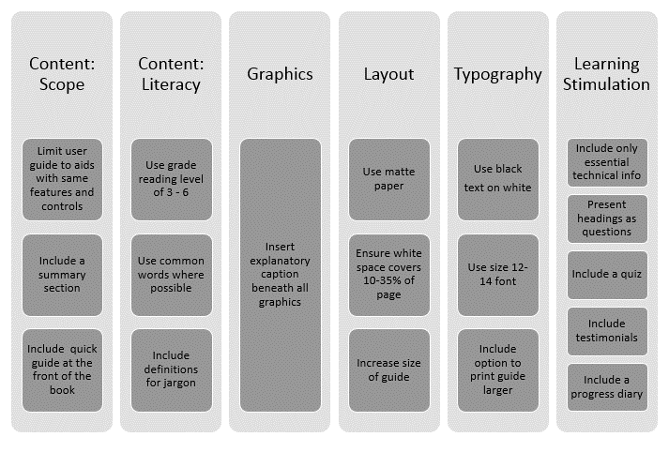
Suggestions
There is a great deal of scope for improvement. Poorly designed user guides may impact on HA self-efficacy, outcomes, and success
Caposecco, Hickson & Meyer, 2012
Notes:
The authors’ suggestions for improving the inadequacies they uncovered during their assessment of hearing aid guides using the SAM are shown in the above graphic. As you can see, every area needed something to render it more suitable for the layperson.
For example, the guides’ scopes were too broad, so it was suggested that each guide focus only on hearing aids with the same features and controls, (rather than the whole product line), and should include summary sections for each hearing aid, plus a “quick guide” at the front of the book, so users can navigate to the appropriate location.
In terms of content literacy, it was suggested that a reading grade level of 3-6 be used (achievable by utilizing the previously discussed grade level algorithms) and that jargon be replaced with more common words, or at least defined.
In terms of learning stimulation, it was suggested to present headings as questions, include a quiz, add testimonials and even incorporate a progress diary -- all items that could potentially enhance the users’ self-efficacy.

Slide 29
Implications
Poor understanding of information costs time, money and frustration
Needing to make additional appointments for clarification of hearing aid function.
Poor understanding can lead negative outcomes
E.g. failure to use the hearing aid at all
Poor understanding can affect selfesteem
Psychological consequences of untreated hearing loss can be far-reaching
Poor understanding can negatively impact overall health
A hearing impaired person without some form of amplification will not thrive in group or individual conversational settings: social isolation and depression may occur
Poor understanding in the healthcare setting can lead to misunderstanding
Overall health outcomes could be negatively affected
Notes:
The implications of both studies reviewed so far are clear. Patients need to be able to understand information presented to them, yet materials we provide and the jargon we use present barriers to understanding.
There are many disadvantages, to both the patient and the clinician, if a patient is unable to understand the information they are presented with.
Money/time/frustration: if a patient does not understand they are much less likely (as mentioned previously) to adhere to directives. This can lead to more visits that may otherwise be unnecessary. This is not cost-effective, nor time- efficient, for clinicians and will likely lead to immense frustration for the patient.
Frustration may lead to rejection of the diagnosis, its impact and of the intervention strategies provided. This study does a great job of illustrating how a bad outcome may be reached as a result of poor health care literacy.
If a patient is unable to accept their diagnosis and unable to manage their diagnosis, a lack of self-efficacy can lead to a loss in self-esteem. These feelings can spill over into all aspects of a patients life and general health status.

Slide 30
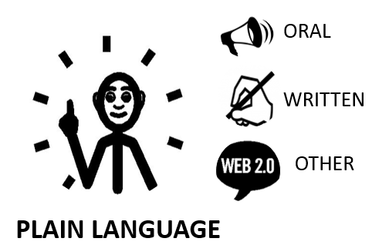
Plain Language: Clear Communication
Everyone benefits from clear communication
Clear communication is essential to ensure patients receive plain, unbiased and culturally appropriate information that will equip them to understand their condition and make educated choices about treatment.
Information must be in accessible format and presented in a range of modalities.
Notes:
It is clear that Audiologists need to change aspects of their behavior to address the needs of their clients.
Now we will turn to some suggestions of what we, as audiologists, can do to improve patient understanding in the area of health care literacy.
First we must use clear communication in every domain we use to communicate: oral, written, and any other type.
The first rule of thumb for this is to use plain language.
Source: Gilligan and Weinstein, Commun Disord Deaf Stud Hearing Aids 2014, 2:2 http://dx.doi.org/10.4172/2375-4427.1000110

Slide 31
Plain Language: Oral
Notes:
How can we improve plain language in the oral domain? The graphic above suggests several modifications we can make to the way we converse with our patients. For example:
Speak slowly, loudly, and clearly
Use an amplifier if necessary
Use Jargon-free language
Be specific, not general
Incorporate simple diagrams and graphics
Categorize, organize and prioritize information
Use repetition and clarification
Minimize shame
Maximize respect and cultural diversity
Encourage questions
Gilligan, 2015 Modified from information on ASHA.org

Slide 32
Plain Language: Printed
Use a size 14 font or larger
Leave adequate white space
Use jargon-free language
Use a grade reading level of 5 or below
Use concrete and familiar words
Emphasize key points in headings
Chunk related information
Use bulleted lists
Use simple tenses (present is best)
Use short sentences with active voice
Use relevant and simple diagrams/graphics
Caption the graphics
Notes:
Plainlanguage.gov is an excellent resource for clinicians looking for guidance in creating printed materials at appropriate health literacy levels for patients in the English language.
Above we provide some tips and recommendations for things to keep in mind to improve the effectiveness of printed materials. These are consistent with those recommended by Caposecco et al, and the SAM analysis.

Slide 33
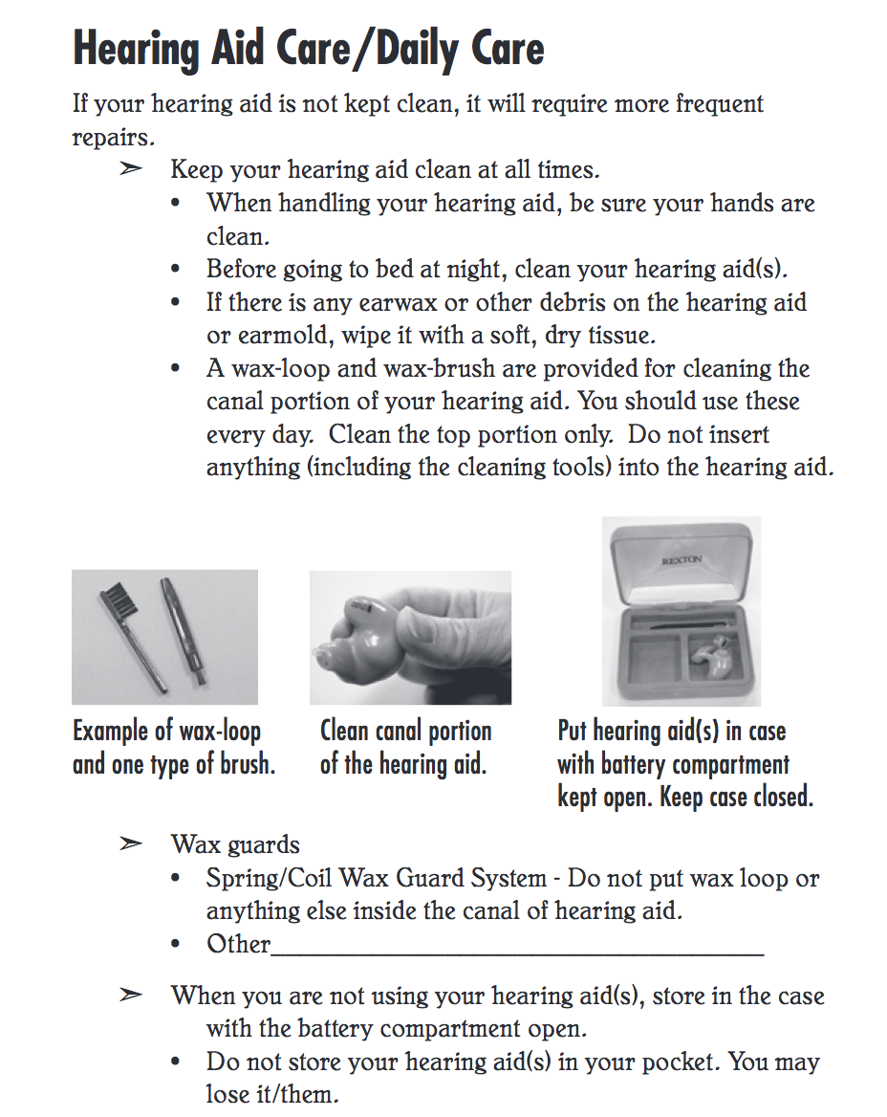
Health Literate Hearing Information?
This is for veterans, from the government’s National Center for Rehabilitative Auditory Research (NCRAR)
Source: VA.gov (n.d.)
Notes:
The Veterans Administration department in the United States, has taken a number of steps to ensure that the information patients receive is provided in understandable terms. Many VA hospitals have full-time boards that examine literature generated by clinicians before it falls into the hands of the veterans.
This is an excerpt from a large-format manual entitled “Your VA hearing aid” which contains information, organized by chapter, about what a hearing aid is for and how to best use and care for it.
Note the use of the following:
1) headings
2) The chunked information presented as a bulleted list,
3) the jargon-free plain language that uses active voice with captioned graphics.
How do you think this excerpt would fare, by the SAM standards, just by glancing at it? (Answer: It is a pretty good example of health literate information, based upon the SAM domains).
Your VA Hearing Aid (1st ed., p. 18). Portland.

Slide 34
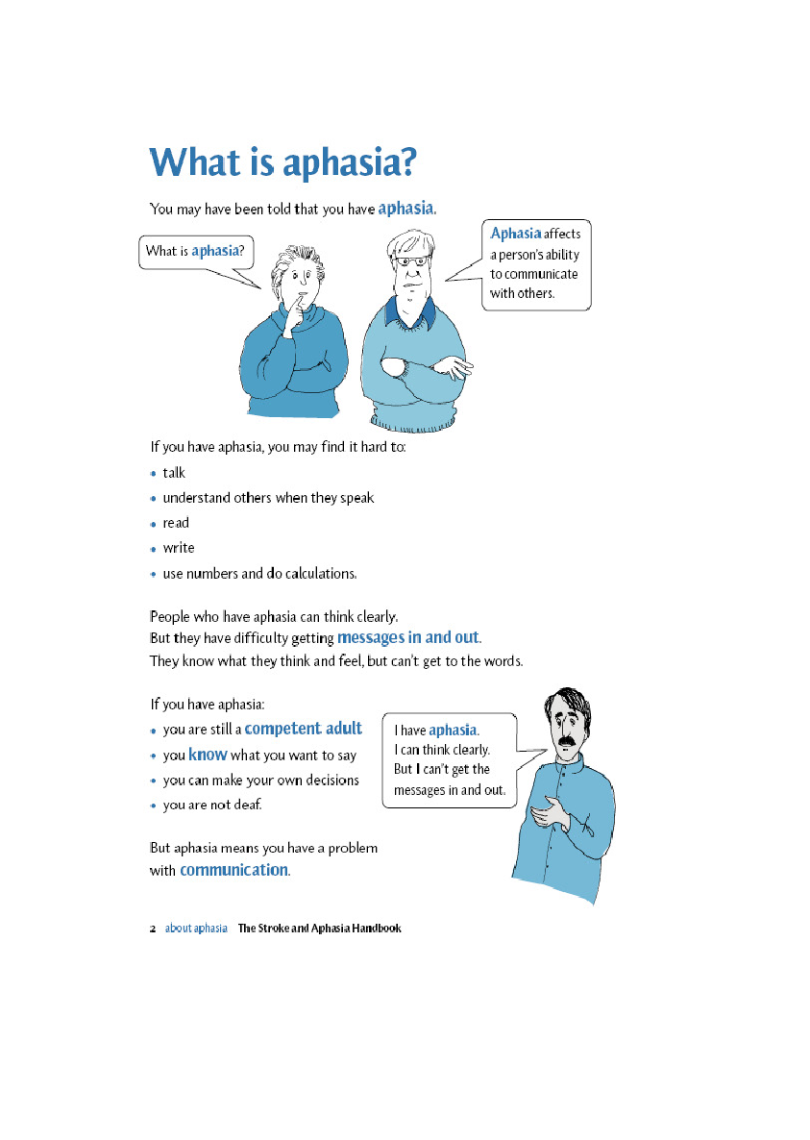
What Does Health Literate Patient Information Look Like?
Notes:
Here is another example of printed health-literate information. This is from a handbook for families of patients who have acquired aphasia post-stroke.
Notice the use of questions as headings, the definition of complex terms, the chunking and bulletting of information, and the ample white space.
What are your thoughts on the use of font size and color? Do you think this information could benefit from larger print and better graphics? (In general, this is a pretty good example of health literate information; however the use of blue might be difficult for some people to see. High contrast black and white is preferred).

Slide 35
Plain Language: Web-Based
All of the preceding information from oral and written plain language, plus:
Organize content and simplify navigation
Label links clearly
Include printer-friendly tools and resources
Incorporate audio and visual features
Use bold colors with contrast; avoid dark backgrounds
Make sure the “back button” works
Use linear information paths
U.S. Department of Health and Human Services, Office of Disease Prevention and Health Promotion (2010)
Notes:
As the Internet has become a primary source for information, it is important to consider the way in which web pages are designed. The written information has to be organized logically, and content should be structured so that the user can locate the information easily (“information architecture”).
PlainLanguage.gov has many useful resources on generating web-based plain language.

Slide 36
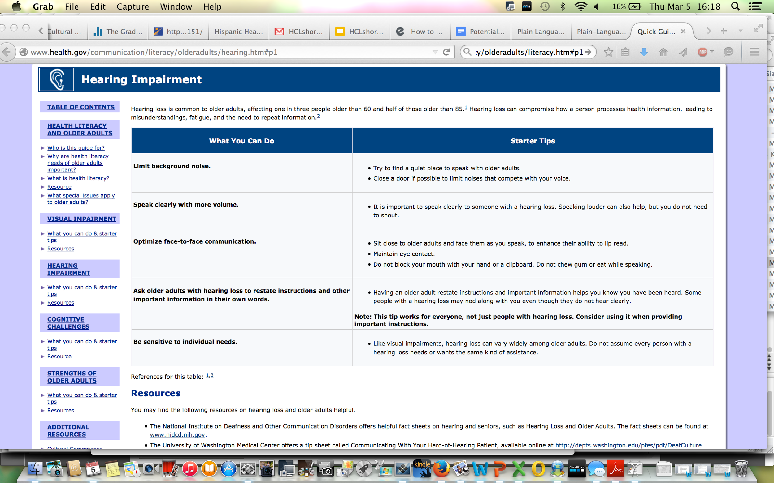
Health Literate Hearing Information?
This is for professionals who serve older adults on health and aging issues.
Health.gov (2015)
Notes:
This is from a government website that gives tips for professionals who serve older adults with hearing loss. It is a nice example of web-based plain language, with a logical information architecture, and plenty of white space surrounding information that is chunked by topic. Note the resources offered at the bottom, and the related topics available to view on the left side. This is for professionals. Do you think the public could also benefit from this piece? Why or why not? Do you think this needs any graphics?
This is a pretty good example of health literate information, especially for the professional working with older adults. Graphics would add a nice touch to this page. The page is easy to read and easy to navigate. This page could be used for the public.
The Quick Guide to Health Literacy and Older Adults is for people who serve older adults on health and aging issues; Health.gov,. (2015). Quick Guide to Health Literacy and Older Adults - Health Literacy and Older Adults. Retrieved 2 February 2015, from http://www.health.gov/communication/literacy/olderadults/literacy.htm#p1

Slide 37
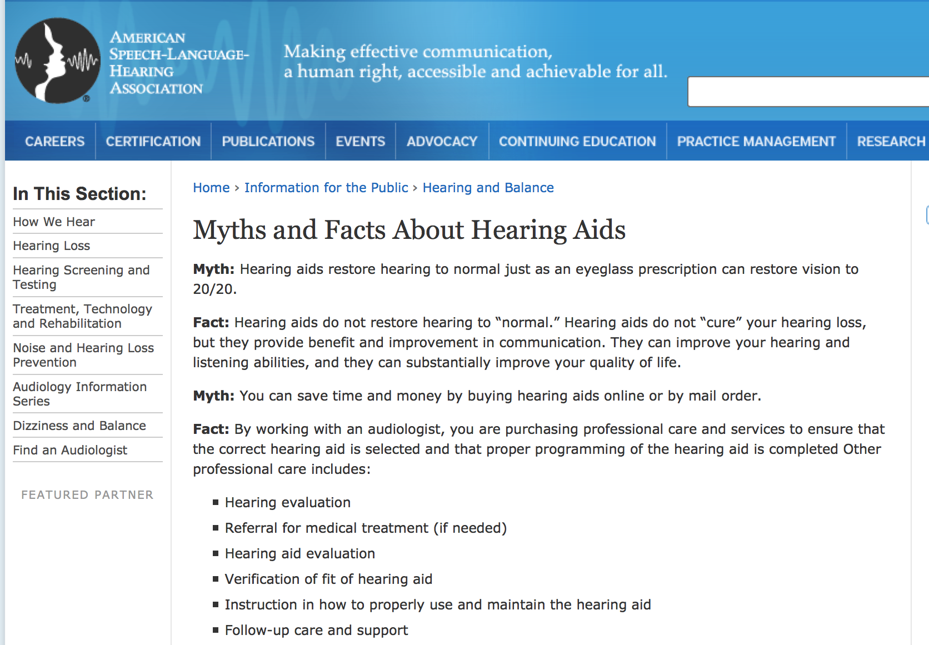
Health Literate Hearing Information?
This is for the general public
ASHA.org (2015)
Notes:
This is a site for the public from ASHA.org. It is presented in a “myth versus fact” paradigm, which is engaging.
What do you think about the language level used in this piece? (It’sprobably too complex.)
How does the information architecture look? (It looks okay)
Do you think this could benefit from having a “definitions” box, like the stroke brochure? (Yes: the language is too complex). How would you change the item “verification of fit of hearing aid” to make it more understandable? (Something along the lines of “Fine-tuning your hearing aid to make sure it is comfortable and working well”).
Overall, this example approaches some of the domains of health literate information, but it lacks graphics and explanations, and includes jargon.
Asha.org,. (2015). Myths and Facts about Hearing Aids. Retrieved 2 February 2015, from http://www.asha.org/public/hearing/Hearing-Aid-Myths-and-Facts/

Slide 38
Benefits of Optimizing Health Literacy
Improves analytical skills
Empowers decision making
Enhances ability to apply that knowledge in one’s life
Increases understanding of risks and benefits of treatment
Facilitates the interpretation of test results
Fosters skills necessary to manage a condition and prevent it from getting worse
Promotes self efficacy
Garners readiness
Notes:
If our goal as healthcare practitioners is to be effective, and help patients achieve positive outcomes, then we must consider the levels of health care literacy our patient populations have before we begin assessment, diagnosis, or treatment options.
Clearly there are benefits associated with optimizing health literacy, including all of the factors above.
As health care providers, we may not be able to improve our client’s reading skills, but we play an important role in communicating at a level where understanding is clear. Thus, by adapting how we communicate we can influence or optimize health literacy in the patients with which we interact.

Slide 39
Summary
Poorer Overall Health Outcomes
Poor Health-Related Decision Making
Limited
Health
Literacy
Poor Compliance
Poor Motivation
Notes:
To summarize, if health literacy is not accounted for, we risk poor outcomes, poor decision making on the part of the patient, poor compliance with medical directives and poor motivation to adhere to directives.
If we can tip the scales, and increase our understanding of health literacy and come to utilize more health literate documentation and vocabularies, we have the ability to better outcomes, better decision making skills, increase compliance and motivation.

Slide 40
Reflection Moment
How did this lesson inspire you to think of new ways to approach patient counseling?
What are some ways you can adapt your own clinical routines right now, to ensure better patient understanding?

Slide 41
Homework
Please rate the clinical materials you use in your clinic in term of readability (see associated handout) and improve upon them by making them more health literate.
Judge the health literacy of the information in terms of its
readability
content
design
Develop health literate information about hearing loss or hearing aids for a patient in one of the video re-enactments.

