Slide 1
Time and Talk: Aligning Communication Skills with Clinical Tasks
Deborah von Hapsburg, Ph.D.

Slide 2
Lecture Goals
Goal 1: To review the key aspects of Person-Centered Care
Goal 2: To introduce communication types (content and process) in clinical teaching and learning
Goal 3: To introduce the Calgary-Cambridge Model of learning clinical skills alongside communication skills.
Goal 4: To review skills needed to conduct an effective patient interview
Goal 5: To introduce the Time and Talk Tool, used to create a safe learning environment in which to learn and practice communication skills and clinical skills.
Notes:
Today we will learn about the challenge of conducting a patient-centered care interview.
We will begin by reviewing the key aspects of Person-Centered Care.
We will introduce two types of communication (content and process) in clinical teaching and review the challenges students and clinicians face in integrating these into clinical practice during encounters with patients.
We will also introduce the Calgary-Cambridge model of learning clinical skills alongside communication skills.
We will review skills needed to conduct an effective patient interview
And finally we will introduce the time and talk tool, used to create a safe learning environment in which to learn and practice communication and clinical skills.

Slide 3
Key Aspects of the PRCC Approach
Philosophic
Whole person/biopsychosocial
Perspective
Therapeutic context and environment
Therapeutic relationship
Process
Eliciting narratives, hearing patients’stories
Providing empathy for validation, trust
Mutual understanding, shared decisions
Promoting self-efficacy, self-management
Clinical benefits
Results
Cost benefits
Intra- and interpersonal benefits

Slide 4
Research Findings - EVIDENCE….
Enhancing communication leads to better outcomes.
Increasing:
Patient understanding & recall
Symptom relief
Adherence & concordance
Physiological outcomes
Patient safety
Patient satisfaction
Doctor satisfaction
Decreasing:
Costs
Complaints and malpractice litigation
Notes:
Extensive research has shown that good communication skills lead to better outcomes for patients and clinicians.
Practicing good communication skills improves the level of patient centered care. This increases:
Patient understanding & recall
Symptom relief
Adherence & concordance
Physiological outcomes
Patient safety
Patient satisfaction
Doctor satisfaction
Also, practicing patient centered care communication skills results in additional benefits to clinicians, resulting in decreased:
costs
complaints and malpractice litigation
References:
Arora NK.(2003). Interacting with cancer patients: the significance of physicians’ communication behavior. Social Science and Medicine,57, 791–806.
Stewart MA.(1995). Effective physician–patient communication and health outcomes: a review. Canadian Medical Association Journal, 152,1423–33.
Epstein RM, Street Jr RL. Patient-centered communication in cancer care: promoting healing and reducing suffering. Bethesda, MD: National Cancer Institute; 2007 [NIH Publication No. 07-6225].
Kaplan SH, Greenfield S, Ware Jr JE. (1989). Assessing the effects of physician–patient interactions on the outcomes of chronic disease. Medical Care,27, S110–27.
Jackson JL. (2005). Communication about symptoms in primary care: impact on patient outcomes. Journal of Alternative and Complementary Medicine,11,S51–6.
Stewart M, Brown JB, Donner A, McWhinney IR, Oates J, Weston WW, Jordan J. (2000).
The impact of patient-centered care on outcomes. Journal of Family Practice,49, 796–
804.

Slide 5
Evidence for Need for Good Communication
“Extensive research has shown that no matter
how knowledgeable a clinician might be,
if he or she is not able to open good communication
with the patient, he or she may be of no help.”
Asnani, 2009
Notes:
It is important to reiterate here that “extensive research has shown that no matter how knowledgeable a clinician might be, if he or she is not able to open good communication with the patient her or she may be of no help”
Asnani MR (2009). ”Patient-physician communication”. West Indian Med J, 58(4):357-61

Slide 6
Types of Communication Skills
Content skills (clinical methods)
History taking and information gathering
Physical Exam
Diagnosis
Planning and Discussing
Process skills
How you communicate
How you structure interaction
How you relate to patients
Nonverbal skills
The goal is to integrate both types of skills at the same time!
Notes:
Having established the importance of good communication skills to patient outcomes. We must address the fact that putting into practice good communication skills has been challenging to many clinicians in daily practice. In order to understand why this is, it is important to reflect on how these skills are taught or have been taught typically.
Traditionally, communication skills have been taught separately from the clinical method in clinical education programs. Thus students may learn communication models describing the process of the clinical interview (how to build rapport, gather information, show empathy, discuss and plan results and treatment) separately from the content of the medical interview (how to take the content of medical history, perform a physical exam, deliver a diagnosis, make a plan for treatment etc.). As a consequence of separating content and process, these skills are not actually integrated in daily practice, with the downside being that patient centered care is not ensured.
Unfortunately clinicians do not apply learned communication skills (process), if they learned them separately from the content of the clinical method. For example, they may not apply good communication skills while they are taking a history, performing hearing evaluation, explaining the diagnosis, or forming a plan. This is particularly a problem if clinical faculty do not reinforce communication skills during student practice opportunities.
The goal is to practice or integrate both types of skills at the same time.

Slide 7
Class Activity 1:
What clinical tasks do you have to accomplish during an audiologic appointment for a new patient appointment?
2. What communication tasks do you need to accomplish for the same appointment above?
Notes:
Please have students take about 5 -7minutes and work in pairs and build a comprehensive list of tasks that need to be accomplished for each of the above questions.
Possible Answer for Question 1: What clinical tasks do you have to accomplish during an audiolgic appointment for a new patient appointment?
Take clinical history, otologic history,
Calibration of equipment when needed
Otoscopy
Immitance
Other diagnostic tests
Test Interpretation and Diagnosis
Gather information about possible diagnosis/treatment options
Possible Answer for Question 2: What communication tasks do you need to accomplish for the same appointment above?
Greet the patient
Introduce myself
Make the patient feel welcome
Find out why the patient came to see me, or what the main concern is
Show concern for the patient’s problem
Verify that I understand what the patient’s concern is
Ask how the problem affects the patient’s personal life, work life, etc.
Communicate a plan for the appointment once I understand the patient concern
Explain in words they can understand the rationale for the tests, and why I am doing what I am doing
Explain the diagnosis tactfully, and check for understanding
Elicit shared understanding, and discuss treatment options that the patient is in agreement with
Etc…
Chances are the students will not create as thorough a list as the one above. This exercise is meant to get them thinking about more than just the clinical tasks they need to accomplish, and will get them ready to think about the duality of the tasks as we introduce the Calgary-Cambridge method.

Slide 8
Calgary-Cambridge Consultation Model (Kurtz, et al. 2005)
Integrates: the traditional clinical method with effective communication skills
Incorporates Patient Centered Care into both content and process teaching
Provides a way of eliciting information about: the biomedical disease process and the patient’s perspective
Provides a framework of three diagrams that delineate the
Tasks to be accomplished during a clinical interview
Objectives to be accomplished under each
Communication Process Skill Lists (Detailed in the Guides) required to accomplish the Objectives.
Notes:
The model we are going to discuss is the Calgary-Cambridge Consultation Model. It addresses the traditional problems discussed in the previous slide (the separation of teaching the content and process) by proposing a comprehensive clinical method, that explicitly integrates the traditional clinical method with effective communication skills such that both get equal emphasis and importance in teaching. The Calgary-Cambridge model provides a content guide for medical interviewing that more closely aligns with the structure and process skills of communication training.
It incorporates patient-centered medicine into both process and content aspects of the interview.
It provides a framework of three diagrams that help place communication process skills within a comprehensive clinical method. The Guides identify a total of 71 communication process skills that fit into the framework of Tasks and Objectives.
It provides a way of eliciting information about both: the biomedical disease process and the patient’s perspective. The model addresses the fact that there may be two agendas present in the clinical encounter between a patient and the clinician. There is the doctor agenda and the patient agenda. This model attempts to minimize the potential conflict between the two agendas by suggesting a structured method for consolidating the two agendas in a positive way.

Slide 9
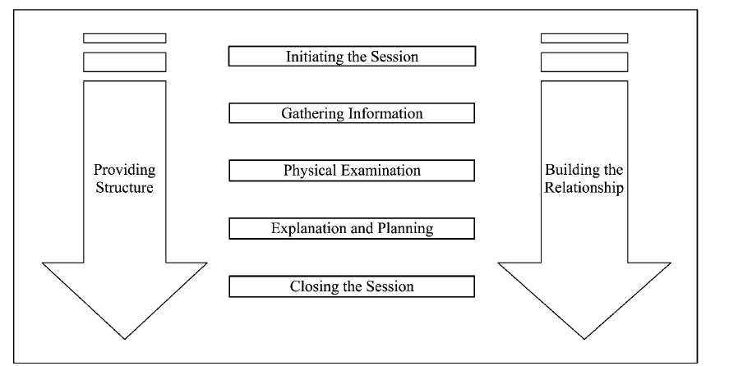
Calgary-Cambridge Consultation Guide BASIC TASKS
Kurtz, S., Silverman, J., Bensons, J. Draper, J.(2005). Marrying content and process in clinical method
teaching: Enhancing the Calgary-Cambridge Guides. Academic Medicine,78(8),802-809.
Notes:
We will now introduce the conceptual frameworks (three diagrams) which show a) what is happening in the medical interview, and 2) how the skills of communication and the physical examination work together.
The basic framework of the Calgary-Cambridge Guide is provided above showing the flow of the five medical interview tasks in clinical practice. Thus, during the course of the encounter the clinician must in sequence: 1) Initiate the session, 2) Gather information, 3) provide a physical examination of some kind, (for our purposes audiological), 4) explain the results and plan a treatment, and 5) bring the session to a close. This represents the typical sequence of tasks that comprise the clinical interview, or the content.
Within these, the clinician must overtly provide structure and build the relationship with the client. Providing structure and building relationship must occur throughout all of the tasks detailed in the clinical encounter.

Slide 10
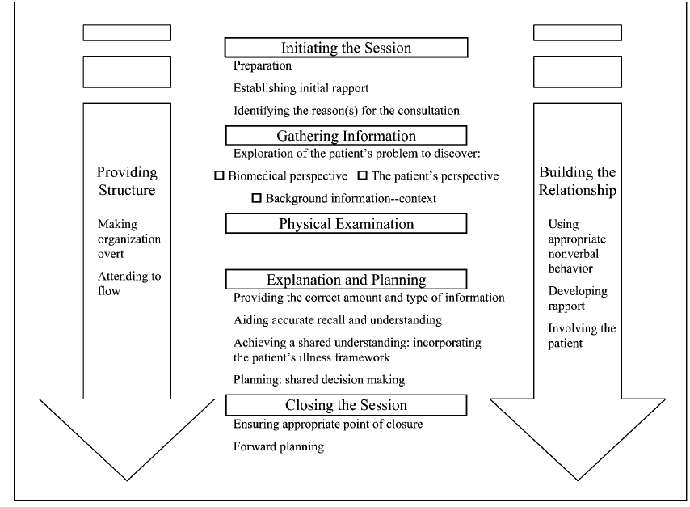
Calgary-Cambridge Consultation Guide Expanded Model: OBJECTIVES
TASKS
Objectives
Notes:
The above figure now shows the expanded framework. It expands on the objectives to be achieved within each of the medical interview tasks. These objectives are shown as subheadings that are meant to refine conceptualization of the main tasks.
Thus this expanded framework show the Tasks and their Objectives, which are designed to help clinicians learn and remember the skills that are associated with each.
The skills associated with each Objective are then detailed in a more complex guide, the Calgary-Cambridge Process and Content Guides. These will be explained in the next slide.

Slide 11
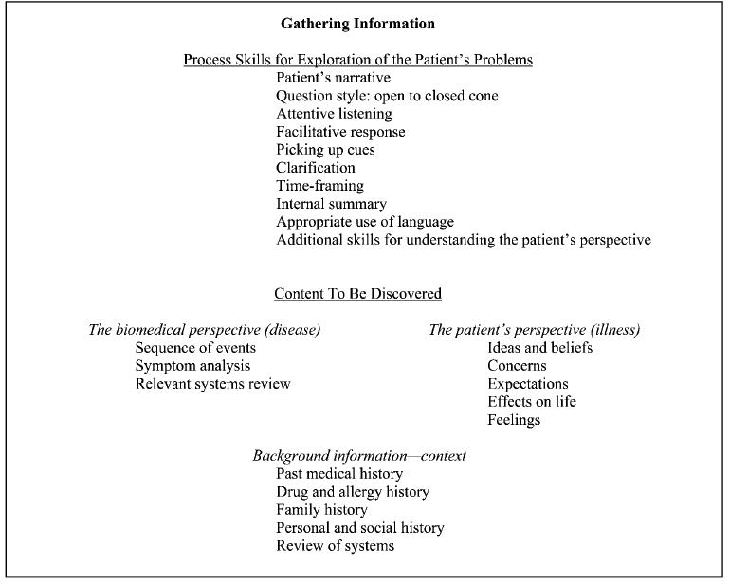
Calgary-Cambridge Consultation Guide Expanded Model - SKILLS
TASKS
Objectives
Notes:
The process skills for each Task and Objective are provided by the Guides for Content and Process. These process and content guides are used to provide concrete skills and behaviors required to carry out the medical interview.
For an example of the Calgary-Cambridge Process Guides used by Hull York Medical School please log in to the Ida web site, use the following link, go to the section “Time and Talk” and download the hand-out “Calgary Cambridge HYMS Modification”: http://idainstitute.com/toolbox/university_course/videos_and_handouts/unit_ii/
The example above shows the communication skills suggested by the Process Guides necessary to appropriately explore the patient’s problems (objective) under the Gathering Information Task .
In the above example, according to the Process Guides, exploring the patients problem can be accomplished by a) encouraging the patient to tell their own story, use open ended questions at first and moving towards close end questions later, using attentive listening, facilitating responses using verbal and non-verbal techniques, etc. Thus students need to work on achieving competency and skill in using these skills.

Slide 12
Calgary-Cambridge Guides
70 Core Evidence-Based Process Skills
Each one validated by research
2. Not all skills needed all the time
Notes:
The Guides identify a total of 71 communication process skills that fit into the framework of Tasks and Objectives.
Each one of these skills has been validated by research, and not all skills are needed all the time. The clinician should think of these as tools they can access whenever they need to and so the toolbox analogy is helpful here.

Slide 13
Task 1: Initiating the Session
Preparation
Establishing Initial Rapport
Identify the reason(s) for the consultation
Notes:
We will now go over each of the tasks and objectives and some of the skills suggested by the Guides. However, it is recommended that the instructor ensure that students become familiar with all of the Process skills in the guides so that they are acquainted with the skills they need to learn under each of the objectives. The goal is that over the course of their education, students will have gained competency in all communication areas. As a reference the Ida Institute Website has an abbreviated list-handout of Competency Skills that can be downloaded. Use the following link, go to the section called “Time and Talk” and download the hand out: http://idainstitute.com/toolbox/university_course/videos_and_handouts/unit_ii/
Preparation:
- The guides do not mention skills under preparation. However, students should prepare in advance of the meeting by making sure they create an environment that is conducive to patient centered care. For example, if the room where the meeting is to take place has computers and a lot of equipment, the clinician should arrange the chairs so that there are minimal barriers or distractions between the client and the clinician. Additionally, the clinician should make sure to limit the number of interruptions that can take place during the meeting (such as making sure the phone is answered by someone else, etc.)
Establishing Initial Rapport:
-Greets patient and obtains patient’s name
-Introduces self and clarifies role.
Identifying reason for consultation
-Uses an opening question to identify the issues
- Listens to the opening response without interrupting or directing
-Checks and confirms list of problems
-Negotiates to set an agenda for the session taking both patient’s and physician’s needs into account

Slide 14
Task 2: Gathering Information
Exploration of the patient’s problem with the purpose of discovering:
Biomedical Perspective
The Patient Perspective
Background Information and Context
Providing Structure
Building Relationship
Notes:
Once the session has been initiated and the reason for consultation been established the clinician can move to Task 2: Gathering Information. This section involves exploration of the patient’s problem with the purpose of discovering the following different perspectives: The biomedical perspective, the patient perspective, the background and context. Throughout this process, remember that clinicians are tasked with providing structure to the appointment and building relationship with the client. The skills suggested by the Guides to achieve these objectives are provided below.
To discover the biomedical perspective explore:
Sequence of events
Symptoms
Relevant Systems Review
To discover the patient perspective explore:
Ideas and beliefs regarding the cause
Concerns (i.e., worries regarding each problem)
Expectations (i.e., goals, what help the patient had expected for each problem)
Effects on life (how each problem affects the patient’s life and family)
Feelings-Encourages patient to express feelings.
The Skills listed in the guide to Explore the patient perspective are:
Encourages patient to tell own story
Uses open and closed questions, appropriately moving from open to closed
Listens attentively, leaving the patient space for thinking before answering, and continuing after patient pauses
Facilitates responses by verbal and non-verbal techniques (e.g., encouragement, silence, repetition, paraphrasing, interpretation)
Picks up and responds to verbal and non-verbal cues
Clarifies statements
Uses clear language avoiding jargon
Summarizes to confirm own understanding before moving on
Elicits relevant and specific information from patients to help distinguish between working hypotheses.
To discover the background information (context), explore:
Past medical history
History of hearing loss
Personal and social history (communication partners, etc.)
Providing Structure
Summarizes at the end of a specific line of inquiry to confirm understanding before moving on to the next session
Progresses from one section to another using signposting, transitional statements; and includes rationale for next session.
Attends to flow: structures the interview in a logical sequence
Attends to timing and keeping interview on task.
Building Relationship
Using appropriate non-verbal behavior:
Demonstrates appropriate non-verbal behavior (eye contact, facial expressions, posture, position, and movement)
If reading/writing notes or using computer, doing so in a manner that does not interfere with rapport or dialogue.
Demonstrates appropriate confidence.
Developing Rapport
Accepts legitimacy of patient’s views
Uses empathy-to communicate understanding and appreciation for the patient’s feelings or predicament; overtly acknowledges patient’s views and feelings.
Provides support: expresses concern, understanding, willingness to help; acknowledging coping efforts and appropriate self-care, offers partnership.
Deals sensitively with embarrassing and disturbing topics and physical pain including when associated with physical examination.
Involving the Patient:
Shares thinking with patient to encourage patient involvement.
Explains rationale for questions or parts of physical examination that could appear to be non-sequiturs.
During the physical examination, explains process, asks permission.

Slide 15
Class Activity 2: Information Gathering
Hair Cutting Exercise
Washing Powder
Notes:
There are different ways of gathering information during interactions. We would like to engage students in a class activity in which they engage in information gathering, that is not clinical in nature.
Part 1. Hair Cut:
Please have the students get into pairs.
Have one participant ask the other to tell them about how they get their hair cut.
The participant asking the question should not say or ask anything else after they ask the question, just listen to the other participant provide an answer.
Please have them continue for X minutes, until told to stop?
Reflection:
Interviewer Reflection: What information was gathered? How did it feel to let the person talk? What was challenging?
Interviewee Reflection: What was it like have someone just listen? Was there a challenge? Other reflection?
Part 2: Washing Powder
1. Have participants swap roles.
Have the interviewer make a list of things they want to know about the washing powder/detergent their partner is using to wash clothes.
Ask your partner about what the washing powder they use. You must make sure to ask as many questions as possible from the list, and keep on asking them, before time is stopped.
Reflection: After the interviews, interviewers reflect on the kind of information they got and how this interview technique differed from the one applied in round one.
Instructor to ask the following questions:
Did you ask all of your questions?
Did you ask new questions?
How did it feel to have to ask all those questions?
How did it feel to have been asked all those questions?
Compare this way to first way of asking questions: what did you like about it? Did you learn just as much from just listening to someone tell their story? For the person being interviewed, what did you like about each way of being interviewed? Do you feel one way was better than the other? Did you feel better rapport was built up with one method versus the other?
This exercise shows different ways of asking questions, and gathering information.

Slide 16
Task 3: Physical Examination
Equipment Calibration
Auditory Examinations and Tasks
(otoscopy, hearing test, balance tests, immittance, ear molds, others)
Hearing Aid Fitting and verification, CI Programming, Other Device fitting and orientation
Notes:
During the physical examination you will practice content skills but you will do so by using the process skills discussed earlier related to building relationship, and providing structure.
Involving the Patient:
Shares thinking with patient to encourage patient involvement.
Explains rationale for questions or parts of physical examination that could appear to be non-sequiturs.
During the physical examination, explains process, asks permission.
Providing Structure
Summarizes at the end of a specific line of inquiry to confirm understanding before moving on to the next session
Progresses from one section to another using signposting, transitional statements; and includes rationale for next session.
Attends to flow: structures the interview in a logical sequence
Attends to timing and keeping interview on task.

Slide 17
Task 4: Explanation and Planning
Providing the Correct amount and type of information
Aiding Accurate Recall and Understanding
Achieving shared understanding: Incorporating the patient’s perspective
Planning: Shared Decision Making
Notes:
Providing the correct amount and type of information
Chunks and checks: gives information in manageable chunks, checks for understanding, uses patient’s response as a guide to how to proceed
Assesses patient’s starting point: asks for patient’s prior knowledge early on when giving information, discovers extent of patient’s wish for information
Asks patients what other information would be helpful e.g. etiology, prognosis
Gives explanation at appropriate times: avoids giving advice, information or reassurance prematurely
Aiding accurate recall and understanding
Organizes explanation: divides into discrete sections, develops a logical sequence
Uses explicit categorization or signposting (e.g. “There are three important things that I would like to discuss. 1st...” “Now, shall we move on to.”)
Uses repetition and summarizing to reinforce information
Uses concise, easily understood language, avoids or explains jargon
Uses visual methods of conveying information: diagrams, models, written information and instructions
Checks patient’s understanding of information given (or plans made): e.g. by asking patient to restate in own words; clarifies as necessary
Achieving a shared understanding: incorporating the patient’s perspective
Relates explanations to patient’s illness framework: to previously elicited ideas, concerns and expectations
Provides opportunities and encourages patient to contribute: to ask questions, seek clarification or express doubts; responds appropriately
Picks up verbal and non-verbal cues e.g. patient’s need to contribute information or ask questions, information overload, distress
Elicits patient's beliefs, reactions and feelings re information given, terms used; acknowledges and addresses where necessary
Planning: shared decision making
Shares own thinking as appropriate: ideas, thought processes, dilemmas
Involves patient by making suggestions rather than directives
Encourages patient to contribute their thoughts: ideas, suggestions and preferences
Negotiates a mutually acceptable plan
Offers choices: encourages patient to make choices and decisions to the level that they wish
Checks with patient if accepts plans, if concerns have been addressed

Slide 18
Task 5: Closing the Session
Ensuring appropriate point of closure
Forward planning
Notes:
Ensuring point of closure
Summarizes the session briefly and clarifies plan of care
Final Check that patient agrees and is comfortable with plan and asks if any corrections, questions or other items are left to discuss.
Forward Planning:
makes a contract with patient regarding the next steps for patient and physician.
safety-nets- explaining possible unexpected outcomes, what to do if plan is not working, when and how to seek help.

Slide 19
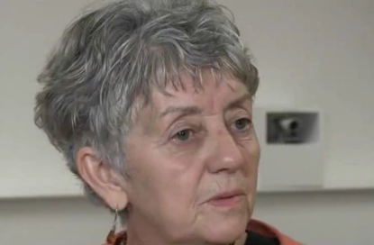
Class Activity 3: Time and Talk Introduction
Notes:
The Calgary-Cambridge method is taught in medical schools using role-playing and simulated patients. The Ida Institute has created a program for using Role-Playing and simulated patients to teach the Calgary-Cambridge Method to Audiology students.
Please watch Dr. Leslie Jones introduce the rationale and background for the Calgary Cambridge Method in Audiology. Note to instructor: Please log into the Ida web site, use the following link, go to the section called “Time and Talk” and watch the video of Dr. Leslie Jones introducing the rationale and background for the Time and Talk Tool (Time and Talk – An Overview): http://idainstitute.com/toolbox/university_course/videos_and_handouts/unit_ii/
After the video, we will introduce the Time and Talk method in more detail.

Slide 20
Time and Talk Tool
Experiential Method of Teaching Counseling in Audiology
Uses role-play and active learning to teach communication skills to audiology students
Time and Talk provides a framework which delineates:
Ground Rules for Interaction in Role-Play
Preparation for Role-Play Orientation
How to work with simulated patients
How to participate as an actor or as an observer
Topics for possible role play
Methods of providing feedback
Notes:
The Ida institute has adapted the Calgary-Cambridge model to develop a way to teach communication skills to audiologists, called Time and Talk. The Time and Talk tool relies on creating a safe and constructive environment in which to teach person centered communication skills.
It is an experiential method, that relies on active learning, focusing particularly on role-playing to help students learn how to integrate communication skills with the clinical tasks they need to accomplish during an audiological appointment.
The tool relies on creating a framework for using scenarios and role-plays of clinical situations to teach how to integrate process skills (how you conduct the patient interview) with practical clinical content skills (what you actually do) in the audiological appointment.
Thus the Time and Talk Tool provides a structure around role-playing interactions and provides guides for several important aspects of role playing that need to be learned by the students first in order to be able to get the most out of the role playing scenarios.
The Time and Talk Tool include guides on:
a) Ground Rules-orientation for understanding the ground rules for interaction in group activities and role-play.
b) Preparation for Role Play- it provides orientation as to how role-playing can be done effectively, including guidance on how to work with simulated patients, and provides techniques students can use to actively participate in the role-pays. Finally, it has suggestions for how to select possible role-playing scenarios.
c) Structured Methods of providing Feedback: The Tool also provides instruction on how to give feedback in an acceptable form during the role play. This provides ways the teacher can give feedback, but also how students can give each other constructive feedback during a role-play session.
The Time and Talk Tool puts into action principles of active learning discussed in an earlier lecture in this course, titled Learning the Ida Way. Throughout this course we will be using Role-Play to learn how to conduct person-centered appointments with patients while accomplishing clinical task.
It is important that students and teachers learn about how to use Role-Playing in the context of Time and Talk, as these methods will be used throughout the course.
In the next set of slides we will introduce you to these methods.

Slide 21
Time and Talk: Ground Rules for Safe Learning Environment
Ground rules
Confidentiality (what happens in the group stays in the group)
Observing is just as important as role-playing
Respect each other
Do not interrupt each other
The group takes joint responsibility for each role-play session
Give constructive, non-judgmental feedback
Freely ask for support from the group
Watch Group Rules – Creating a Safe Environment, by Dr. Leslie Jones
Notes:
CREATING A SAFE ENVIRONMENT
Students are more likely to share their experiences and feel comfortable in role-play situations when the learning takes place in a safe environment. It is important that we create this environment by setting ground rules early on in the learning session. This will help everyone feel at ease during role-play and feedback situations.
The ground rules are shown above. These ground rules also exist in a handout that should be given to the students and these ground rules should be discussed in detail. Please watch Dr. Leslie Jones discuss the Ground Rules in the video “Group rules – creating a safe environment”. Video and hand-out can be found in the section of the course website called “videos and handouts”. Use the following link, go to the section called “Time and Talk” and find the video “Group rules – creating a safe environment” and the handout called “Prepare for Role-play”: http://idainstitute.com/toolbox/university_course/videos_and_handouts/unit_ii/
Note to Instructor: This section provides suggestions on how you can effectively plan role-play sessions
Note to Instructor: Before moving on it will be important to ask the students whether they all agree to the ground rules above.

Slide 22
Time and Talk: Preparing for Role Play: Use of Simulated Patients
A role-play session will typically, at a minimum, involve two characters:
A patient and
A hearing care professional
The patient can either be played by one of the participants in the group or you can choose to use an outside individual or an actor as a simulated patient.
All simulated patients, regardless of their own experience, bring a ‘non-medical’ patient perspective to the scenario.
Notes:
This section provides suggestions on how you can effectively plan and role-play sessions, considering specifically the use of Simulated Patients.
Sometimes, the scenario involves one or more additional characters such as relatives, caretakers, or other individuals who play a part in the patient’s life. Simulated patients can also help play these parts and may
contribute to discussions among students and tutors about the different perspectives of the characters involved. Role-plays can also be done with scenarios based on communication with colleagues, e.g., asking for
advice about a client or challenging a decision. Using simulated patients who are not associated with the hearing care community can be very valuable, since they cover an outside perspective of the appointment. Simulated patients, who have acting experience, may also find it easier to re-enact emotionally difficult situations than
other group participants.

Slide 23
Time and Talk: Preparation for Role Play: Group Engagement
Collaborative Learning Environment is obtained by:
Allowing all participants in the class to contribute and by
Providing Methods that allow students to contribute such as:
Hot Seating - Build a patient profile, developing a characters sketch
Alter Ego - Using to understand what may be going on in the heads of the clinician and patient as the conversation unfolds.
Life Line - Role-Players can pause and ask others for help.
Reality Check - How would you describe to a close friend, what happened at the appointment today?
Matching Game - to reflect on the session
Notes:
Group exercises and role-plays are central to the Time and Talk experiential method. Group activities allow participants to learn from each other's resources, skills and experience.
To ensure a positive learning experience for all participants, a collaborative learning environment needs to be created. This can be done by ensuring that the role-players are not always at the center of attention.
All participants in the exercise should be given an opportunity to contribute by offering input and suggestions and by acting out those suggestions.
Below are suggestions for group activities that can help create a collaborative learning experience. You will also find instructions for how to do them in the hand-out “Group Activities”. Use the following link, go to the section called “Time and Talk” and download the handout: http://idainstitute.com/toolbox/university_course/videos_and_handouts/unit_ii/
Please go over these techniques with the students so that they are familiar with them and when to use them. This will allow them to benefit maximally from the role-plays used throughout the course.
HOT SEATING
Description: Build a patient profile by having observers ask questions of the person who will play the patient.
Questions could include age, work situation, feelings about their life with hearing loss, family relations, or how they spend their free time.
Note to Instructor: When to use it: Hot-seating can be used to cover the initial phases of a consultation quickly so that participants can move on to other areas. It can also be used to change the pace of a session if a particular role-play scenario is becoming repetitive. It may also be useful if there is a need to explore the patient's ideas, concerns, feelings and expectations.
Purpose: Hot-seating is a way to involve all learners in a session from the start. It provides the entire group with an opportunity to practice their interview skills. This makes for a more interesting and realistic character sketch and can be quite lighthearted.
ALTER EGO
Description: During the role-play, a participant is asked to come to the front and put a hand on the shoulder of the person playing the clinician or the patient. He/she will be asked to say out loud, using the first person pronoun, what he/she really thinks or feels but is not saying. For example, the clinician may think: “I am really worried about how I am going to break this piece of bad news. I fear that the patient will get really upset. How can I possibly break it in a gentle manner?” This approach can be used for any person in the role-play. The method can be further developed by asking the alter egos of both participants to speak to each other using their “honest” voices.
When to use it: If the role-players get stuck or are unsure about how to handle a particular situation, this group activity may be elective. It may also be useful if you want to bring in other members of the group to
highlight a learning point which is not overt or explicit.
Purpose: The Alter Ego helps participants understand what may be going on in the heads of the clinician and the patient as the conversation unfolds. This new understanding of each character’s "train of thought” enables them to take appropriate next steps in the conversation. It may also reveal any “hidden” agendas under the surface.
LIFE LINE
Description: The role-players can pause at any time to ask the audience for a suggestion on what to do next. The audience can encourage the role-players to continue as they were doing or suggest that they take a completely new direction.
When to use it: If the role-players are uncertain about how to respond in a certain situation or lack confidence to continue, asking the group can be a useful way to gain new inspiration or regain the courage to keep going.
Purpose: This activity allows the role-players to take a break and seek help from their peers. It also provides the group an active role and a stake in the further development of the scenario. This contributes to a healthy collaborative learning environment.
Reality Check
Description: Ask observers: “If you were the patient, what would you tell your partner or spouse about the appointment today?” or ask the role-players: “At this point, how would you describe what has happened so
far to a close friend or someone at home?”
When to use it: At the end of a role-play, or if the role-players get stuck.
Purpose: By asking participants to answer this question, they are stimulated to reflect on the content, quality and outcome of the conversation they had with the patient and on what the patient’s experience might have been. By changing the context, a different perspective may emerge.
MATCHING GAME
Description: Participants review the list of Competency Skills and develop a question that they would ask a patient based on a particular skill, e.g. finding out why the patient has really come to the appointment.
When to use it: At the end of the session when participants are ready to reflect on their practice.
Purpose: Enables participants to become familiar with a structure for their consultations, e.g., a beginning, middle and end.
Note to Instructor: The following are tips to help you better engage students during Role-Play.
ENGAGE OBSERVERS
To involve the whole group and maximize the learning outcome of the session, you can give observers a task to complete while they are watching the role-play. For example, you can ask observers to identify and call out
different aspects during the role-play:
-Body language
-Tone of voice
-Looking out for open-ended or close-ended questions
-Looking out for Empathic responses

Slide 24
Time and Talk: Preparing for Role-Play: Selecting Role-Play Topics
Role-play is an effective, experiential way for the whole group to explore communication problems and challenges. By sharing observations, comments, and feedback, observers can learn at the same time as the people who are engaged in the role-play.
Students will benefit the most from role-playing if the scenarios are as true to real-life clinical situations as possible.
Role play topic examples can be found in the handout called “Role Play Topics”
Notes:
Instructor: Read above slide.
The handout can be found in the section of the website called videos and handouts. Use the following link, go the section called ”Time and Talk” and download the handout called ”Role Play Topics”: http://idainstitute.com/toolbox/university_course/videos_and_handouts/unit_ii/

Slide 25
Time and Talk: Providing Feedback
Feedback should be:
Non-Judgmental
Honest
Relevant
Descriptive
Detailed
Formative
Notes:
After a role-playing exercise, sufficient time for reflection and feedback should be provided. This will create a more positive and constructive experience that will help students develop skills and confidence.
Reflection occurs at individual and group levels. At the end of a role-play scenario, we will first ask the person playing the clinician how he/she felt it went. Then ask the person playing the patient what it felt like to be interviewed. Finally, ask the group for their comments based on the interview task (was XYZ skill evident?, etc.).
During the feedback session, we will focus the discussion on the agenda set by the person playing the clinician. The discussion can also include new topics that might have come up during the role-play. As we deconstruct the interview process and examine the challenges and the skills we applied to deal with them, we can reflect on our own practice.
Below is some guidance on how to structure the reflection and feedback process and give good feedback. Following these feedback principles is crucial to creating a positive and safe environment in which to practice role-playing.
Non-judgmental: Constructive feedback will ensure that all participants benefit from the session.
Honest and positive: It is important to tell participants about situations in which they can improve their communication skills. Give encouraging, positive feedback and praise when appropriate. Having a sense of humor often helps when giving less positive feedback.
Relevant: Feedback should be aligned with the aims and objectives of the teaching session, the competency level of the participants, and their individual agendas. It should complement other feedback already given and avoid repeating points already made.
Descriptive: Feedback should refer to what actually happened in the role-play. It is not enough to say "well done". The group should comment on the words the role-players used, their non-verbal behavior, and the effects of their actions on the direction of the consultation.
Detailed: General statements should be avoided. Feedback should be precise. It should describe and detail what the participant said and did.
Formative: The feedback given (where it indicates room for improvement) should provide suggestions for skills, techniques or approaches that the participant can try.

Slide 26
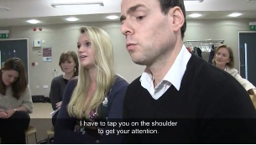
Class Activity 4: Putting It Together: Role Play Example
Notes:
Please watch the set of Role Play videos and discuss the examples. All the videos can be found in the section of the course website called videos and handouts. Use the following link, go to the section called “Time and Talk” and play the videos: http://idainstitute.com/toolbox/university_course/videos_and_handouts/unit_ii/
Start by watching the video titled: Planning the Role Play (2:47).
In this short video, the students are shown looking through different scenarios they may like to role play. Notice that the students have discussed reasons why a scenario is difficult, and what emotions may be difficult to work with, therefore making a particular scenario important.
Watch Role-Play titled: Manipulative Patient (11:43)
This short video starts out with the student who is going to role-play a scenario being asked which scenario she wants to work on.
Notice, that she then steps out of the room, and then the class works with a simulated patient to build his character. This is a place in which students can help in the role-play by giving dimension and a personal history to the patient. There is an advantage to this, because the student who role-plays the patient is not held responsible for making this up on their own.
Notice also, that they use the Hot Seating technique to interview the simulated patients questions like: “what job do you do?” “What do you spend your money on?, “when do you see your children?”, “Where do you live?”, “Is that where you want to live?” “where do you want to live?” “Do you enjoy your job?”etc. The point of all these questions is to get the patient a background. Additionally, it is important to be curious about the possible patient’s life and ask questions in the Hot Seating that you would never ask in real life.
At this point, the Audiologist comes back into the room and starts the role play. It takes her a little while to get into the scenario but eventually she gets right in. At around 5:35 minutes into the video the student playing the audiologist stops the action, because she doesn’t know where to go from there. At this point the student observers volunteer ideas of where to take the action or go from there. They go on for about a minute when she become stuck again and stops the action. At this point the instructor suggests using the Alter Ego technique, in which a different student (her alter ego) stands behind her, with her arm on her shoulder and says what the audiologist is really thinking, using I statements. This helps the audiologist focus in on what needs to be addressed.
At around 10:20 the class begins the reflection, and they go around reflecting on what went on. Different students were tasked with focusing on different aspects of the interaction. Some were tasked with focusing on non-verbal language, and others with different communication skills shown in the Calgary-Cambridge Guide.
Watch Role-Play titled: Patient in Denial (7:58)
This video shows how the class prepares for dealing with a “pushy wife” scenario to a patient who doesn't want to acknowledge that there is a hearing loss. In this video, the students have already gone through the process of creating a character sketch for the wife and patient, and the video starts at the beginning of role play. The audiologist stops the action 1 minute. The student discusses with the class the options and strategy for what to do next, and so they begin the action once more at about 2 minutes and 45 seconds. At 4:15 the audiologist stops the action and gets confirmation of what to do next. He closes the appointment, and the class goes into reflection and feedback.
Finally, after watching the Role Play examples, reflect with the class how a) the characters were created, b) what the student roles were, c) what methods students used to help each other out, d) reflect on the skills used by the students (regarding the Calgary-Cambridge skills), and e) how difficult/easy it is to complete clinical tasks while engaging in patient centered care communication.

Slide 27
Class Activity 5: Using Time and Talk in Role Play
Use the Time and Talk Method to practice using clinical and communication skills together
Notes:
Note to Instructor: Please see instructor’s guide for details of this class activity.

Slide 28
Reflection
How has this lecture changed the way you think about communication skills used during appointments in which you have to complete clinical tasks?

