Slide 1
TELE-AUDIOLOGY AND PERSON-CENTERED CARE
Frances Lockhart

Slide 2
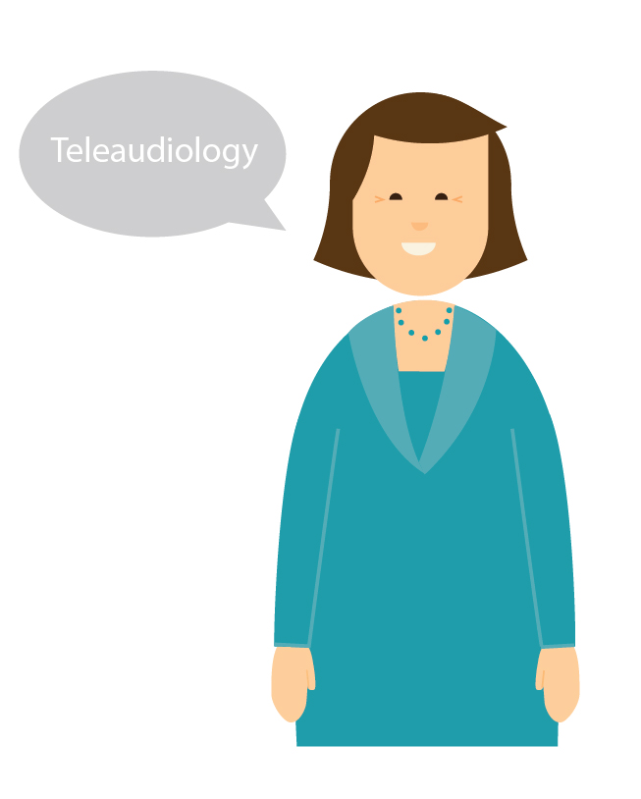
LEARNING OBJECTIVES
Goal 1:
Understand what tele-practice in audiology looks like, what forms it can take, and why it is important.
Goal 2:
Consider how tele-audiology can be applied at each stage of the Ida Circle.
Notes:
This course has 4 main goals:
Goal 1: To understand what tele-audiology looks like and what forms it can take, and why this type of service is important for equity of care around the world and an essential part of a modern person-centered audiology clinic.
Goal 2: To understand and consider different tele-audiology approaches that can be used at each stage of the Ida Circle approach to the patient journey.
Goal 3: To explore the different non-audiological skills and knowledge that are required prior to implementing a tele-practice approach in a hearing clinic.
Goal 4: To develop a plan and strategy for implementing person-centered tele-audiology in your clinic.

Slide 3
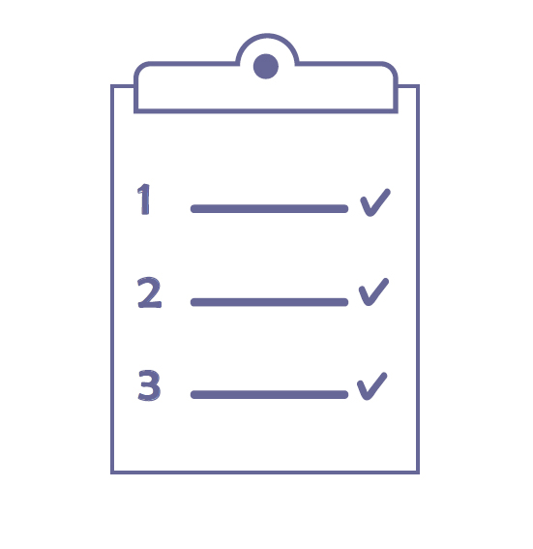
LEARNING OBJECTIVES
Goal 3:
Explore the skills and knowledge outside of audiology that are required to successfully implement a tele-audiology service.
Goal 4:
Develop a plan and strategy for implementing person centered tele-audiology in your clinic.
Notes:
This course has 4 main goals and is broken into 4 sections.
Goal 1: To understand what tele-practice in audiology looks like and what forms it can take.
Goal 2: To understand why tele-practice is important for equity of service around the world and as part of a modern person-centered audiology clinic.
Goal 3: To explore the different non-audiological skills and knowledge that are required to successfully implement a tele-audiology service in a hearing clinic.
Goal 4: To develop a plan and strategy for implementing person centered tele-audiology in your clinic.

Slide 4
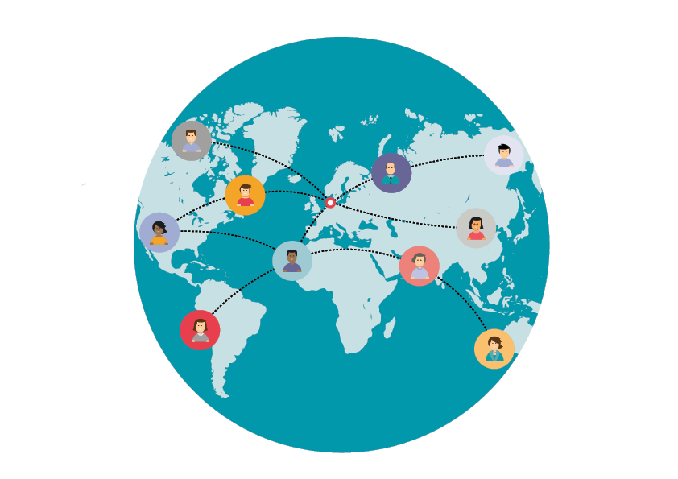
PART 2 & 3: TELE-AUDIOLOGY
This module explores:
What is tele-audiology?
Why is it important?
Notes:
Part 2 & 3 covers the first goal of the course:
2: This section covers what tele-audiology is, how to define it, and understanding its components.
3:This sections explores why it is important to have a tele-audiology service available in a modern audiology practice.

Slide 5
PART 4: TELE-AUDIOLOGY & THE PATIENT JOURNEY
This module explores:
How to incorporate tele-audiology into your everyday clinical practice
Matching stages of the Ida Circle with various tele-audiology approaches
Examples of tele-audiology
Notes:
This section explores a mechanism for how you could incorporate tele-audiology into your everyday clinical practice.
It considers an approach that takes into account the stage that each person is at in their hearing rehabilitation journey using the Ida circle as a tool.
Examples are given where you can match, explore, and utilize various tele-audiology approaches that are mentioned in part 2 to each of these stages to ensure that your service is truly person-centered.

Slide 6
PART 5: A RECIPE FOR SUCCESS
This module explores:
What does it take to achieve successful person-centered care in tele-audiology?
Non-audiological factors
PCC
Notes:
In part 5, we’ll explore “a recipe for success”-- what does it take to achieve successful person-centered care?
This practical, activity-based module considers some of the non-audiological factors that go into ensuring any tele-audiology service is successful and person-centered.
It will utilize an investigation guide for participants to explore some of the local technological requirements, personal skills, knowledge, and traits needed of both clinicians and patients/clients, in order to ensure success with this type of service.
We will also explore the various demographic, geographic, physical, legal, and cultural contexts that may impact its success.
This module will involve exploring local services and regulations along with hints and tips for what to consider.

Slide 7
PART 6 & 7: MAKE IT HAPPEN
Use the Ida Change Guide to develop an implementation plan for incorporating tele-audiology into your practice
Get to know the Ida Telecare Tools to help you implement tele-audiology further.
CHANGE GUIDE
Notes:
These sections will use a version of the Ida Change Guide and other resources to assist participants in developing an implementation plan to incorporate some or all aspects of a tele-audiology service, in their local clinic or practice.
This will involve developing goals aimed at providing some or all aspects of a person-centered tele-audiology service, in order to enhance their current audiology practice. It will also involve investigating physical, technical, cultural, and legal environments that might require change or adaptation in order for a tele-audiology service to be implemented.
This section will result in a guide that participants can then use to monitor their progress towards developing tele-audiology service(s) suited to their patients’ needs.
Section 7 will provide an in depth look at which Ida Telecare tools are available and how you could implement them in your daily practice.

